Slide 1

Vaping Pilot - Overview
Mark Bowles, Director, TTE

Slide 2
Introductions & About us
Introductions & about us

Slide 3
Youth Vaping Pilot – Evaluation
‘The programme appeared to have its strongest and most immediate impact on staff. Teachers who had taken part in the RSHE training and the behaviour change sessions reported increased confidence and greater clarity in how to respond to vaping in the classroom or in the wider school environment.
One provider noted that teachers were using the resources directly in lessons and “felt they had the evidence to back up what they were saying.” Additional providers and school leads similarly found that the behaviour change training gave staff practical tools and a structured manual they could refer back to, which several schools said would support consistency.’
Essex School Youth Vaping Pilot Programme Evaluation, 2025

Slide 4
Introductions & About us
Youth vaping pilot - Purpose

Slide 5
Youth vaping – Purpose
To test and implement a behavioural focused approach to tackling youth vaping with a limited number of pilot schools (3-4 secondary schools approx.)
Focus on simple behavioural change techniques drawn from existing approaches e.g. motivational interviewing, solution focused approaches.
Training and a manual of resources provided to participating schools which includes one page overview documents that aims to develop consistency of messaging across the school community.
Additional resources provided to support delivery of the suggested approaches / strategies.
Outcomes relate to pupils as well as staff confidence.
A key focus related to Nicotine and Nicotine dependency by pupils.

Slide 6
Why a focus on nicotine?
Nicotine use is problematic for many pupils who vape.
Information based ‘levers’ for vaping can be considered limited from a information giving perspective.
Is vaping the issue or is it what the vapes contain?

Slide 7
Further justification for nicotine focus
Youth vaping has significantly increased in the UK since the COVID-19 pandemic, data from ASH (Action on Smoking and Health) has shown that the percentage of children aged 11-17 who have tried vaping has increased from 13.9% in 2020 to 20% in 2025. This percentage is also likely to be significantly higher for those in the upper end of this age spectrum.
The UK nicotine product market has also seen significant growth in nicotine pouches with a 2023 UK market analysis report showed significant growth in the nicotine pouches sector for the second year running. In 2023, the two most popular nicotine pouches brands, Velo and Nordic Spirit, grew by 121% and 54%, this upward trend has continued into 2025.
Whilst use of nicotine pouches remains low amongst youth populations increases in use have been observed over the past two reporting years and consideration should be given to potential increases in use by nicotine addicted young people.

Slide 8
Introductions & About us
Resources

Slide 9


Slide 10
resources
Modular in nature.
Can be used for both formal and informal approaches.
Cover 5 key strategies which can be used to support intervention and conversations with pupils.
Also provide additional resources which can support RSHE / Assemblies etc, some are independent and some complement the 5 key strategies.

Slide 11
5 Strategies
Provide Information (to everyone)
Identify willingness / ability to change (as/when appropriate)
Develop discrepancy and promote change talk (as/when appropriate)
Explore behaviour and reasons for vaping (as/when appropriate)
Help pupils set goals and think about future behaviour.

Slide 12
Introductions & About us
Delivery

Slide 13
The offer
Schools requested to attend a flexible training session of approx. 90mins.
Schools provided with a manual of resources covering the 5 key strategies.
Support from TTE to deliver the resources as required.

Slide 14
Challenges
School recruitment proved to be challenging throughout the 2025/26 academic year.
Initial sign up was positive, but commitment to attend the short training session was problematic for some schools.
Support from Waltham Forest Council staff was positive in relation to school sign up towards the end of the academic year.
Further recruitment and training activities planned for this academic year.

Slide 15
Introductions & About us
Feedback

Slide 16
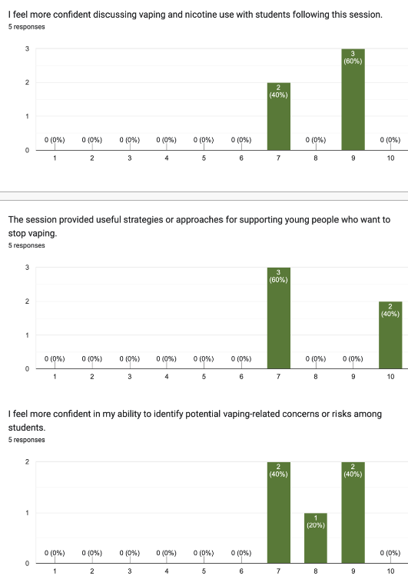

Slide 17
Introductions & About us
Next steps

Slide 18
Contact
mark@thetrainingeffect.co.uk

