Slide 1
Waltham Forest Education Conference 2026
Wednesday 7 October 2026
Education Strategy & Leadership in Challenging Times

Slide 2

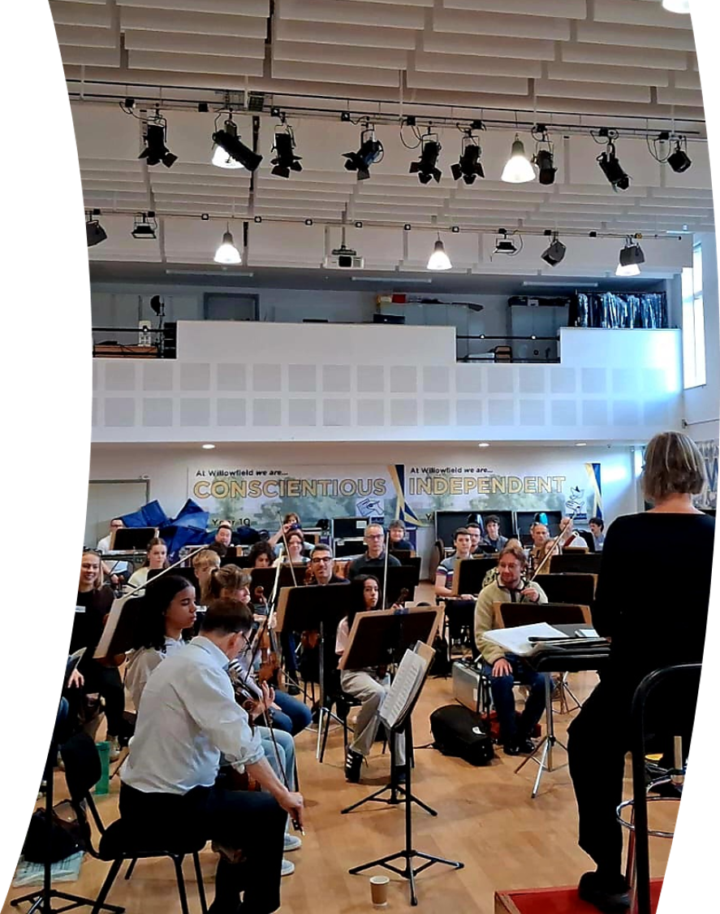
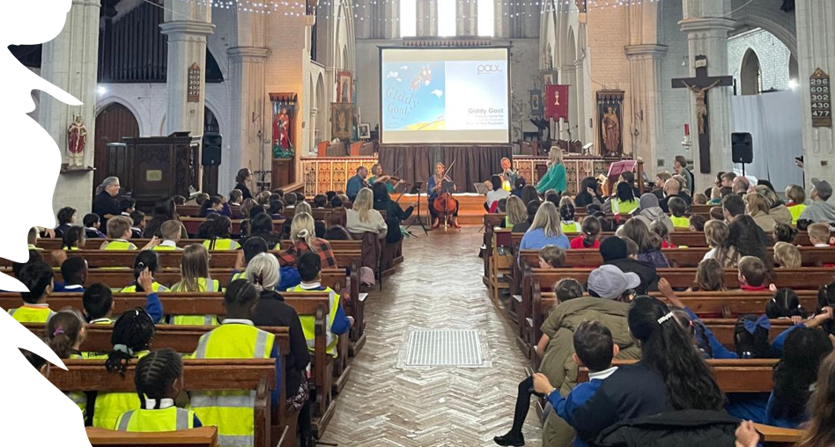


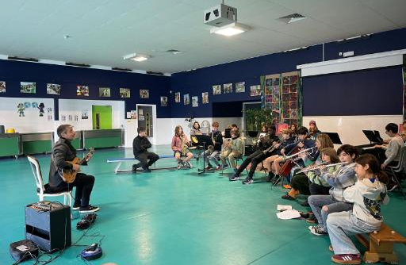
Music Service Performance
Mary.Mycroft@walthamforest.gov.uk / David.Austin@walthamforest.gov.uk
Notes:
Photographs, original WFMS logo and introductory wording sourced from Mary Mycroft, Music update JUNE 26. Source presentation: https://lbwf-my.sharepoint.com/personal/mary_mycroft_walthamforest_gov_uk/Documents/MM%20Area/My%20Documents/Tonnie/Music%20update%20JUNE%2026.pptx?web=1 . Images from source slides 1, 2 and 4. Introductory wording from source slide 2.

Slide 3
Welcome
Councillor Daisy Richards

Slide 4
Delivering practical inclusion & SEND reform in your school
Margaret Mulholland, Independent Consultant & Inclusion Policy Specialist

Slide 5

Shift in priority and purpose
Culture
Professional learning and Teacher Education
Communities and Partnerships
Pedagogy and Innovation
Vulnerable
learners
School improvement
Notes:
Inclusion and SEND are no longer a specialist strand - they become the spine of PD
Not SENCO responsibility – sits with everyone – whole school approach
The implication for PD leaders
This is a major shift in responsibility. Inclusion can no longer sit only with the SENCO, specialist teams, or occasional INSET. At scale, trusts will need to build:
a shared language for inclusive teaching,
coaching and walkthroughs that include adaptive practice,
subject-specific inclusion guidance,
training for support staff and pastoral teams,
leadership development on resource deployment and quality assurance.
The practical question for PD leaders becomes: Can we evidence that our PD model is improving inclusive classroom practice across all schools, not just offering SEND training?

Slide 6
The objective
More inclusive
mainstream
Inclusive mainstream
by design
Inclusive mainstream
by default

Slide 7
What are we being asked to do?
By 31st December
The strategy must be available on your website to parents and carers and to Ofsted inspectors, while governors and trustees are expected to scrutinise it.
It asks us to identify predictable needs and barriers to learning & participation.
It asks for strategic intent, not information sharing.
Asks what are we doing that makes it difficult for CYP to learn, participate & belong.
Deploy our existing resource better.

Slide 8
Your inclusion strategy should…
align to School Development Plan, not be an adjunct
be a team endeavour, driven by SLT not a lone SENCO.
Have a focus on inclusive teaching. High-quality teaching and inclusive classroom practices make the most significant positive difference for learners with SEND.
distribute leadership for SEND & Inclusion.
strengthen the universal offer.

Slide 9
1.
Gather evidence
2.
Evaluate evidence
3.
Align to current
SIP
4.
Select agents for whole school change
5.
Identify priorities

Slide 10

What is the everyday experience of a child who has additional needs at our school?

Slide 11
National data – our data?
only 56.62% of SEN pupils reported feeling a sense of belonging at their school, compared to 62.98% of non-SEN pupils.
When evaluated using a broader multi-variable belonging index, the data shows that pupils without SEND achieve significantly higher belonging scores across the board
seven times more likely to be severely absent
30% more UK pupils with SEND report being bullied than their non-SEND classmates
children with special needs frequently feel excluded from the wider curriculum, including after-school clubs, sports, and recreational activities.
Children with Special Educational Needs and Disabilities (SEND) face significantly higher rates of suspension and permanent exclusion in England compared to their peers without identified SEND
Notes:
According to the Department for Education’s (DfE) School belonging and attainment at key stage 4: linked data study, only 56.62% of SEN pupils reported feeling a sense of belonging at their school, compared to 62.98% of non-SEN pupils. When evaluated using a broader multi-variable belonging index, the data shows that pupils without SEND achieve significantly higher belonging scores across the board. [1, 2]
1. Attendance Rates (Twice as Likely to be Absent)
Official Department for Education (DfE) data confirms the "twice as likely" metric. Analysis from SEND Parents Help details that pupils on SEN Support have a persistent absence rate of 27.8% compared to just 14.7% for children with no identified SEN.
Severe Absence: The crisis is even more acute for pupils with an Education, Health and Care Plan (EHCP). A report published in The Conversation notes they are up to seven times more likely to be severely absent (missing 50% or more of school).
Rising Trends: According to the BBC, the record rise in severe absenteeism across England has been primarily driven by a surge in SEND pupils missing classes due to systemic pressures.
Proportion of Disruption: Nearly half (around 49%) of all suspensions are issued to children with special educational needs, despite these pupils making up roughly 20% of the overall school population. [1]
SEN Support vs. EHCP: Pupils receiving SEN support (extra help in school without a formal plan) generally experience higher rates of suspension and permanent exclusion than those with an Education, Health and Care Plan (EHCP). [1, 2]
Multiplier Effect: Pupils at the SEN support level are over 4 times more likely to be suspended and up to 8 times more likely to be permanently excluded than children with no identified SEN. [1]
Long-term Trends: The gap in suspension rates between pupils with SEN and those with no identified SEN has widened steadily since the COVID-19 pandemic. For example, permanent exclusions for pupils with EHCPs rose from 347 in 2014/15 to 1,198 by 2024/25. [1, 2]
Primary Reason: Across both SEND and non-SEND groups, persistent disruptive behaviour remains the leading cause cited for the vast majority of suspensions and permanent exclusions. [1]

Slide 12
Inclusive mainstream fund
Will help equip schools to improve the inclusivity of their universal practice, providing them with more resource to meaningfully embed inclusion and remove commonly occurring and predictable barriers to learning.
This includes:
  investing in high quality, adaptive teaching
  inclusive pedagogy and decision-making
  creating safe, calm and accessible learning environments
Schools will also be able to spend this funding on developing more targeted evidence-based support, such as specific group interventions for those that need them.

Slide 13
DfE Inclusion Strategy steps
Statement of intent
(500 words)
Barriers to learning & participation
Activities to address barriers
Intended outcomes
From Year 2 review progress

Slide 14
DfE Inclusion Strategy steps
Statement of intent
(500 words)
Barriers to learning & participation
Activities to address barriers
Intended outcomes
From Year 2 review progress
What inclusion means at our school
Environment
Distributing
leadership
Belonging
Achieving
Thriving
What do we want to achieve
Culture
Inclusive teaching
How will we know
Where will we prioritise improvement
systems
Notes:
Test and learn

Slide 15
Ambitious leadership and governance
1
Early, evidence-based support
2
High-quality teaching
3
Accessible, enriching provision beyond the classroom
4
A safe and respectful culture
5
Strong partnerships with families and wider services
6
Creating inclusive environments
7

Slide 16
Funding
IMF
Instigate
reform
Inadequate
change
“Operational”
“Strategic”
Current PP £
Current SEND £
IMF
Instigate
reform
Foundational change
IMF £

Slide 17
Culture
Systems
Impact
Cohort reality
Diversity
Planning choices
Equity
Cycles of improvement
Inclusive practice
Desired outcome
Belonging
Trajectory toward more inclusive mainstream
Notes:
Trajectory changing schools - consider their systems
Clear goals but also training – not just technique driven but challenges attitudes and dispositions
TA – you can lead the provision
Mindset

Slide 18
Diagnostic labels don’t tell us the whole story…
1 in 5 people with Dyslexia have DCD (Kaplan, 1998) 20%
3 in 10 people with Dyslexia have ADHD (Germano and Gagliano,2010) 33%
1 in 2 people with DLD/SLI have Dyslexia (Snowling,2000) 50%
1 in 3 people with ADHD have DCD (Gillberg,1998) 33%
1-2 in 4 people with ASC have ADHD ( Handen,2015) 25-50%
4 in 5 people with ASC have DCD (Cacola, 2017) 80%
1 in 2-3 people with DLD have DCD (Archibald, 2008) 33%
41% of people with DLD have ASC (Georgitsi,2021) 41%
Dr Amanda Kirby

Slide 19
Co-occurrent, overlapping, co-existing…
Dyslexia
20%
DCD + dyslexia
33%
dyslexia + ADHD
33%
DCD + ADHD
DCD
ADHD
50%
DLD + dyslexia
33%
DCD + DLD
80%
DCD + ASC
25-50%
ASC + ADHD
41%
DLD + ASC
DLD
ASC

Slide 20
Dynamic layers of provision that enable us to stretch the universal offer
Specialist
Targeted plus
Universal
Targeted
Notes:
Ordinarily available

Slide 21
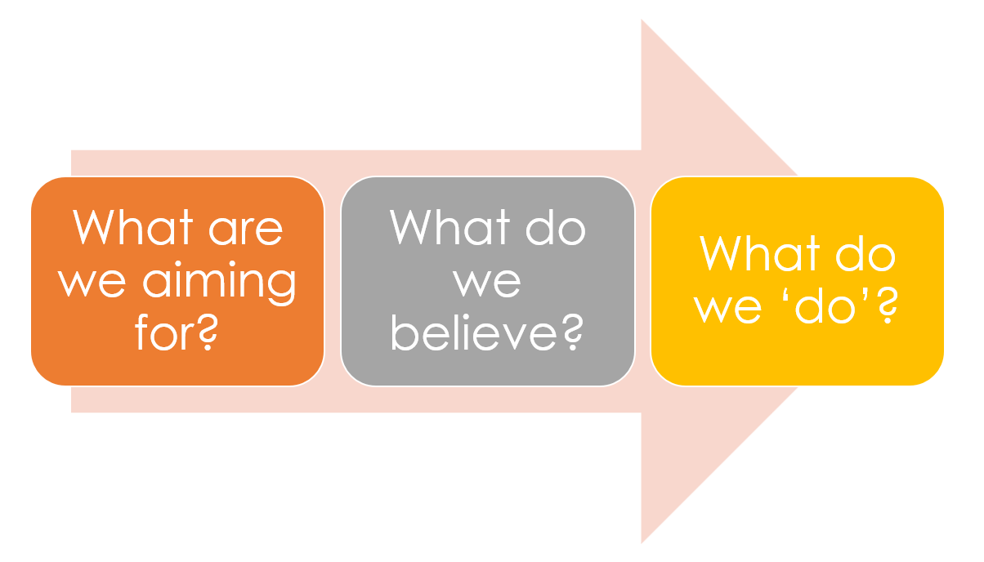


‘Creating Excellence Together’

Slide 22
This child ‘is’ SEND.
These ‘are’ the SEND children.
She is ‘naughty’.
They are ‘kicking off’
They didn’t do well, but they are SEND.
Lowest 20%
Low ability
They should be in special school.
They should not be here.
They shouldn’t be in a mainstream school.
They don’t belong here.
They’d be better off somewhere else.
We can’t meet their needs.
When they are in ‘mainstream’.
‘Creating Excellence Together’

Slide 23

This child ‘is’ SEND.
These ‘are’ the SEND children.
She is ‘naughty’.
They are ‘kicking off’
They didn’t do well, but they are SEND.
Lowest 20%
Low ability
They should be in special school.
They should not be here.
They shouldn’t be in a mainstream school.
They don’t belong here.
They’d be better off somewhere else.
We can’t meet their needs.
When they are in ‘mainstream’.
‘Creating Excellence Together’

Slide 24

From adaptive teaching to inclusive pedagogy
Inclusive pedagogy
Adaptive teaching

Slide 25
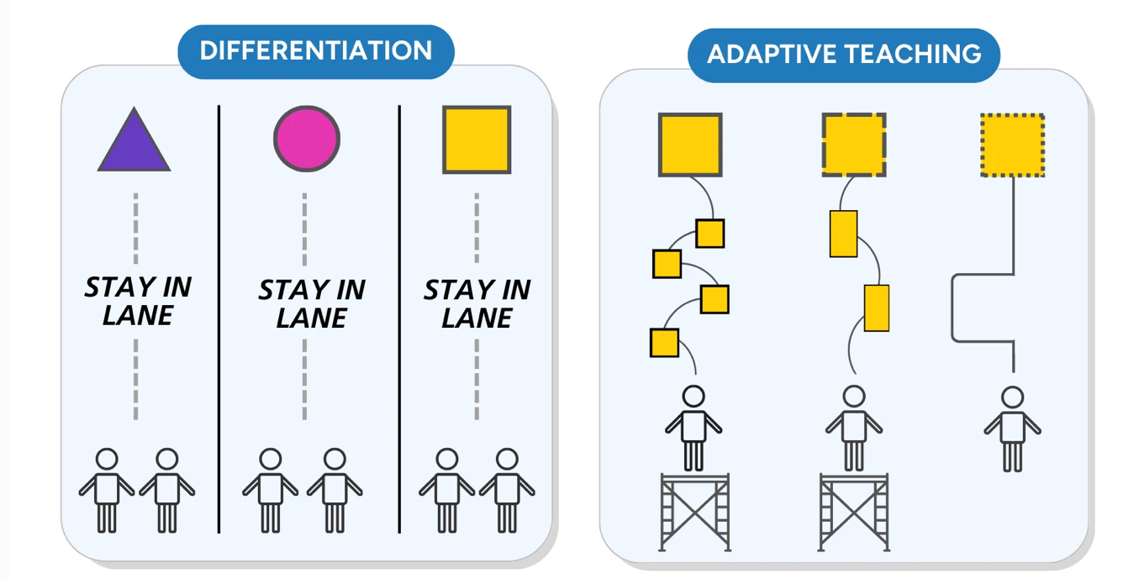
Adaptive teaching provides a positive shift away from poorly executed differentiation
Notes:
Moved away from differentiation – whole school approach but many of the systems remain as barriers

Slide 26
Adaptive teaching provides a positive shift away from poorly executed differentiation, within a strengths-based culture of inclusive pedagogy
Notes:
Moved away from differentiation – whole school approach but many of the systems remain as barriers

Slide 27
Developing better decision-making to inform teaching
Adaptive mindset
Cognitive and Metacognitive habits
Adaptive problem solving
Teacher to Teacher collaborative learning and coaching
How teachers understand and position themselves as learners
How teachers monitor their learning and performance and reason about practice
How teachers transfer knowledge and skills to solve new and ill-structured problems
How teachers learn from one another
Adapted from: Hatano, G. & Inagaki, K (1986). Two courses of expertise. Hammerness, K.. Darling Hammond, L.E, & Bransford, J. with Berliner, D. Cochran-Smith, M. & Zeichner, K. (2006). How teachers learn and develop. In L. Darling-Hammond & J. Bransford (Eds.) Preparing teachers for a changing world: What teachers should learn and be able to do, (pp. 359-389). San Francisco: Jossey-Bass
Notes:
Great mentoring supports the development of adaptive expertise – mentor who encourages reflection, who puts challenges in front of a trainee and says lets ‘work on this opportunity’ – eg. GT deploying teaching assistant – reflecting on the research and mentor recognised that whilst they were discussing deployment it was a rigid pre-planning of how she as the TA was to be used, not practicing responsive deployment based on her knowledge of the learners and what she was prioritising.
The white paper also says the TTE will:
strengthen the national offer,
extend provision to experienced teachers and leaders,
improve clarity and accessibility of development opportunities,
and support schools to build strong development cultures.
What this means in practice for trusts and schools
A credible PD strategy now needs to look less like a menu of stuff on offer and more like a compelling, career-stage pathway, for example:
ECT and early-career development,
middle-leader development,
experienced teacher expertise-building,
senior leadership / headship support,
support staff and specialist roles.
In other words, “CPD calendar” thinking will be too small. The white paper invites (and eventually may require) PD architecture thinking.

Slide 28

EEF Guide to Inclusive Teaching
Myth 1 “Inclusive teaching is all about what schools do differently for pupils with additional needs"
Myth 2 “The more adaptations teachers make, the more pupils will learn”
Myth 3 “Interventions are the most important way to support pupils with additional needs”
Myth 4 “If a pupil has a diagnosis, we automatically know the best way to support them”
Myth 5 “Teachers need specialist expertise before they can effectively support pupils with additional needs”
Notes:
Inclusive teaching is about helping every child to participate and succeed in school. As captured in the SEND Code of Practice (2014), some pupils with additional needs will require support that is additional to or different from what is generally available to other pupils. However, inclusive teaching is also about considering aspects of universal provision that benefit all pupils but are especially important for pupils with additional needs. Effective inclusion strategies consider both elements.
Evidence does not strongly support the idea that the more adaptations teachers make, the more pupils will learn. Any adaptation can be effective or ineffective, and ineffective adaptations can hinder learning. For this reason, it is important to support teachers to understand what makes adaptations effective and to monitor their impact with care.
While targeted interventions can help, they are most effective when they supplement – rather than replace – effective everyday teaching. Strong universal provision reduces the number of pupils who require additional support and creates the conditions in which targeted interventions are more likely to succeed.
A diagnosis can provide useful information but may not determine what support will be most effective in supporting learning. Pupils with the same diagnosis can have very different strengths, needs and experiences and these can change over time. Effective support is informed by ongoing assessment, evidence-informed decision making and ongoing monitoring of impact.
All teachers should continue to deepen their understanding of effective inclusive practice throughout their careers, and in many cases this will include the development of specialist expertise. However, inclusive teaching does not begin with specialist knowledge. It begins by attending to elements of universal provision that benefit all pupils, but that are especially important for pupils with additional needs. Doing so is an invaluable contribution that every classroom teacher can make.

Slide 29
Inclusive Pedagogy
Everyone learning
Reject deterministic thinking
Transformative belief
See difficulty as opportunity not deficit
Respect dignity of learners
Focus on what is to be taught & how
Not focusing on who
Rejects fixed ability or 'bell curve' thinking
Being a learner of your own pupils

Slide 30
Two-Part Model
Adaptive practice
+
Inclusive universal provision

Slide 31
What the two-part model is NOT
Inclusive universal provision

Slide 32
What the two part model is NOT – a bolt on
Adaptive practice
+
Inclusive universal provision

Slide 33
Pivot the lens – to ensure we are teaching everyone
1

Slide 34
Pivot the lens – to ensure we are considering everyone
1
2

Slide 35


Pins are the pupils, ball is the lesson plan – if we bowl to the middle we are left with the outliers still standing (we didn’t reach them).
7-10 split is the hardest shot in bowling! The bowler uses the outliers as the focus to determine the direction

Slide 36
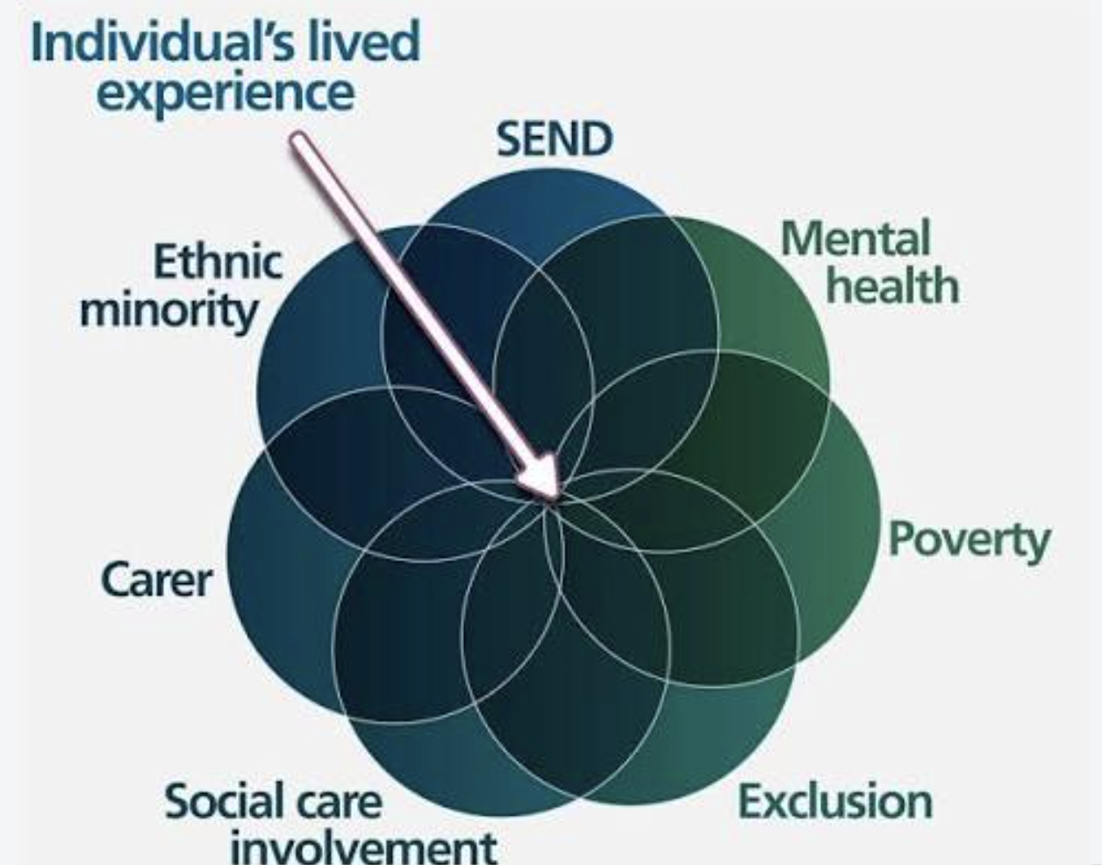

Slide 37
Ambitious leadership and governance
1
Early, evidence-based support
2
High-quality teaching
3
Accessible, enriching provision beyond the classroom
4
A safe and respectful culture
5
Strong partnerships with families and wider services
6
Creating inclusive environments
7

Slide 38
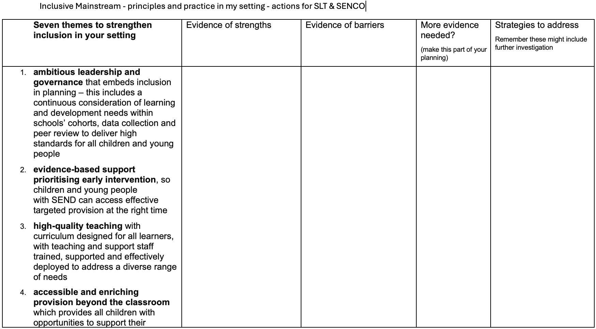

Slide 39

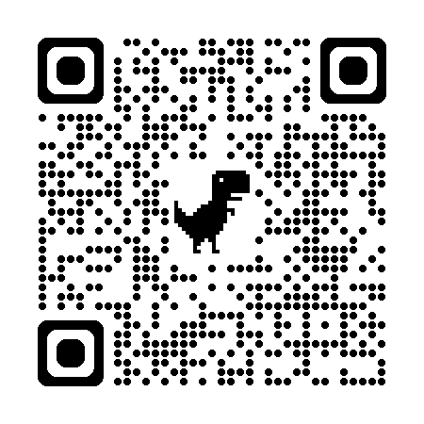

Eight areas of focus:
Outcomes
The quality of teaching and learning
Leadership of SEND
The efficient use of resources
Assessment and identification
Working with parents, carers and pupils
Monitoring, tracking and evaluation
The quality of SEND provision

Slide 40


ASCL
Pre-review
primer

Slide 41
Evidence collection
Systems
Impact
Cohort reality
Diversity
Planning choices
Equity
Cycles of improvement
Inclusive practice
Desired outcome
Belonging
Trajectory toward more inclusive mainstream
Notes:
Trajectory changing schools - consider their systems
Clear goals but also training – not just technique driven but challenges attitudes and dispositions
TA – you can lead the provision
Mindset

Slide 42

KNOW THE CHILD
Notes:
Focusing on the learner - looking at it through the sens lens helps a lot

Slide 43
Marvel College
Designing a system that works for all
1100 pupils
220 SEND register
Culture of confidence
Distributing leadership
Distributing knowledge
100 staff
Notes:
In order to stack the deck to ensure that we are creating the most optimal conditions for success, we need two things.
.
We need to know what are destination is. We need to know what we are aiming for. We need to know what Excellence looks like in these provisions.
[Click]
And then we need to know how we are going to get there, what our roadmap is, to get from where we are, to where we want to go.

Slide 44
Student View | Parent View | Staff View
Its going good with my SEND champion, its my English teacher Mr O, he’s a nice guy. Its someone I can talk to if I’m struggling. I would like to have Mr O next year for my SEND champion as he has helped me. | H says ‘I love Mr O at school’, he says he can go up and talk to him whenever he needs. He always checks in with him and I really appreciate all of the support he has given us this year. | Being H’s SEND Champion has been enjoyable and rewarding. I think it’s really helped him through his transition year into Marvell. In both the official meetings and regular check-ins around school, it has meant that H knows that there is somebody in ‘his corner’ and looking out for him. We’ve worked on how to manage our emotions and have put in strategies to help him, as sometimes he can find lessons challenging. H knows he can come to me about anything. It’s helped me, just as much as him, in knowing our pupils and knowing them well and the positive impact this can have.
It has been helpful. Miss emails my teachers. She has helped me feel more confident and less anxious. We have worked together to find small changes like sitting at the back of the room that make a big difference to me. | S has found this a positive experience and really gets on well with her SEND Champion as it is her English teacher. This has meant that she has built a good relationship with her, and this has helped in the classroom. S has spoken about the SEND champion program at home, and she hopes to be allocated the same champion next year. | I have thoroughly enjoyed being S’s Champion and I have seen first hand, what an effective strategy it is and the difference it can make to our students and parents. By regularly meeting with S, and liaising with mum, it has allowed a more personalised approach for us to support S by listening to her worries and being able to evaluate the strategies she already has in place and try new ones, when needed.

Slide 45

What was the problem that we were trying to solve?
Teachers not using all of the data we gathered to help them make adaptive decisions in the classroom.
Notes:
Historically, believing that if a student has additional needs, then they must have an LSA in the classroom.
The students from disadvantaged backgrounds (SEND, CLA, FSM)
Link it to the one problem linked explicitly students with additional needs. No silver bullet

Slide 46
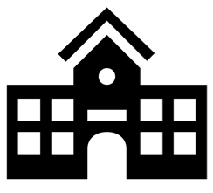
Parallel systems
SEND Systems
knows the pupils, barriers and provision
teachers left to make the connection
T&L Systems
curriculum development, pedagogical expertise
Rob Cooper

Slide 47
Where could this work connect?
defining inclusive classroom practice
processing referrals
statutory paperwork / compliance
provision reviews
defining inclusive classroom practice
processing referrals
statutory paperwork / compliance
provision reviews
setting T&L priorities
reviewing patterns in pupil need
setting T&L priorities
reviewing patterns in pupil need
review of targeted interventions
planning whole - school CPD
review of targeted interventions
reviewing pupil voice
phase / department meetings
reviewing learning walks
arranging specialist appointments
planning whole- school CPD
reviewing pupil voice
phase / department meetings
reviewing learning walks
arranging specialist appointments

Slide 48






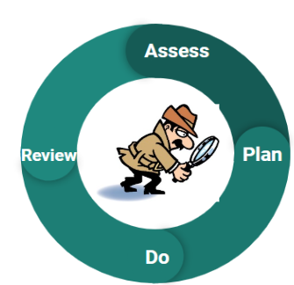
Systematic curiosity
good evidence enables good decision making
Weak literacy
Lower confidence
Emotional regulation
Low prior knowledge
Notes:
Value of data and pupil focused evidence collection – to ensure better decision making around our learners who find curriculum engagement hard.

Slide 49
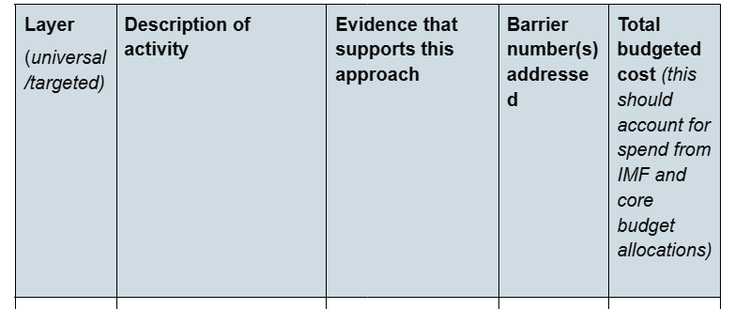
Writing an effective inclusion strategy:
Notes:
Multi-year vs single year

Slide 50
Dynamic layers of provision that enable us to stretch the universal offer
Specialist
Targeted plus
Universal
Targeted
Notes:
Ordinarily available

Slide 51

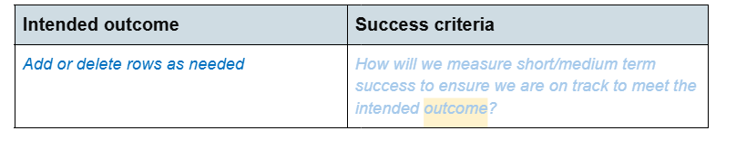
Writing and effective inclusion strategy:
Intended outcomes

Slide 52
Culture
Systems
Impact
Cohort reality
Diversity
Planning choices
Equity
Cycles of improvement
Inclusive practice
Desired outcome
Belonging
Trajectory toward more inclusive mainstream
Notes:
Trajectory changing schools - consider their systems
Clear goals but also training – not just technique driven but challenges attitudes and dispositions
TA – you can lead the provision
Mindset

Slide 53
DfE Inclusion Strategy steps
Statement of intent
(500 words)
Barriers to learning & participation
Activities to address barriers
Intended outcomes
From Year 2 review progress
What inclusion means to us
Environment
Distributing
leadership
Belonging
Achieving
Thriving
What we want to achieve
Culture
Inclusive teaching
How will we know
Where will we prioritise improvement
(7 principles)
systems
Notes:
Test and learn
Suggested structure:
Statement on what inclusion means at the school and what the school hopes to further achieve through the strategy to positively impact all pupils’ outcomes and experiences.
Identify and detail which of the 7 principles of inclusion will be prioritised in your inclusion strategy
Brief statement detailing how you have developed your strategy

Slide 54
Website links
ASCL inclusion strategy resources can be found here https://www.ascl.org.uk/Help-and-Advice/Inclusion/Inclusion-disadvantage-social-mobility/Preparing-your-2026-inclusion-strategy
Graduated Approach for your Leadership Team https://www.ascl.org.uk/News/Podcasts/SEND-Bites
A guide from Judith Carter https://www.willowtreelearning.co.uk/

Slide 55
Leadership in Challenging Times
Evelyn Forde MBE

Slide 56
What happens to us
under pressure?
2

Slide 57
What’s in our gift?
Even now. Especially now.
3

Slide 58
Who are we missing?
And what might we need to question?
4

Slide 59
Mattering.
Seen • Safe • Significant • Stretched
5

Slide 60
Who’s pouring
into you?
6

Slide 61
What will you
take back?
Hold on to. Question. Ask for.
7

Slide 62

*Refreshment Break*
(15 minutes)

Slide 63
An update on inspections under the renewed inspection framework
Nick Turvey, Ofsted

Slide 64
Waltham Forest Education Conference 2026
Nick Turvey, Senior His Majesty’s Inspector
London region - schools
Autumn term 2026

Slide 65

Education Inspection Framework - our renewed approach

Slide 66
Inspections that look and feel different
Collaboration at the heart of the inspection through open reflection meetings
Shaped around context and what is happening in your school

Slide 67
The renewed framework 10 months in
What has gone well:
There has been
Improved collaboration and discussion with leaders
More nuance in the profile of gradings awarded to schools
A raising of the profile of inclusion
A positive start to the monitoring process.
What we know is working:
We know that
The methodology is being followed.
We are all becoming more familiar with the toolkit standards for each evaluation area
Schools are becoming clearer on how grading works, including ‘secure fit’
There is better understanding of the grades particularly, ‘needs attention’.

Slide 68
A summary of key aspects
New report card
A five-point grading scale
A renewed focus on inclusion
New toolkits
New inspection methodology
Renewed focus on context

Slide 69
Leadership, inclusion and an open and positive safeguarding culture are key areas of focus when gathering evidence.

Slide 71
Some other key terms that we use on inspection
Typicality
Generally
Proportionate
Indicative grading

Slide 72
What happens and when during the inspection?

Slide 73
Preparation
Planning call
Pre-inspection
Context
Strengths
Priorities for improvement
Top-level view
(in readiness for initial evidence gathering)

Slide 74
Initial evidence gathering
Day 1: Part 1 morning
Start of the school day
Case sampling
Discussions with pupils
Learning walks with leaders
Social times
Safeguarding
Reflection meetings
Reflection meetings

Slide 75

Exploring further
Day 1: Part 2 afternoon
Focused leadership meeting
Case sampling follow up
Discussions with teachers
Safeguarding
Further discussions with pupils
Further learning walks with leaders
Social times
End-of-day reflection meetings
End-of-day reflection meetings

Slide 76

Exploring further
Day 2: Morning and afternoon
Focused leadership meeting
Case sampling follow up
Discussions with staff
Safeguarding
Further discussions with pupils
Further learning walks with leaders
Social times
Reflection meetings
Reflection meetings

Slide 77
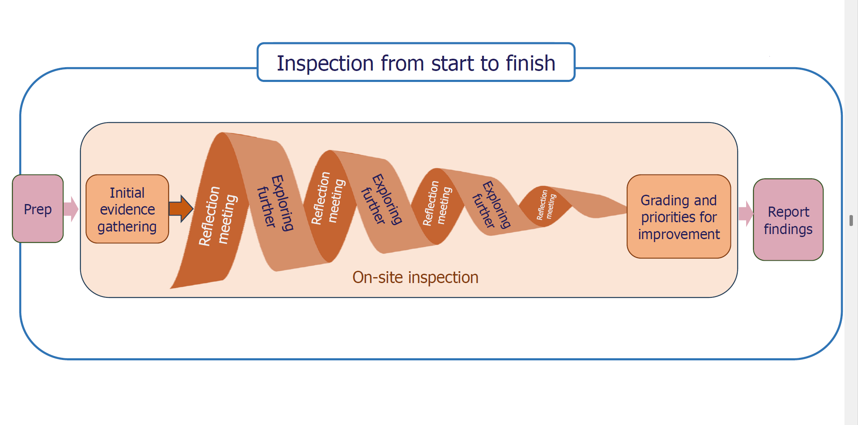
Building a picture….

Slide 78
A word about inspection in small schools….
When inspecting small schools, we:
consider the impact of inspection on leaders
group activities together where possible
are proportionate about the time we spend in classrooms
recognise that each child has a greater impact on published data

Slide 79
Key inspection activities
Case sampling
Learning Walks
Meeting with leaders

Slide 80
What is case sampling?
Seeing the school through the pupils’ eyes.
Selecting a small sample of pupils (about 6) and tracking them across inspection activities to gain a deeper understanding of their experiences and outcomes.

Slide 81
What is case sampling?
Case sampling is:
a window into a sample of pupils’ experiences.
an indicator of what is typical for other pupils.
an opportunity to identify some specifics to explore further to check for typicality.
Case sampling is not:
asking schools to provide case studies.
the only evidence gathering activities for inclusion.
the end of the journey – we are not grading a school based on six pupils.

Slide 82
Learning Walks

Slide 83
What will this look like?
The lead inspector will complete a learning walk with the headteacher.
Team inspectors will complete learning walks focusing on curriculum, teaching and achievement as well as strong foundations.
All inspectors will consider leadership and inclusion through their learning walks.
Team inspectors will focus specifically on inclusion and case sampling.
Inspectors will also look for evidence across all the evaluation areas during learning walks.

Slide 84
Working with leaders- reflection meetings

Slide 85
Grading decisions
The team will always start with the ‘expected’ standard.
They will apply a secure fit rather than a best fit.
The team can share indicative grades as soon as they have sufficient evidence.

Slide 86

Let’s focus in…

Slide 87

Exceptional
Expected
Strong
Exceptional

Slide 88
Exceptional grade
An area of practice that:
has exceptionally high standards sustained over time
has had a transformational impact on all of our identified groups.
should be shared to support system-wide improvement internally, regionally and/or nationally.

Slide 89

Achievement

Slide 90
Achievement- how we approach this
Importance of context
How well all pupils are achieving
Use evidence prompts in the toolkit
Not just about national assessment outcomes

Slide 91
Evaluating pupils' achievement
From the toolkit: On the whole, pupils achieve well.
Typically this will be reflected in their attainment and progress in national tests and examinations, which are broadly in line with national averages, including for disadvantaged pupils.

Slide 92
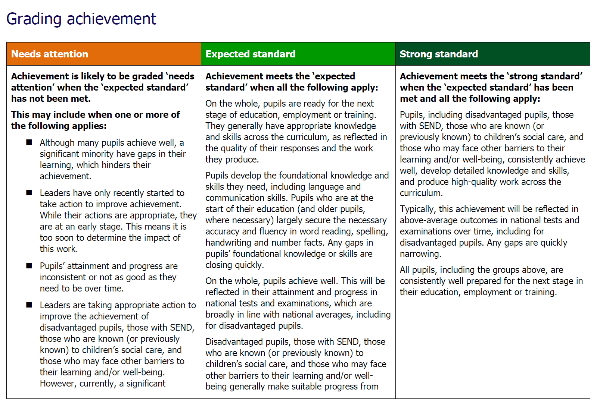

Slide 93


Slide 94
New for this year: similar schools
Similar schools data is an additional layer of information. It puts achievement in context.
It is not a definitive measure, but it is helpful. It needs to be treated with caution like any other data.
It groups schools which are similar, but not the same.

Slide 95
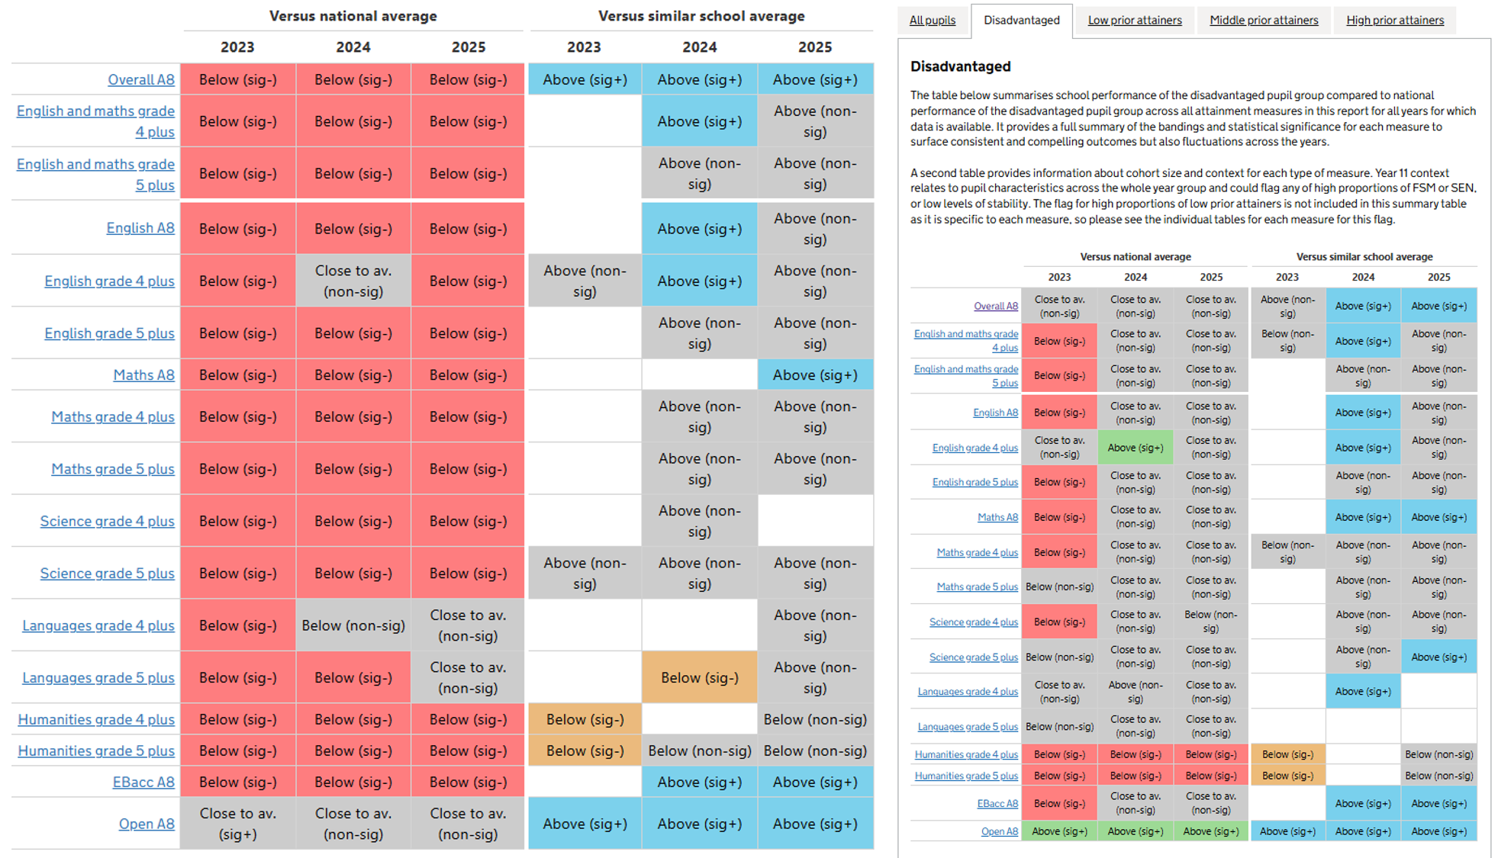

Slide 96
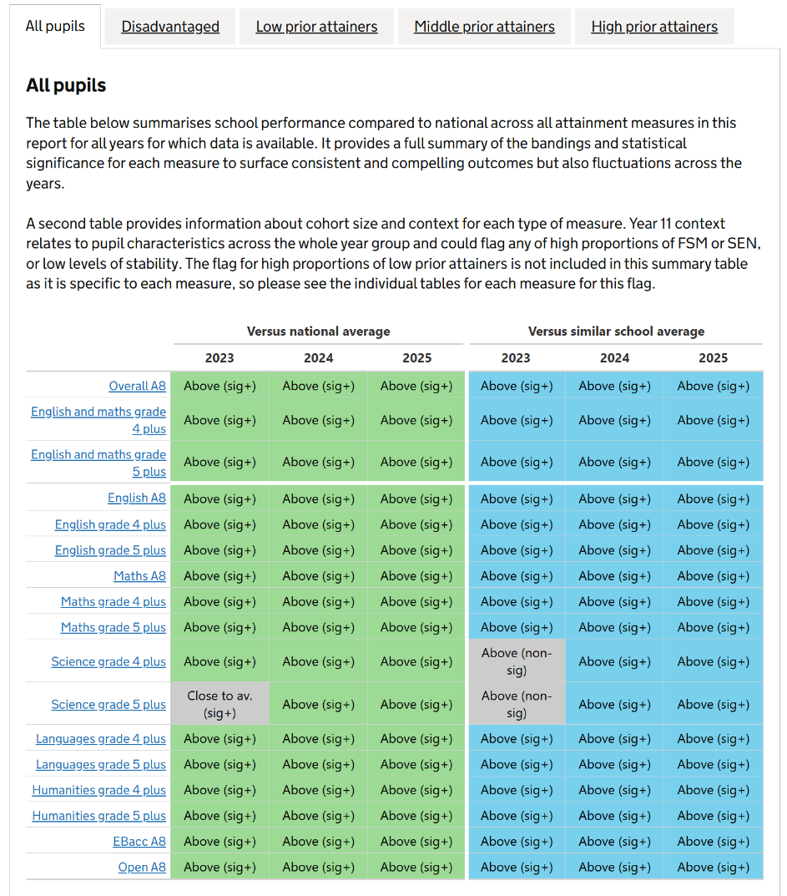
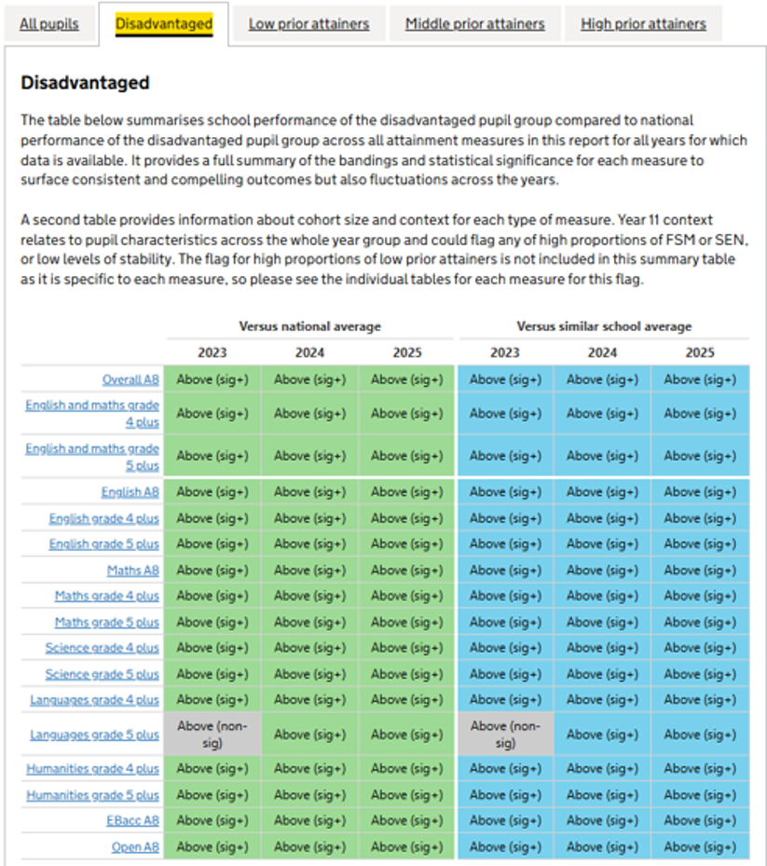

Slide 97
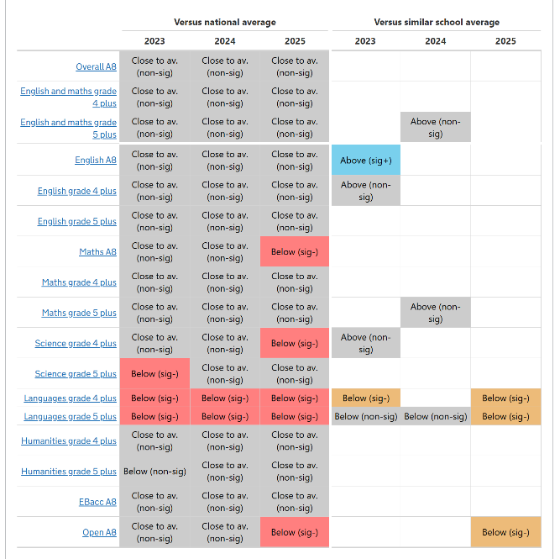
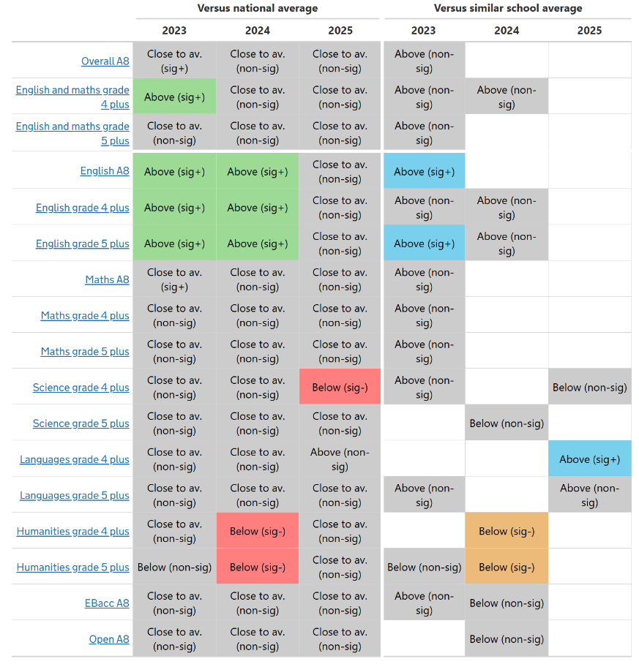
What if similar schools data is ‘below’ the group average?

Slide 98


Reminder: Similar schools data is useful as additional triangulation of evidence. However, it is not a performance indicator in itself.
Inspectors will consider this new measure, when appropriate, in relation to all the other evidence on achievement gathered on site.

Slide 99
An update on monitoring inspections
A more tailored monitoring model.
Greater flexibility in the improvement monitoring programme.
New ongoing contact for schools graded ‘needs attention’.
Clearer expectations about grade changes.

Slide 100
Let’s conclude with some words from HMCI, Sir Martyn Oliver
‘Now, change is difficult and we can never expect a universally positive response. We will keep listening to what you tell us, so we can reflect and improve.
But there is a sense that our published toolkits give more transparency around inspections, helping everyone to understand exactly what inspectors will be looking at and how you will be held to account.
We have made it very clear what is required for each grade in each evaluation area and all the training materials our inspectors use are also available online.
Our improved methodology makes room for reflective practice and increased dialogue. That’s the one thing we’re definitely hearing. You’re telling us that inspection feels more collaborative, more like a productive conversation than something that is done to you…
These aspects all make for better wellbeing for leaders and also for your staff.
I am really pleased with what we are hearing. It’s still a rigorous process, I know. That is how we assure high standards. But it’s also fairer, more human, more collaborative.’

Slide 101

Any questions?

Slide 102
Thank you

Slide 103




www.gov.uk/ofsted
reports.ofsted.gov.uk
  www.youtube.com/ofstednews
  www.linkedin.com/company/ofsted
  www.x.com/ofstednews
  www.facebook.com/ChildcareRegistration

Slide 104

*Lunch*
(The Mallinson Restaurant)
Please visit our range of market stalls
(12.30pm to 1.30pm)

Slide 105
Education Strategy Update
Nicky Crouch, Strategic Director, Children Services |
Mary Jarrett, Corporate Director, Education

Slide 106

Education Strategy: Draft Launch
Following a period of engagement with school leaders, stakeholders, education staff and pupils we are planning to consult on a draft education strategy that lays out Waltham Forest's ambition for the next five years (2027-31)
The strategy was led and developed by the Education Strategy Partnership Board that is made up of representatives from across the education sector and partners
It involved consultation with more than 350 pupils, school leaders and stakeholders. Further consultation with parents and carers is planned.
This presentation summarises the strategy and advises on next steps
Thank you to everyone who took part!
Notes:
The strategy was intiated and led by the Education Strategy Partnership Board
We know we have a lot to do and that there is a need for strong leadership and bringing people together across organisations so we we are delighted to be working on this strategy that pulls together our ambition for the local area in one document
We recognise that we all need to work together across organisations to deliver and so this is not a Local Authority strategy but a local area strategy
Thank you so much! We could not have done it without you.

Slide 107
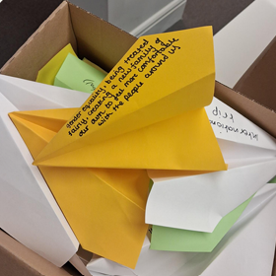
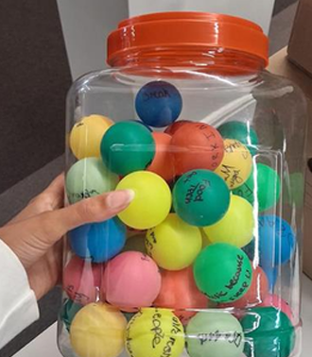
How did we do it?
The Education Strategy Partnership Board identified four priorities, then designated a Steering Group to lead the work. This group met five times and led the approach.
We conducted two surveys with school leaders and education staff from the council
We held open meetings for school leaders and stakeholders to attend and feed into the strategy
We held workshops with more than 350 pupils across 9 schools – inviting them to participate creatively in a series of exercises facilitated by The Insyte Team, a powerful team of trained young people from the borough aged 13-25
Pupils produced two podcasts, beautiful artwork and contributed their ideas fully. A full report of pupil views will be available as an appendix to the main report.
Notes:
This slide summarises HOW we did the exercise and is self explanatory
Stress that more than 350 pupils took part
Led by The Insyte Team, they took part in a set of creative activities including – drawing pictures of their dream school, sending paper aeroplanes with hopes into the future, producing a podcast about their school experience. Some of this is displayed here today and we will share more soon.

Slide 108

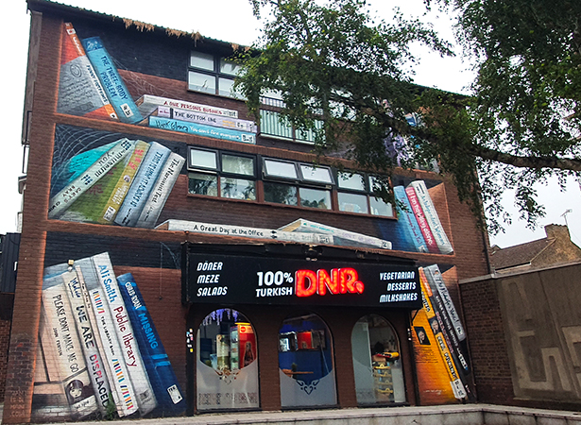

Find your path, Shape your Future
This Strategy is written with and for the children and young people of Waltham Forest. We want to create the conditions that mean:
I Belong Here
My Voice Matters Here
I Thrive Here
I Learn Here
I am Safe Here
I am well prepared for life in the modern world
Notes:
The Steering Group gave us the steer that they wanted the strategy to feel positive and to give children and young people the message that this is a great place to grow up. We know that the world can feel a little daunting at the moment for young people and we wanted the strategy to have the sense of – we understand that and we want to do all we can to ensure you are well prepared for the world as it is. We want to make the most of all the great opportunities that exist locally and ensure young people feel safe, a sense of belonging and opportunity.
We therefore chose the title 'Find Your Path, Shape Your Future' which was suggested by one of our staff members. We like it because it is active – we will provide the conditions that allow young people to achieve their potential and shape their own future.
We wanted this to be a strategy that is for Waltham Forest specifically – not one that could be for anywhere. Therefore it focuses on both our specific strengths and also the specific areas we need to improve.
We think this is a uniquely child centred borough – where else do you have children playing right outside your door when you are in meetings? We hope that the strategy brings all of this to life.

Slide 109

Priorities
All Waltham Forest children and young people feel that they belong and that their voices are heard.
All Waltham Forest children and young people are well-prepared for adulthood and achieve their potential.
Waltham Forest has a strong, effective and sustainable Education workforce.
Our settings will be financially sustainable with effective use of resources.
Notes:
These priorities were chosen by the Education Strategy Partnership Board.
The first two, most importantly, are focused on the cyp themselves.
The first is about what I just described – ensuring young people feel safe, a sense of belonging and that they matter here. These are important not just for wellbeing, which is of course v important, but because we all do our best learning when we feel safe and calm.
The last two are about us a system – all of us in this room. We know we face immense challenges. Falling population, rising SEND need, budgetary challenges, system change imposed by national policy changes.
We know that in order to get through this, we need to work together as one system – recognising the distinct challenges that you as schools face, and those that we as a local council face.
We hope that through this strategy we can identify a shared set of goals and actions that we can take as part of an ongoing conversation that enables us to do our best for all the children in our local area.

Slide 110
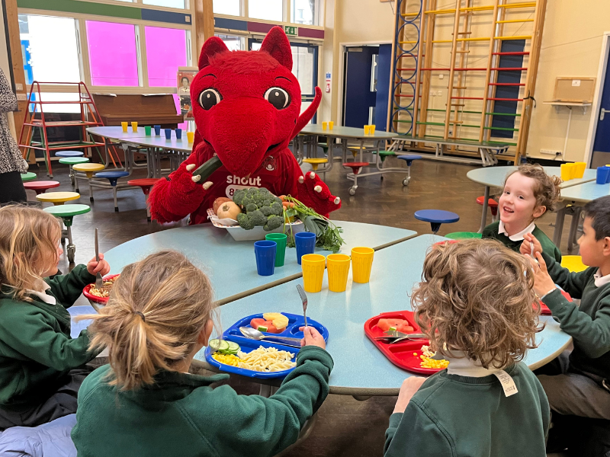

What already works well?
We have good schools and settings, meaning parents have positive choices
Very strong early years and primary outcomes
Our sense of community is strong, and we work well together across settings and organisations
Our borough is rich with cultural opportunities, and we value and nurture creativity
Our pupils told us they value when schools are inclusive, friendly and offer enriching opportunities like trips
We are a borough of sanctuary and committed to ensuring all are welcomed
We are innovative and try new things
We are committed to creating a cleaner environment for children to grow up in e.g. Mini Holland
A growing number of schools are 'Healthy Schools' committed to creating a positive and healthy environment for learning
Notes:
As part of our engagement, we asked people what works well
This is a summary of what school leaders, staff and pupils told us
Young people also mentioned a lot of good things about their specific schools – feeling safe, good teachers, friends!, feeling included

Slide 111
What are our key focus areas?
Delivering the SEND Reforms and improving EHCP Timeliness – currently 15.6% and national average 45.5%, London 60.3%
Permanent Exclusions (Overall and for pupils with SEND) - above London and national average and rising for past few years
Ensuring our education system supports all pupils equally and enables them to thrive– e.g. currently there are higher rates of exclusion for specific ethnic groups and poorer performance at secondary school
Attainment 8 and Key Stage 5 outcomes – Behind London and national for the past three years although showing signs of improvement, this needs consolidating
Mental health and wellbeing –our pupils told us how important this is and specifically mentioned fairness for girls in the way they are treated in schools. When they described their 'ideal' school it was one that felt safe, warm, nurturing and fun – one where you could be yourself and learn well as a result.
Notes:
However, we know that there are also issues we need to address. We looked at the data to guide us in terms of where Waltham Forest is an outlier – performing more poorly than national averages or other London authorities. We also focused on ensuring that our system works for ALL pupils and looked at any areas where this is not happening. We know that our cyp deserve the very best education so want to focus specifically on:

Slide 112
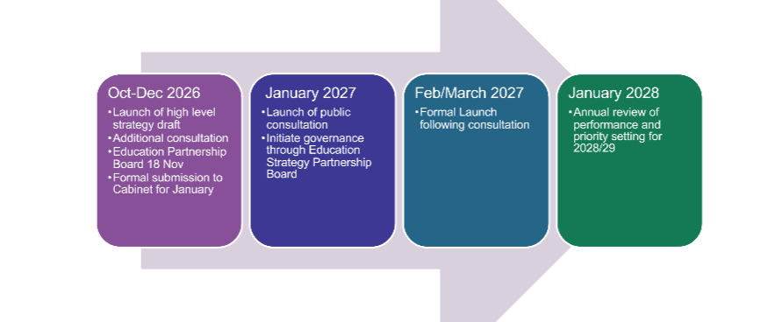
Next Steps
Notes:
We will now conduct some additional engagement with parents and carers and speak with more of our stakeholders
We will then take the document through formal governance ensuring it is signed off by politicians and senior leaders
We will prepare an action plan that outlines HOW we will deliver it
There will also be an open consultation so that anyone can feed in views
We will not wait for it to be signed off, we will begin delivering immediately and conduct a first progress review in January 2008 that will then become annual
Thank you so much. We look forward to working together to deliver!

Slide 113
*Refreshment Break*
(20mins)
Please visit our range of market stalls

Slide 114
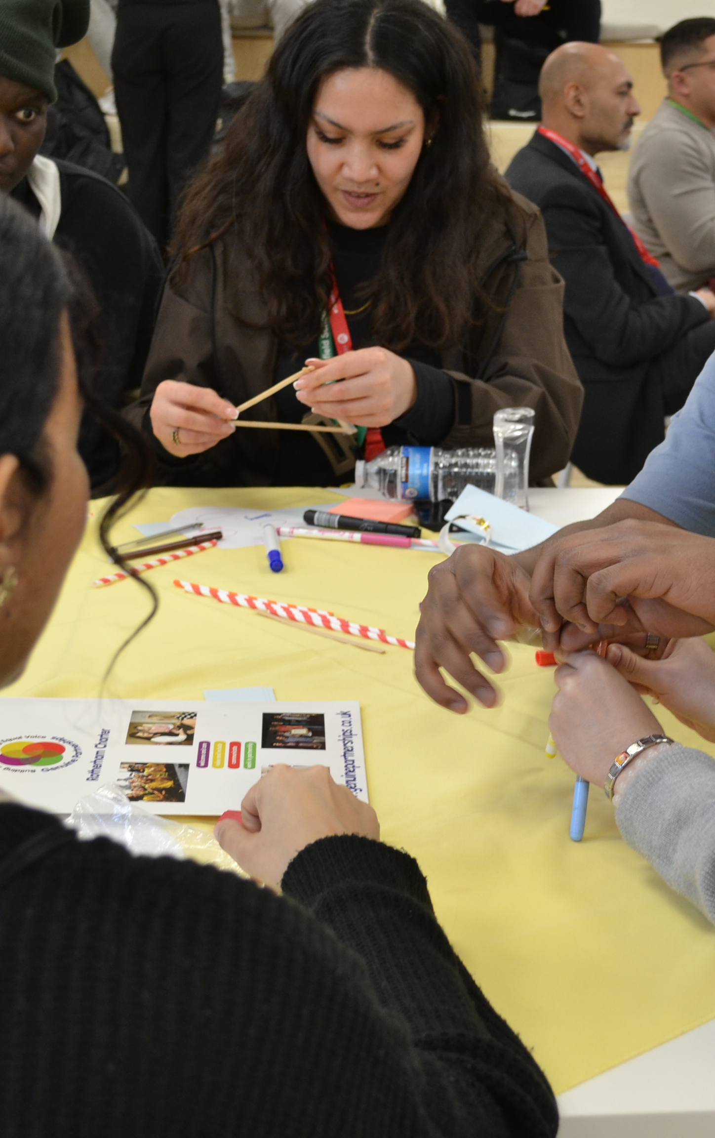
Education Strategy Workshop
The Insyte Team (Young Advisors & YIAG Team)

Slide 115


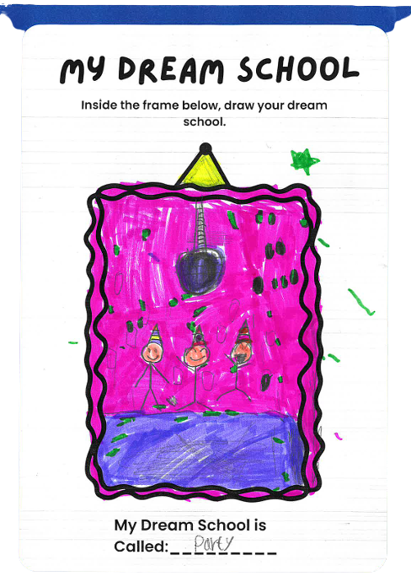
Young People’s Ideas, Education Strategy
  We are the Insyte team, a collective of young people aged 13-25 from Waltham Forest.
  Last July we designed and delivered a number of workshops across the borough for young people, to ensure their views about what is important in education were reflected.
  We engaged with over 350 young people including young people in primary, secondary and alternative provisions.
  Today we are going to present back the key themes and explore with you, how together we can focus on them
To get started, we want to do a similar exercise that we did in the workshops. You should each have a table tennis ball and sharpie. Please write down:
  One thing you love about your school
  One thing you learn from the children and young people you work with

Slide 116

What young people like about their schools?
Friends & Friendships
Socialising, Lunch Time & Break
Socialising, Lunch Time & Break
School Trips, Exciting Projects
Teachers
Art
English
History
Sports
Reading
Diversity in School & Inclusion
Learning Opportunities
School environment
Sports Day

Slide 117

Priority 1: All Waltham Forest children and young people feel that they belong, their voices are heard and they are healthy and safe.

Slide 118
A representative workforce that reflects the young people in Waltham Forest
Inclusion and belonging
A represenatative workforce that reflects the young people in Waltham Forest
A supportive environment that is calm, supportive & welcoming

Slide 119


Slide 120
Priority 2: All Waltham Forest children and young people feel prepared for adulthood and achieve their potential.

Slide 122

What young people would like all children in Waltham Forest to experience in Education before Year 11
Trips, residentials, new opportunities and experiences
Being treated, justly, feeling genuinely listened to and having a positive relationship with staff
Friendship, memories, community
Fun, celebrations and being celebrated
Having individual achievements, confidence and an experience of success
Feeling safe, good mental health and inclusion
Feeling ready for the future, careers and having life skills
Friendship, memories, community

Slide 124

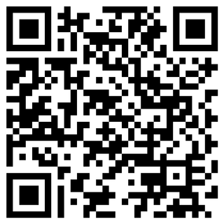
We’d love to hear your feedback

Slide 125

Thank you for attending!
Please take a few minutes to complete our evaluation form →

