Slide 1
Education Business Effectiveness SBM Induction Individual School Business Support September 2024
Notes:
CF - intro

Slide 2
Education Business Effectiveness
Notes:
CF

Slide 3
EBE Service – Structure Access, Participation & Inclusion
The EBE Team /
School Business Support Team

Slide 4
Education Business Effectiveness Team
The Education Business Effectiveness Service (EBE Service) is a non-statutory service within the borough’s Strategic People Directorate, providing free business support to all maintained schools by:
Providing advice, guidance and training to business professionals within schools to support best practice and continued professional development​
Chairing termly SBM Network meetings to share expertise and best practice among business professionals in schools​
Series of focused training sessions delivered each term through the SBM Network
Supporting schools’ financial management by linking to other council services and providing first line support for finance management software and key software licences ​
Running Action Groups to support maintained schools in challenging financial positions, including falling reserves or deficit budgets, to protect education standards for children and young people in Waltham Forest.
You can find full details on EBE page on The Hub website
Notes:
CF

Slide 5
Education Business Effectiveness
EBE Team
EBE Helpdesk
Budget setting support
Link to council services
SBM Network
SFFC & SUM Action Groups
School Business Support
Training & CPD
Access Workspace & Budgets
Secure file sharing and budget development software
1:1 tailored support from dedicated officer
Budget setting assumptions document shared with schools in Spring term
Forum meetings for School Business Managers – advice, guidance & best practice
Notes:
CF

Slide 6
School Business Support
Launched in September 2023
Designated EBE Support Officer - first point of contact for schools
Tailored support through regular contact to progress school specific queries/ outstanding queries with other LA Teams
Regular support meetings with Support Officer
Contact your Support Officer via mobile, email and Teams
Continued support through EBE Helpdesk
Dedicated Support Officer
Regular Support Meetings
Tailored
Support
Notes:
PH/CF
PH - Based on your feedback from the Conference we will be we will be moving to a new 1-1 support model from September 23 – schools will have a named support officer as your first point of contact, the benefits of this will be tailored support and building a closer working relationships as by developing this your EBE support officer understand the specific needs for your school such as PFI, New SBM, SFFC, Traded Services)
CF - We will be aiming to have Touch base meetings – which will be us coming to you to catch up on key issues/ comms from school to LA – the main focus is to build a closer working relationship in order understand need and how we can support – this can be an opportunity to understand trends across school to inform training opportunities we have (EBE) and need for your school , linking school with others school facing similar issues and schools that have found solutions,
PH – Termly touch base (so for autumn term this will be in person the idea is to get to know your school and how you work )
CF - Returning drop in – focused around key milestones in year, topic areas
PH – First port of call is your EBE Support Officer but please do copy in Helpdesk as visibility and we can pick up any queries if someone is off – communications will still be coming via the helpdesk but support first point of contact LA Team/EBE Support Officer)
You can contact us multiple ways – email, mobile landline which will be shared after this meeting and sent out with the notes.

Slide 7
School Business Support
1:1 tailored support
Charlie Fagan
charlie.fagan@walthamforest.gov.uk
Mobile: 07770 053 282
Acacia Nursery
Barn Croft Primary School
Chapel End Infant School
Chase Lane Primary School
Church Hill Nursery
Frederick Bremer School
George Tomlinson Primary School
Greenleaf Primary School
Handsworth Primary School
Henry Maynard Primary School
Kelmscott School
Leytonstone School
Low Hall Nursery
South Grove Primary School
St Patrick’s Catholic Primary School
Willowfield School
Gurpreet Kataora
Gurpreet.Kataora@walthamforest.gov.uk
Mobile: 07799 191 446
Belmont Park
Downsell Primary School
Edinburgh Primary School
Gwyn Jones Primary School
Hawkswood Group
Leytonstone School
Mission Grove Primary School
St Joseph’s Junior School
St Joseph’s Infant School
St Mary’s Catholic Primary School
Stoneydown Park School
Fiza Kazmi
Fiza.Kazmi@walthamforest.gov.uk
Mobile: 07824 747 874
Ainslie Wood Primary School
Buxton School
Chingford CofE Voluntary Controlled
Coppermill Primary School
Heathcote School & Science College
Holy Family Catholic School
Jenny Hammond Primary School
Opossum Federation – Dawlish, Oakhill, Newport, Thorpe Hall
Our Lady and St George’s Catholic
Parkside Primary School
Walthamstow School for Girls
The Winns Primary School
Whitehall Primary School
Notes:
CF - These are your EBE Support Officers – introductory email and touch base meeting in Autumn 1/2 (stress benefit of 1 on 1 support and to understand need for school)

Slide 8
EBE Team – Links to Council support Council teams we work with
Education Finance
Traded Services
Assets/Premises
Insurance
Schools HR
School Admissions
Health & Safety
Capital Delivery
Energy Team
Early Years Service
SALA / NOPAL / TTO Project
Enrichment Activities
The Hub
16-17 Participation Service
SEND Service
Pupil Place Planning
Apprenticeships
BACME
Governor Services
Catering Team
Pensions
Climate Outreach Team

Slide 9
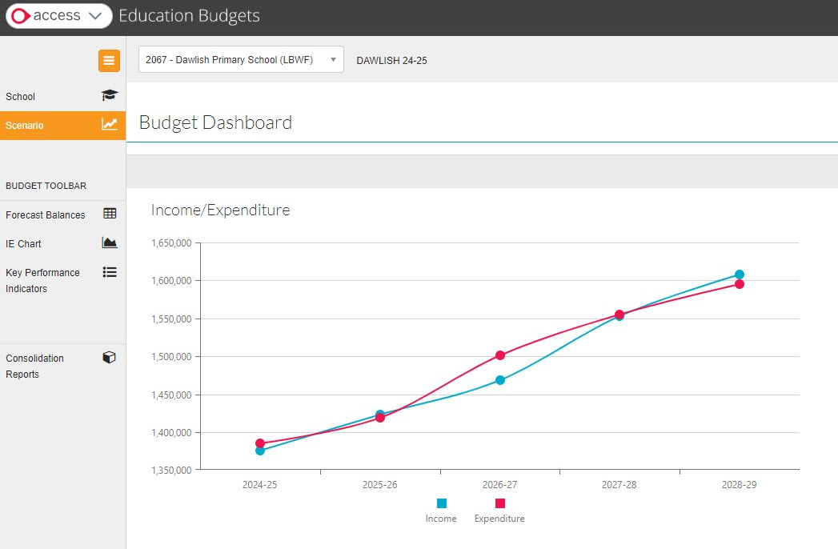
Access Workspace and Budgets
Access Workspace
Secure financial submissions
Secure file sharing
Training and Guidance
Accessible by designated school and council staff
Access Education Budgets
Cloud-based budget setting and monitoring software.​
5-year financial forecasting functionality, supporting strong financial management
Scenario modelling to forecast changes income or expenditure, staff pay, pupils, etc.

Slide 10
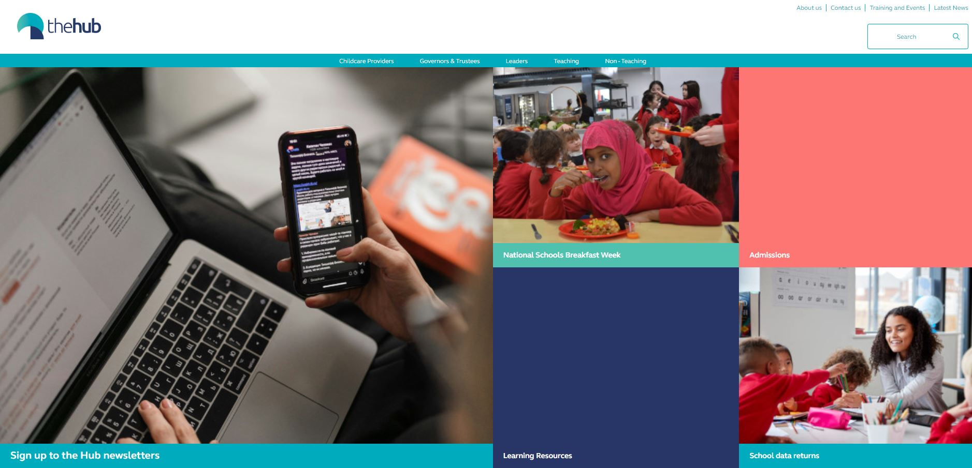
The Hub Website
https://thehub-beta.walthamforest.gov.uk/
Information and guidance relating to school business functions
Fortnightly newsletter
School policy documents
LBWF Schools Forum papers

Slide 11
Useful Contacts
EBE Helpdesk - EBE.Helpdesk@walthamforest.gov.uk
Education Finance - EducationFinance@walthamforest.gov.uk
Traded Services - wftradedservices@walthamforest.gov.uk
Traded Services Finance - wftsfinance@walthamforest.gov.uk
Public Health - Public.Health@walthamforest.gov.uk
Health & Safety - healthandsafety@walthamforest.gov.uk
Schools’ HR - SchoolsHR.Helpdesk@walthamforest.gov.uk
Governor Services - Governor.services@walthamforest.gov.uk
Pensions - Pensions@walthamforest.gov.uk
Admissions - school.admissions@walthamforest.gov.uk
SEND Service – SEND@walthamforest.gov.uk
Insurance - insurancesection@walthamforest.gov.uk
Early Years - earlyyears@walthamforest.gov.uk
School Annual Leave Agreement (SALA) – ttowaltham@hrod.co.uk
Energy Team - Energyteam@walthamforest.gov.uk
The Hub - thehub@walthamforest.gov.uk
The HUB newsletter - https://thehubbeta.walthamforest.gov.uk/hub-newsletter-signup

Slide 12
New SBM Checklist
WF SBM Network meetings - Ensure you have received email invites to the three WF SBM Network meetings for the academic year (held via Microsoft Teams) - Please contact ebe.helpdesk@walthamforest.gov.uk for further details and consult The Hub website for meeting dates - https://thehub-beta.walthamforest.gov.uk/education-business-effectiveness-service
Waltham Forest traded services - Ensure you have your login details for Waltham Forest Traded Services an online portal (WF Online) where you can access a range of paid for services to further support your work in Education- Please contact wftradedservices@walthamforest.gov.uk ​
Ensure you have the name and contact details of your dedicated EBE School Business Support Officer – please contact ebe.helpdesk@walthamforest.gov.uk
Ensure you have the name and contact details of your allocated WF Education Finance officer - Please contact EducationFinance@walthamforest.gov.uk ​
Access Workspace and Education Budgets- Ensure you have login details and access to Access Workspace and the Access School Budget tool (previously HCSS) - Please contact ebe.helpdesk@walthamforest.gov.uk. ​
The Hub - Ensure you have signed up to The Hub newsletters. The newsletters are an important way to keep up to date with key information - please consult https://thehub-beta.walthamforest.gov.uk/hub-newsletter-signup ​
EBE Training Offer- Ensure you have received email invites to a range of free EBE Service training sessions for School Business Managers, including School Budget tool training - please contact ebe.helpdesk@walthamforest.gov.uk for further information. ​

Slide 13
Any questions?

