Slide 1
Windrush 2023
75 pieces exhibition briefing pack for schools

Slide 2
Briefing Pack for Schools - Context
The 22nd June 2023 marks the 75th year anniversary of the arrival of HMT Empire Windrush bringing one of the first large groups of post war West Indians Immigrants to the UK.
To commemorate and celebrate the arrival of the Windrush generation and the contribution made to the UK, Waltham Forest Council have curated a programme of celebratory events and activities in partnership with schools and local community groups.
To mark Windrush 2023 we are asking schools across the borough to create Windrush themed art pieces that will be collected to create a 75 Pieces Exhibition. The art pieces will be unveiled at the Windrush Day flag raising ceremony on the 22nd and feature in the West Indian Front Room Exhibition at the Windrush Day festival on Saturday 24th June.
This briefing pack summarises the list of Windrush themed art pieces for the 75 pieces exhibition and how you can express your schools interest.
We ask that you:
Read the description of art activities and decide which one your school would like to express an interest in participating in order of preference.
Let us know if you are already working on Windrush Day projects that you would like to suggest for the 75 Pieces exhibition
Confirm a point of contact who we can arrange collection of the art pieces from
Include a short write up on why your school chose to participate in the 75 Pieces Exhibition

Slide 3
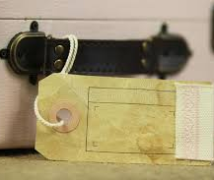
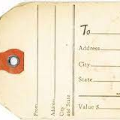
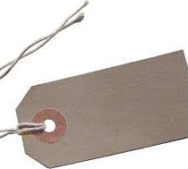
Windrush Luggage tags
Request: create your own luggage tag
Background: Using reinforced heavy-duty tags recreate your own Windrush luggage tag. On one side include your name and a message to the Windrush community
Age: Primary school
Amount: up to 15

Slide 4
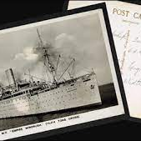
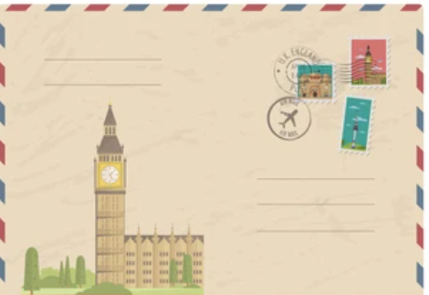
A post card home
Request: Write your own postcard
Background: Imagine you have made the journey to England and now settled in school. Write a post card to family in the Caribbean. What things would you share with them? How is school? Your new home? A drawing of England
Age: Primary school
Amount: Up to 10

Slide 5
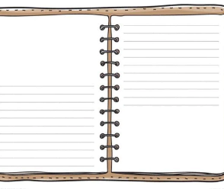
Windrush Diary entry
Request: Write a Windrush diary entry
Request: Write a diary entry about the journey on the Empire Windrush and their first impressions of Britain when they arrived in Essex. You may want to include drawings or even a family photo
Age: Primary and secondary school
Amount: Up to 10

Slide 6
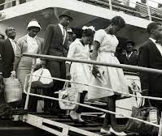
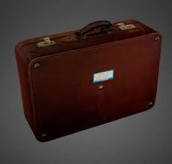
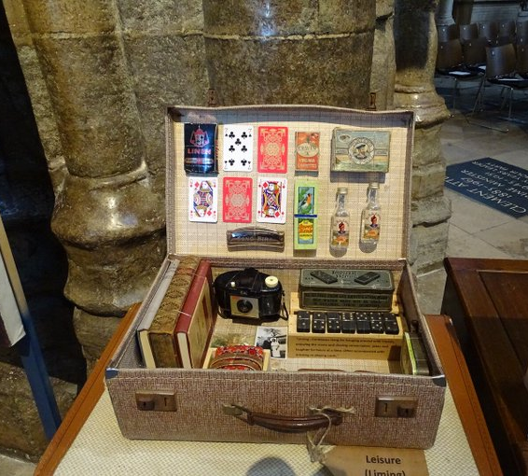
Replica suitcases ‘grips’
Request: Create replica suitcases also affectionally known as grips using sustainable materials e.g. cardboard boxes. You could also fill the items with replica items that would have been packed for the journey.
Background: “grips,” were small suitcase that most West Indians packed when they were going on a trip. Each “grip” also held valuable belongings that many West Indians brought from home to remind them of the Caribbean.
Age: Secondary school
Amount: You may want to make two replica suitcases.

Slide 7
Windrush Day Bunting
Request: Windrush Day bunting
Background: Why not have a go at making your own bunting using the many flags of the Caribbean. You may want to include fun drawings of items/people that remind you of the Windrush Generation.
Age: Primary and Secondary school
Amount: One bunting string with all the Windrush flags - see all the flag here

Slide 8
Briefing Pack for Schools – Next steps
Confirm your choice of activity by completing the MS Forms by 10th May
w/c 1st – 15th May
Once council have allocated activities school will be contacted to confirm activity.
Council will check in three weeks before deadline to check everything is going well and address any concerns
Council will arrange collection of art pieces between 26th and 30th May
Windrush Day unveiling of the art pieces exhibition on 22nd June at Fellowship Square and Windrush Festival on the 24th June
if you have any questions please contact ConnectingCommunities@walthamforest.gov.uk

