Slide 1


Induction
L4 School Business Professional
ixionholdings.com

Slide 2



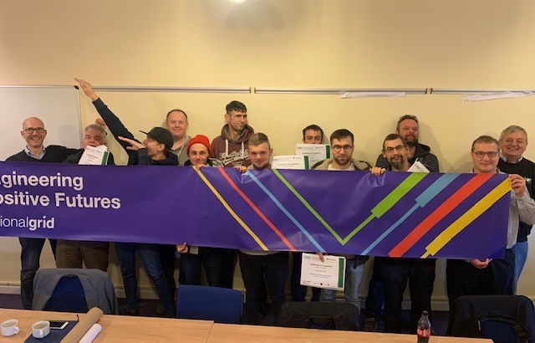
Your Teaching Assessor
Shell Coltman
Email Shell.Coltman@ixionholdings.com
Mob 07935 004425

Slide 3
Your Internal Quality Assessor
Tracey Hilton
Email Tracey.Hilton@ixionholdings.com
Mob 07518 905150
Notes:
Tracey’s picture to be added

Slide 4

Aims and Objectives
Understand what an Apprenticeship is and what is involved
Provide a step-by-step guide to your learner journey
Components of the programme
Timeline for the delivery
Look at the resources available
Additional support that can be accessed
Formal sign up to the Apprenticeship Programme
Review of expectations
Clarify next steps

Slide 5
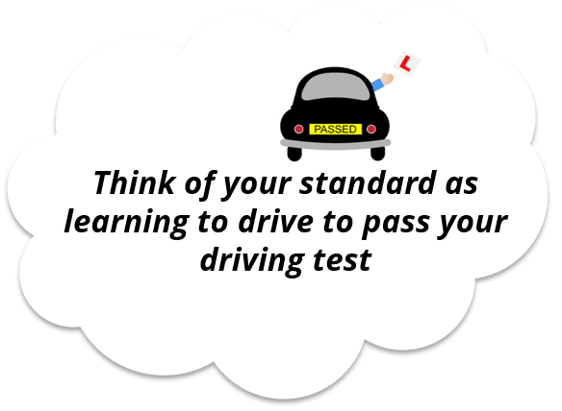
What is an Apprenticeship Standard?
Your ‘Driving Instructor’ is your Ixion Teaching Assessor who will help you learn everything you need in terms of building your knowledge, demonstrating your skills and behaviours (your ‘driving lessons’) to be able to pass your End Point Assessment (your “driving test”)
Your IQA is there to monitor your teaching and learning assessment activities to ensure that all activities are Valid, Reliable, current and Authentic. They are the link between your teaching Assessor and End-Point Assessor
Your TA and your employer, will help you identify when you are ready to take your end-point assessment.
Your End-Point Assessment will be carried out by an independent End-Point Assessor (‘Driving Examiner’)

Slide 6







Learner Journey
✔
End Point Assessment
01
Induction
Assessment by an external assessment organisation to assess competency
Welcome to the programme training
06
02
✔
Gateway
On Programme
Learning
TA, Learner and Manager agree and sign off that all components of the programme have been met and the learner is ready for EPA
Mixed cohort or 1:1 operational training
Math's and English Functional Skills L2 (first 6 months on programme)
One File Learning
Classroom/Remote delivery
Teaching Assessor support
05
03
Knowledge/Skills into Practice
Milestone Checks
Observations
Side by side coaching
Witness statements
Assignments/Assessments
Guided Discussions
Bi- Monthly progress reviews, are you the learner on target?
Reviews to update both learner and Employer
04
Notes:
Induction to the programme
On-programme is the learning phase for apprentices to develop the skills, knowledge and behaviours set out in an apprenticeship standard and required to pass the end-point assessment.
All apprentices need to complete 20% off-the-job training as part of the on-programme phase of their apprenticeship. It must be within an apprentice’s paid hours and doesn’t have to be away from the workplace.
Your TA team have carefully mapped the skills, knowledge and behaviours required and developed the operational training to reflect this
Progress reviews/milestone checks are carried out bi-monthly by the TA and discussed with line managers, where further development needs are identified a development plan will be agreed.
The TA will support line managers with observations, to confirm that knowledge they have gained is put into practice
Your EPA is TQUK

Slide 7
Principles of the Standard School Business Professional
L4 School Business Professional Apprenticeship
Knowledge | Skills | Behaviours
Finance | Financial and Operational Management | Change Catalyst
Procurement | Project Management | Decision Maker
Human Resources | Change Management | Skilled Negotiator
Managing Support Services | Communication and Relationship Building | Collaborative
Governance and Risk | Strategic Management | Resilient
Marketing |  | Challenger
Infrastructure
Ethical Standards
Course length 18 months + 3 months EPA
Notes:
Link – L4 SBP

Slide 8


Your Learning Programme
20%
Learning Programme
What does 20% off the job training look like?
How much time will I have to give?

Slide 9
Your Learning Programme
Learning Programme
What does 20% off the job training look like?
The time you have to give is –
Hrs worked per week
x Duration of course
- Annual Leave
= Total hrs for duration of the course
= 20% Off the Job
20%

Slide 10

Off The Job = On programme training
Teaching of theory - face-to-face
Simulated exercises and role play
Attendance at relevant competitions
Manufacturer training e.g. new equipment or technologies
Some online learning e.g. webinars or blended learning
Shadowing or being mentored
Practical training to develop skills
Visiting the employer's other departments
Time spent by the apprentice writing assessments/assignments

Slide 11
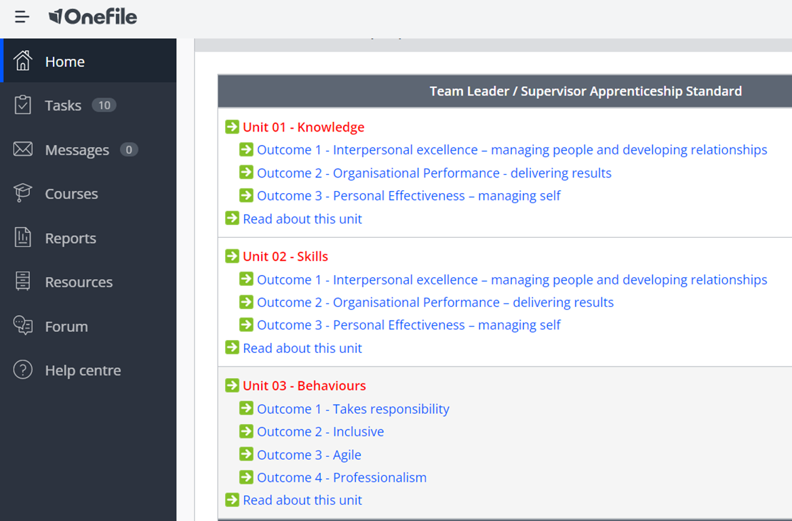
One File
Locate what is involved in your course in detail
Find resources
Find Assessments
Gather and store evidence
Communicate with your Teaching Assessor
Watch your progress grow

Slide 12
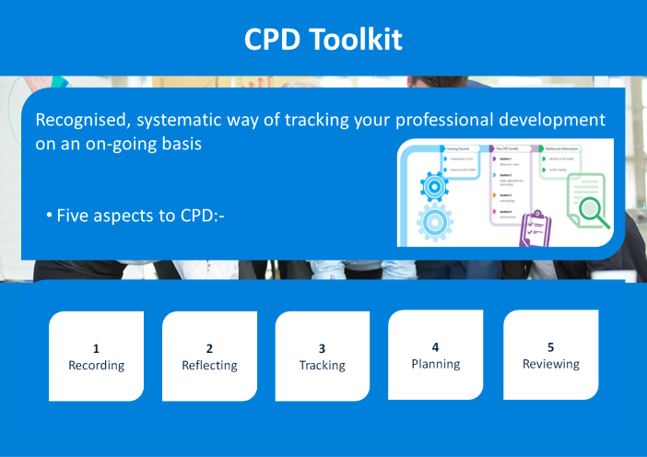

Slide 13
70-20-10 Model
70%
Experiential Learning
20%
Learning and Developing from others
10%
Formal Learning
Workplace learning
Job rotations
Secondments
Projects
Expanded scope, responsibilities or decision making authority
Informal coaching and mentoring
Working with & observing role models
1-2-1 coaching
360 reviews
Networking
Classroom delivery
One File Modules
Internal courses
External courses
Reading
Notes:
.

Slide 14
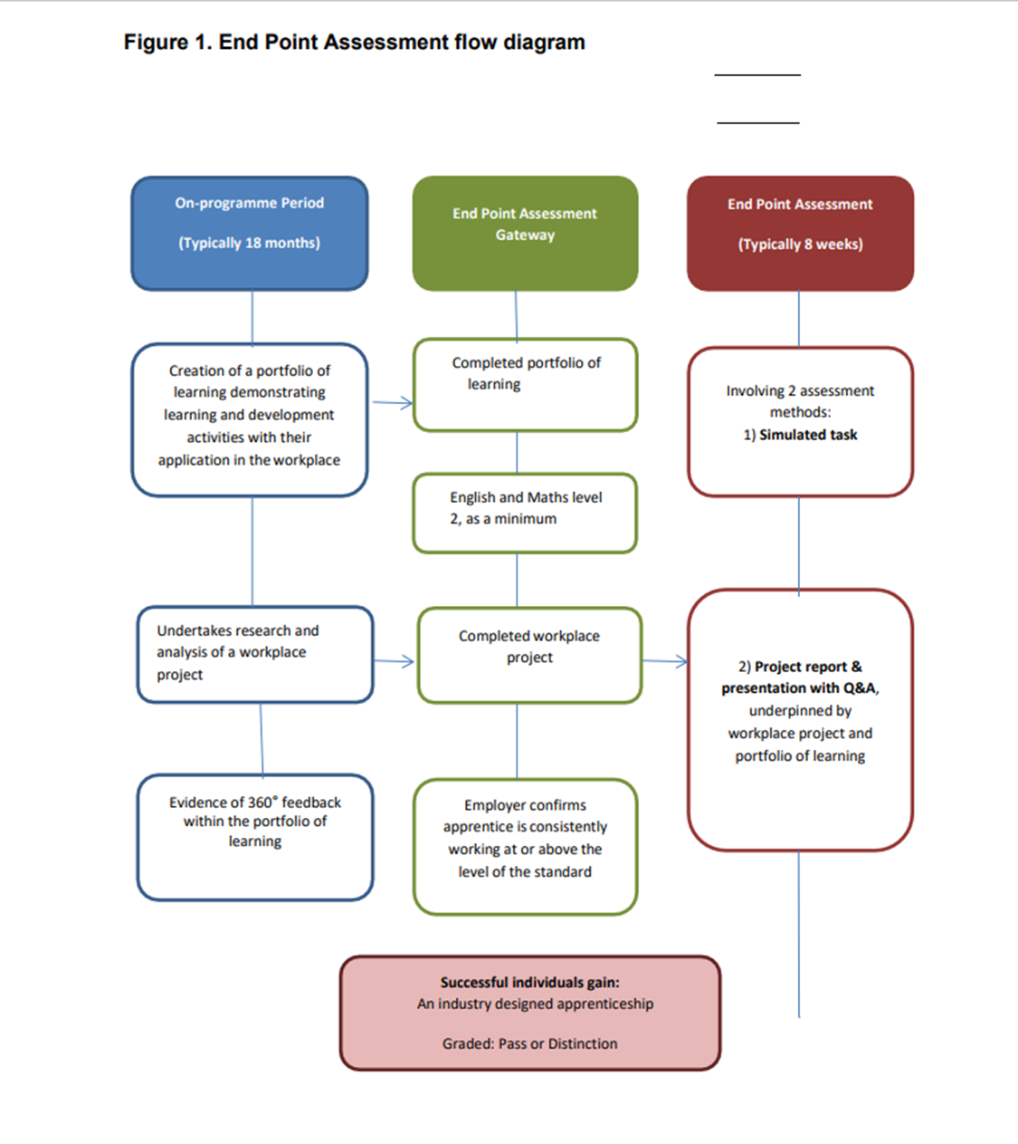
End Point Assessment
Assessment Method 1
Simulated Task
Assessment Method 2
Project report and Presentation with Q&A

Slide 15



Slide 16

Personal Development Behaviours and Attitudes
Health and Safety
Safeguarding
Prevent
British Values
Mental Health
Equality and Diversity
Information Advice and Guidance

Slide 17


Safeguarding Support
Adam Waite – Safeguarding Officer
Email adam.waite@ixionholdings.com
Tel 07908 134085

Slide 18

Cognassist
Visual Perception
Visual info processing speed
Verbal reasoning
Verbal memory
Numeracy
Non-vebal memory
Literacy
Executive Function

Slide 19
Appeals Procedure
Functional Skills
The appeals procedure is to enable you to have a review of any assessment which you feel has been judged unfairly
You may appeal on a variety of grounds, for example: the conduct of the assessment or the assessment decision
Please refer to your Learner Handbook
Apprenticeship Standard
Appeals for the Apprenticeship Standard will be dealt with by Ixion and the respective End Point Assessment Organisation (EPAO) guidelines for Standards

Slide 20

Q&A

