Slide 1


NCE Partnership
Possibilities through the Apprenticeship Levy…

Slide 2
State of Apprenticeship today…
2015 – Manifesto Commitment
2017 – Levy announced
2018 – NCE began programmes
2019 – Ofsted and ESFA inspections
2019 – A guide to apprenticeships for the school workforce, DfE, Nov 2019 paper
2020 – circa. 1500 learners on apprenticeship programmes
2021 – NCE portfolio development and building regional collaborations
2021 – Budget commitment to increase apprenticeships impact
2022 – circa. 3000 learners on apprenticeship programmes
2022 – NCE Regional Partnerships roll out
For further information on Apprenticeship and the Apprenticeship Levy, read our NCE Apprenticeship Whitepaper

Slide 3

The Apprenticeship Levy
Webpage
Brochure
Since April 2017, all organisations with a payroll of more than £3 million/annum must pay the Apprenticeship Levy
The Apprenticeship Levy is 0.5% of the total payroll
Employers pay the levy to HMRC through the monthly PAYE process into a Digital Apprenticeship Service (DAS) account
Government provide a 10% top-up on levy paid by the organisation into the DAS account
Levy Funds may be used to meet the costs associated with the training & assessment elements of the apprenticeship only
It is a “use it” or lose it scheme (24 months roll on) - unspent levy is returned to the HMRC
Organisations must use a provider from the Register of Apprenticeship Training Providers
New and existing employees may benefit
Notes:
ST

Slide 4
“Apprenticeships are a great way for schools to improve the skills base of their employees…Schools should consider apprenticeships as part of strategic workforce planning, promoting a diverse and inclusive workforce and supporting recruitment and retention more widely.”
Taken from: A Guide to apprenticeship for school workforce, DfE, 2018

Slide 5

Co-Investment
Tapping into the National Levy Pot: Co-investment is the process of spending more levy each month than you pay.
Once you have spent your own levy…
  Trust pays 5% of apprenticeship training & assessment costs from its budget
  Government’s Apprenticeship Levy Fund pays the other 95%
    Example: Level 7 SLP with MSc = £700
Not accessed your Levy yet?
  Register for your Digital Apprenticeship Service (DAS) – see Appendix 1

Slide 6

Levy Transfer
Webpage
Brochure
Organisations that pay the apprenticeship levy are not always in a position to spend all of their levy funds on their own apprentices. They can use their apprenticeship service account to transfer up to 25% of their annual levy funds to another organisation to pay for their apprenticeship training.
Transferred funds can only be used to pay for apprenticeship training and assessment and must cover the full cost and duration of an apprentice’s training.
Any organisation can receive a transfer of funds, including levy payers. However, a levy-paying employer cannot send and receive transfers at the same time.
If your Trust/school does not pay the apprenticeship levy, you may be able to save the 5% co-investment cost by arranging a transfer from a levy-paying employer.
If your Trust/school pays the apprenticeship levy and you don’t plan to use all of your levy funds, you could consider supporting another organisation’s apprenticeship programme by transferring funds.
If your Trust/school pays the apprenticeship levy and you don’t have sufficient levy funds to pay for all of your apprenticeship training needs, you could arrange to receive a transfer from another organisation who is interested in supporting your apprenticeship programme.
Levy Transfer site – search for a funding opportunities
Notes:
ST

Slide 7
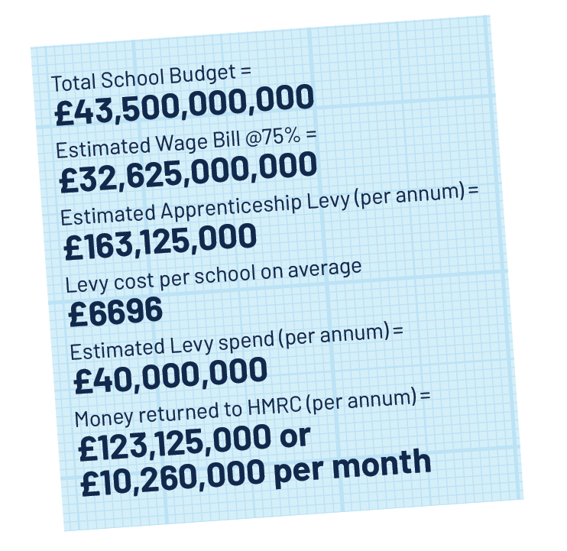
Cost to Education sector in unspent Apprenticeship Levy
Conservative estimates show:
£123m returned to HMRC per year
£10m returned to HMRC per month
Sources:
https://assets.publishing.service.gov.uk/government/uploads/system/uploads/attachment_data/file/774325/Schools_costs_technical_note_Jan_2019.pdf https://ifs.org.uk/uploads/R162-Annual-report-on-education-spending-in-england-schools.pdf

Slide 8

NCE Apprenticeship Portfolio
Opportunities for schools

Slide 9
Level 7 Senior Leadership Programme
Links
L7 SLP
Brochure
For whom
Current Senior Leaders in schools, Trusts or Local Authorities
Qualifications
MSc in Education Leadership and Management
L7 Senior Leader Apprenticeship
Eligibility
Currently in a leadership role in school
Assistant Headteachers, Deputy Heads, Aspiring Headteachers
Serving Headteachers, Trust Central Team members
Bachelors Degree (2:2 or above)
Price
£14,000 (funded by the apprenticeship levy)
GCSE (C or above) in English and Maths
Aspirate Senior Leaders*
* Specific eligibility criteria for these leaders are necessary to apply

Slide 10
Level 7 Senior Leadership Programme
Links
L7 SLP
Brochure
Module Content
  Leading Strategy
  Leading Transformation
  Leading Operations
  Leading People
  Extension Pathway: MSc. or MBA* Extension Modules (60 credit with Uni of Roehampton)
Format
  24-month programme + 9 months MSc/MBA top up credits
  First day of learning and five 2-day Professional Learning Days
  Assessment through four Reports, Strategic Business Proposal and presentation, Professional Discussion and a portfolio of evidence. MSc. and MBA pathways three 3,500-word essays
  Monthly engagement, Off-the-Job (OTJ) training and 12-weekly Reviews (with Line Manager)
  Support from dedicated tutor
* For MBA Pathway, one off fee of £7,000

Slide 11

Level 5 Education
Management Programme
Links
L5 Ed. Man
Brochure
For whom
Emerging middle leaders
Qualifications
Level 5 Departmental/Operations Manager Apprenticeship
Eligibility
GCSE (C or above) in English and Maths
Price
£7000 (funded by the apprenticeship levy)
For teaching and non-teaching leaders
Line Management Role
School Business Managers

Slide 12
Level 5 Education
Management Programme
Links
L5 Ed. Man
Brochure
Module Content
  Leading People
  Operational Management
  Managing People and Building Relationships
  Personal Effectiveness and Decision Making
  Finance and Project Management
Format
  19-month programme
  First day of learning and 12 online Professional Learning sessions
  Delivery from Andy Buck and other senior leaders/headteachers
  Assessment through a School Leadership Project, a portfolio of evidence and assignments
  Support from dedicated tutor
  Monthly engagement, Off-the-Job (OTJ) training and 12-weekly Reviews (with Line Manager)

Slide 13
Future Leaders
Programme
Links
L3 Leaders
Brochure
For whom
Emerging Leaders
Qualifications
Level 3 Team Leader/Supervisor apprenticeship
Eligibility
GCSE in English & Maths
Price
£4,500 (funded by the apprenticeship levy)
RQT+2/3
HLTAs and TAs

Slide 14
Level 3 Future Leaders
Programme
Links
L3 Leaders
Brochure
Module Content
  Delivering Strategy
  Delivering Transformation
  Delivering Operations
  Delivering People
Format
  12-month programme
  8 online professional learning sessions
  Assessment by knowledge test, professional discussion around your online portfolio of evidence.
  Support from Peer Learning Partners and Professional Learning Mentor
  Access to online content, book club and podcasts.
  Monthly engagement, Off-the-Job (OTJ) training and 12-weekly Reviews (with Line Manager)

Slide 15

L7 Bespoke Employer Enrichment Input Sessions
  Trust Input*
  Vision, Values & Mission
  Regional Strategy
  Trust Input
  Guest speaker
  Strategic aims and implementation
  Trust Input
  Alignment of Business Proposal or Project to Trust Strategic aims
  Trust Input
  Impact evaluations
  Next steps
  Professional Learning Group/s within programme cohorts addressing Trust’s priority areas
* these example Enrichment Inputs will not form part of the official programme content – they will be an opportunity to complement NCE input and allow organisational context for on-programme learners. The total number of sessions is at the discretion of the individual organisation.

Slide 16
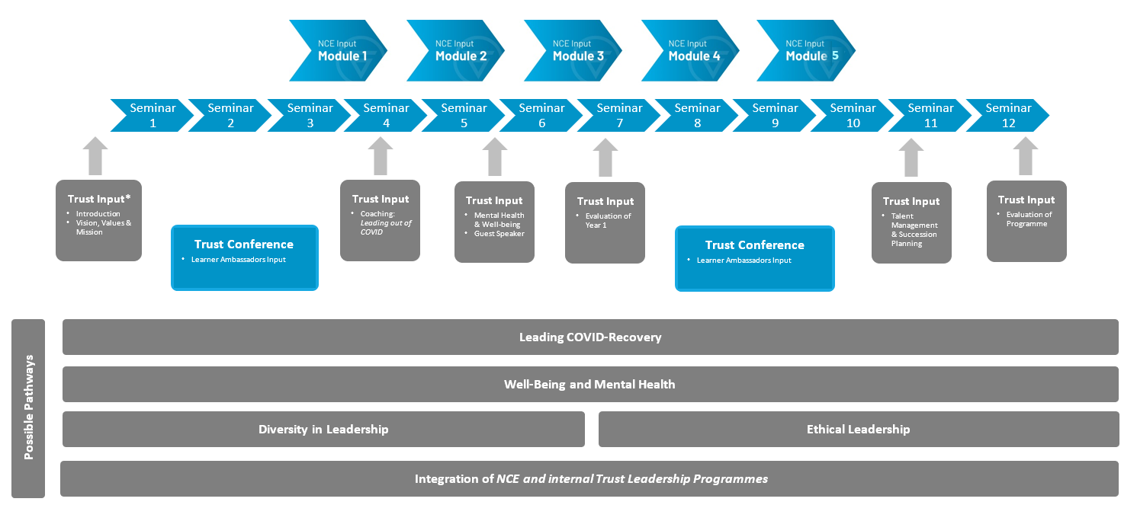
L3/L5 Bespoke Employer Enrichment Input Sessions
* these example Enrichment Inputs will not form part of the official programme content – they will be an opportunity to complement NCE input and allow organisational context for on-programme learners. The total number of sessions is at the discretion of the individual organisation.

Slide 17
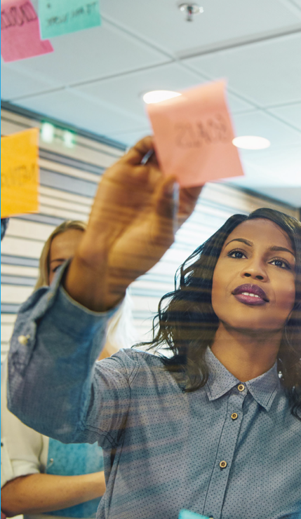
Bespoke NCE Enrichment Programmes
WomenEd
  Level 7
  Level 5
Early Years
  Level 7 for EY leading an EY or Nursery setting
  Level 5 for EY practitioners looking to grow into leadership
Reading (in development)
  Level 5 for Primary Eng/Lit Coordinators and Secondary Literacy/Eng Middle Leaders
  Level 3 for staff leading or aspiring to lead a library
Maths (in development)
  Level 5 for Primary Maths Coordinators and Secondary Maths Middle Leaders
Support Staff (in development)
  Level 3 for LSAs, TAs and HLTAs
For more info about fully funded apprenticeship www.nationaleducation.college
We are also delighted to announce new Early Years programmes: a. I have attached a flyer for a webinar that is running on Thursday 31st March 4pm or you can sign up here ­https://www.eventbrite.co.uk/e/cpd-for-early-years-leaders-level-7-with-msc-level-5-apprenticeships-tickets-277701060347

Slide 18

Get in Touch
Charlee Kilbey
0208 221 9089
Charlee.kilbey@nationaleducation.college
Book a call in with me here.
https://www.nationaleducation.college
Feedback from our learners can be found here or using the Twitter hashtag #OurNCEJourney.

