Slide 1
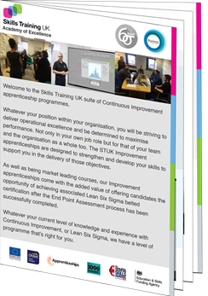
Welcome
Introduction to Continuous Improvement Apprenticeships
Delivering Improvement through apprenticeships
in partnership with

Slide 2
Who are Skills Training UK
WINNER: TES FE AWARDS 2019 “Training Provider of the Year”
WINNER: AAC Awards Outstanding Contribution to the Development of Apprenticeships Award
FINALIST: Education Investor Awards 2018 “Skills Provider of the Year”
FINALIST: SEMTA 2019 “Training Partner of the Year”
WINNER: TES FE AWARDS 2020 “Apprenticeship Programme of the Year”
WINNER: Apprentice of the Year 2021
WINNER: Scientific Apprenticeship Programme of the Year 2021
Over 30 years of experience as a market leading CPD training provider

Slide 3
Lean is the systematic and relentless elimination of waste in every part of the organisation:
Engaging all department and employees in the pursuit of excellence to reduce time and cost enabling you to deliver a higher quality service in the most effective, efficient and responsive manner possible

Slide 4
Why organisations need a Transformational Culture
To continually identify and solve problems quickly, efficiently and permanently
Minimise workplace frustrations and enhance performance
Increase operational excellence by reducing error and repetition
Plus many more hidden benefits including;
Create opportunities for growth
Reduced operational costs
Budget maximisation
Improved colleagues motivation and empowerment
Aids long term strategic planning
Our Improvement suite of programmes are
growing in popularity.
Let’s see why…

Slide 5
Our Impact with Employers
Average 15.2%* increase in productivity following training
*Based on 245 employers
Average 17.1% reduction in waste and unused products, absence rates reduced by 57.3%
*Based on 245 employers
95.1% of Employers identified would use our free recruitment service again to identify new staff
(IPSOS-MORI 2019)

Slide 6
Our Impact with Employers
85.3% of waste recycled. Waste arising reduced by 74.3% since 2010
(Skills Training UK CSR Policy and Impact Plan 2016-2020)
Average annualised saving of £147.3k per employer, £4,345 per learner
*Based on largest 20 employers
92.3% of Employers would recommend us
(IPSOS-MORI 2019)

Slide 7
Collaborative Organisational Development
Designed to involve colleagues in project identification and selection
Adopt existing objectives and problems into course project development
Achieve real measurable organisational impact
Breeds a culture of Continuous Improvement
Personal development supporting organisational objectives
Participation creates sense of ownership – more stakeholders
Understand how to base decision making on facts and data over opinion
Facilitates stronger involvement and interaction
Participation creates Ownership

Slide 8
Benefits of Lean/CI
BENEFITS TO THE LEARNER
Improved job performance
Improved global awareness of the business
New skills and techniques
Confidence in change within the business
Greater team work ethic
Personal development
Improved communication skills
Thinking outside the box
Participation creates Ownership

Slide 9
Benefits of Lean/CI
BENEFITS TO THE ORGANISATION
Potential for improved productivity
Less mistakes
Increased efficiency through confidence
Makes the organisation more adaptable and agile in responding
to market changes.
Helps in informed decision making
Brings fresh perspectives to the workplace
Improved morale and ideas generation
Participation creates Ownership

Slide 10
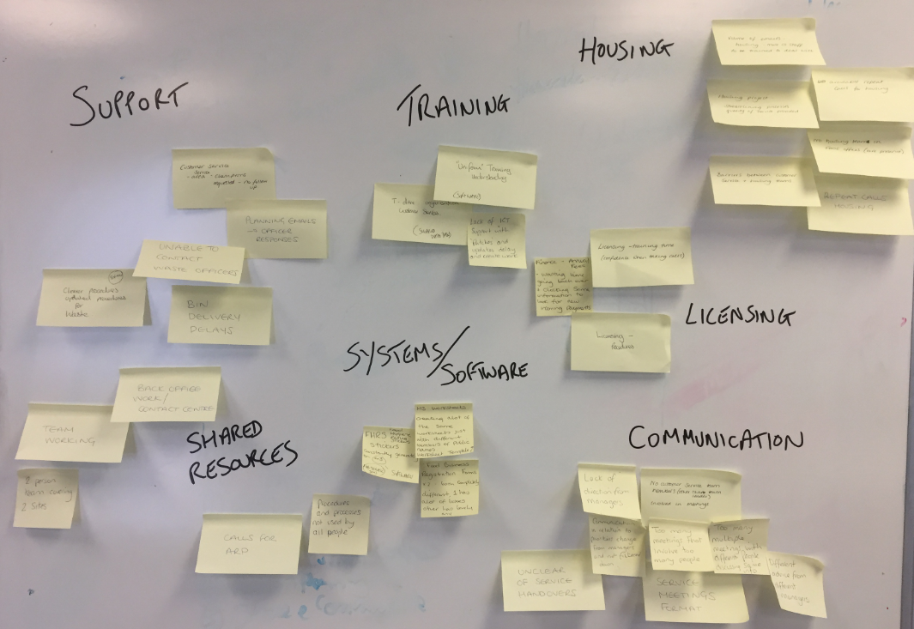
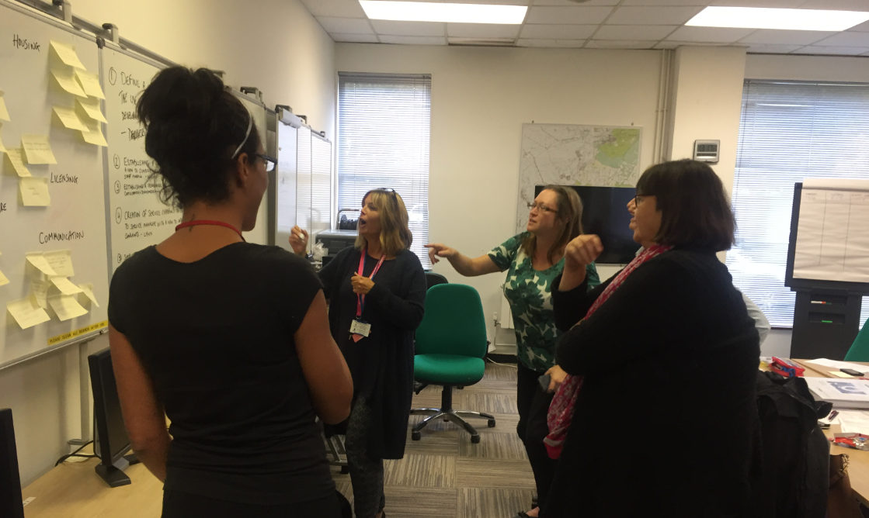
Government sector project examples
Introduce a standardised framework for creating and maintaining SOP’s for UNIFORM software operations to minimise time lost in workarounds and duplication.
Creation of Service Champions for each department to act as a point of contact between teams and Service Managers as liaison when raising points of concern. This is with a view of focusing efforts and resources to eliminate repeat complaints and improve quality of service provision to users.
Define a new comprehensive Training strategy incorporating the expanded use of a cross functional Skills Matrix to identify areas of team development. Introduce Skills Training workshops to support and up skill colleagues.
Develop a simplification of current Licensing financial processes to include more easily accessible reports. Identification of payments made, and those currently outstanding awaiting collection should be readily identifiable to save time and effort reviewing unstructured data and spread sheets.
All of these projects were implemented after development

Slide 11
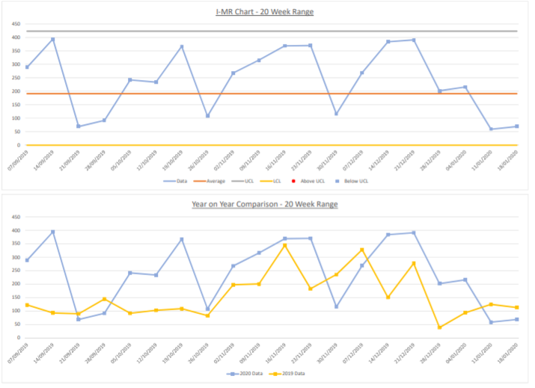
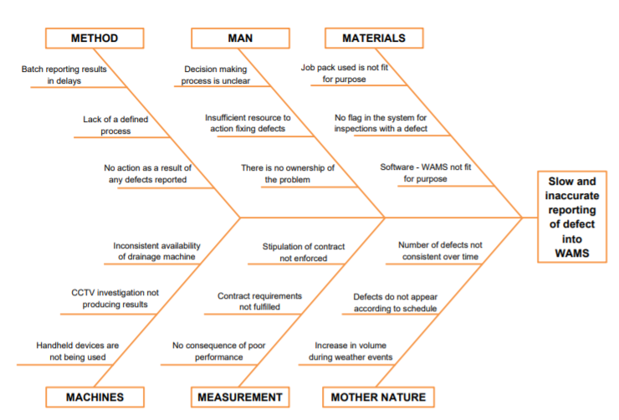
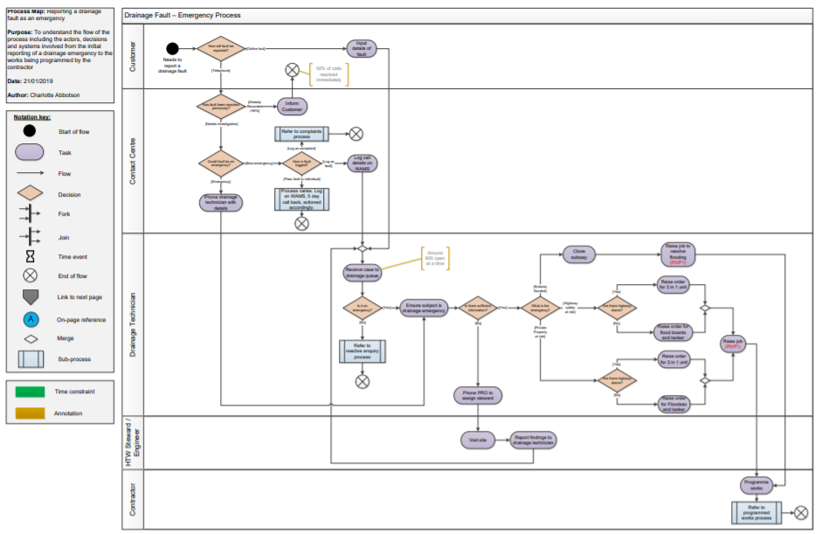
Demonstrating Impact
Projects are created using data, experience and internal expertise by the people involved in the delivery of the process.
We teach you how to demonstrate the true VALUE of project designs based on measurable outcomes and not opinion.

Slide 12
The STUK Suite of Improvement Apprenticeships
Improvement Technician Level 3
Improvement Practitioner Level 4
Improvement Specialist Level 5
Improvement Leader Level 6
All Improvement apprenticeship programmes come with the opportunity to achieve Lean Six Sigma belted accreditation after successful completion of the end point assessment process.

Slide 13
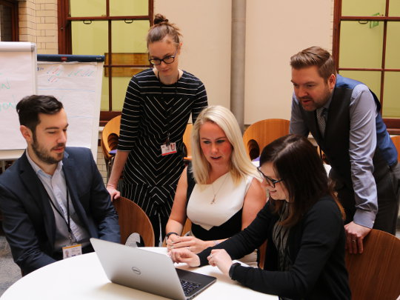
Improvement Technician L3 Course Overview
Improvement Technicians are responsible for delivery and coaching of improvement activity within an area of responsibility, often associated with Lean and Six Sigma methodologies. They can be found across all job roles and functions.
Entry level Improvement programme – aimed at individuals and Team Leaders, Supervisors, Business Improvement Coordinator, Quality Control Senior Analyst
Programme develops KSBs around:
Team Formation and Leadership
Project Management including Project Selection and Scope
Structured Decision Making and Problem Solving
Principles and Methods for Continuous Improvement.
Process Capability and Performance
Typical duration of 14 months & 12 week EPA window

Slide 14
Improvement Technician L3 Course Overview
The End Point Assessment for this programme comprises of:
A 40 question multiple choice exam lasting 40 minutes.
The production of a project portfolio of evidence demonstrating the practical application of course knowledge, skills and behaviours.
The portfolio of evidence will form the basis or a 30 to 40 minute presentation, followed by a 25 to 35 minute Q&A session.
A 30 to 40 minute professional discussion.
Completion of Level 2 Functional Skills Maths and English, or production of existing qualifications for exemption.

Slide 15
Improvement Practitioner L4 Course Overview
Improvement Practitioners use a blend of Lean Six Sigma, project and change management tools and principles to identify and lead the delivery of change across organisational functions and processes. They can be found across all job roles and functions.
Mid level Improvement programme – typical job roles include: Team Leaders, Process Leaders, Quality Control Practitioners, Business Improvement Practitioner, Operational Manager, Quality Control Analyst.
Programme develops KSBs around:
Data Driven Decision Making and Problem Solving
Principles and Methods for Continuous Improvement
Performance Metrics, Sustainability and Control
Project Management – Plan, Manage and Implement
Change Management
Process Mapping and Analysis
Route Cause Analysis
Functional Skills Maths/English
Typical duration of 14 months & 12 week EPA window.

Slide 16
Improvement Practitioner L4 Course Overview
The End Point Assessment for this programme comprises of:
A 40 question multiple choice exam lasting 40 minutes.
The production of a project portfolio of evidence demonstrating the practical application of course knowledge, skills and behaviours.
The portfolio of evidence will form the basis or a 30 to 40 minute presentation, followed by a 25 to 35 minute Q&A session.
A 50 to 60 minute professional discussion.
Completion of Level 2 Functional Skills Maths and English, or production of existing qualifications for exemption.

Slide 17
Improvement Specialist L5 Course Overview
Improvement Specialists are responsible for leading the deployment of Improvement strategy, for training and leading data analysis teams, and for providing broad and deep technical expertise in advanced and complex Lean Six Sigma methodology.
Typical job roles include: Data Analysis Team Leader, Process Improvement Manager, Operational Excellence Leader, Head of Department.
Programme includes KSBs focusing on:
Leading Improvement Teams
Change Planning
Commercial Environment
Strategic Deployment of Continuous Improvement
Process Mapping and Analysis
Software Driven Root Cause Analysis, Statistical Process Control.
Typical duration of 14 months & 12 week EPA window.

Slide 18
Improvement Specialist L5 Course Overview
The End Point Assessment for this programme comprises of:
A four hour data analysis test based on 8 project case studies.
The production of a portfolio of evidence to demonstrate the practical application in the workplace of KSB developed on programme. This will include evidence of an original coaching session designed and delivered by you.
Your portfolio will be used as a point of reference to support you through a professional discussion lasting between 2hours to 2hours 30 minutes.
Completion of Level 2 Functional Skills Maths and English, or production of existing qualifications for exemption.

Slide 19
Improvement Leader L6 Course Overview
Improvement Leaders are responsible for developing Improvement strategy, providing leadership in organisational Improvement and culture change, and coaching and supporting Improvement Specialists. They are senior leaders.
Typical job roles include: Senior Leaders, Heads of Department, Improvement Executives, Improvement Consultants, Directors.
Programme includes KSBs focusing on:
Strategy Development
Coaching and Developing Project Teams
Experimentation, Optimisation & Simulation
Leading Culture Change,
Policy Creation and Effective Deployment
Activity Based Costing and Controls.
Typical duration of 18 months & 20 week EPA window.

Slide 20
Improvement Leader L6 Course Overview
The End Point Assessment for this programme comprises of:
The completion of a dissertation of between 4000 to 4500 words. The dissertation will form the basis of a presentation of between 45 to 50 minutes, followed by a Q&A session of between 35 to 40 minutes.
A portfolio of evidence to demonstrate the practical application in the workplace of KSBs developed on programme. This will include evidence of an original coaching session designed and delivered by you.
A professional discussion lasting between 2hours to 2hours 30 minutes.
Completion of Level 2 Functional Skills Maths and English, or production of existing qualifications for exemption.

Slide 21
End Point Assessment
Comprehensive coaching and preparation at every level.
Use of our Subject Matter Specialists
Will only be taken when you, your trainer, and your line manager are confident of success.
Reference materials and notes produced during programme can be taken into the End Point Assessment process for reference.
Projects produced through programme participation add real organisational value and are not just theoretical.
Pass, Merit, or Distinction grades can be achieved dependent upon standard of work and assignments produced.
Everything we do is aimed at achieving Distinction Status.
Regular 12 weekly reviews and our mock gateway approach to EPA means no surprises.

Slide 22
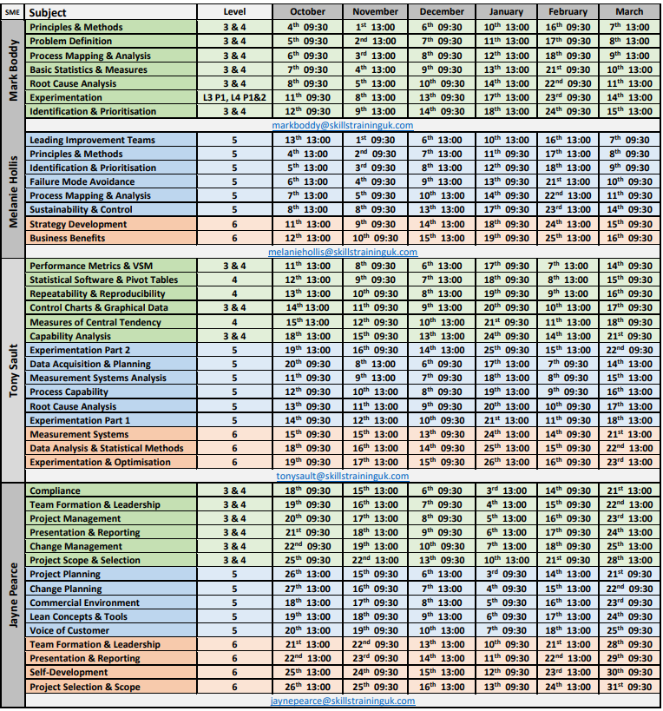
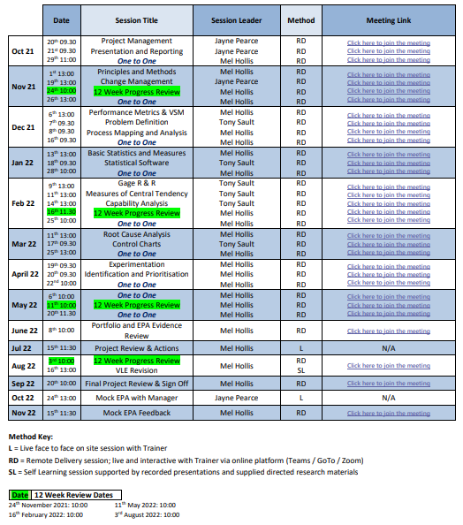
Finding the Right Programme & Level
To help find the right level of programme for each candidate Route Progression Maps and Skill Scans are used in combination with an assessment of previous knowledge & experience, and current job role responsibilities.
Learning delivery and course participation can be achieved in a number of ways utilising our flexible range of platforms:
Face to Face delivery
Full calendar of live and interactive webinars – truly flexible learning
Full programme creation
Virtual Learning Environment (VLE)
On demand 24/7 access to courses
Use of Subject Matter Specialists
Through collaboration we will structure a bespoke blended approach to meet
the needs of you & your organisation

Slide 23
Meet our Virtual Trainers

Slide 24
Technology and Systems
STUK utilise the following software solutions for all apprenticeship programmes:
OneFile – Market leading e-portfolio & virtual-learning environment; utilising live webinars, pre recorded presentations and learner resource libraries.
BKSB – Used by 85% of FE Colleges and Schools; delivers English and Maths Training from Entry to GCSE level.

Slide 25
Flexible Integration of 20% off the job Requirements
Can be flexible & evidenced holistically
Can take place at work as part of candidates day to day working activities
Includes all of the following:
Teaching of theory
Online learning & practical training
Learning support (on and offline)
Time spent writing assignments
Project development work
Developing and delivering presentations
Leading & participating in meetings

Slide 28
Courses designed for individuals and organisations seeking to achieve success utilising Business Skills & Continuous Improvement practices.
Achieve recognised qualifications, open up career progression opportunities, and enhance continued professional development.
Challenging and rewarding programmes.
Flexibility of delivery styles and methods to maximise participation.
As much support and access to learning as is required using our blended approach.
Have a real impact on the working environment, the wider community, and help deliver organisational objectives.
Thanks for listening

