Slide 1
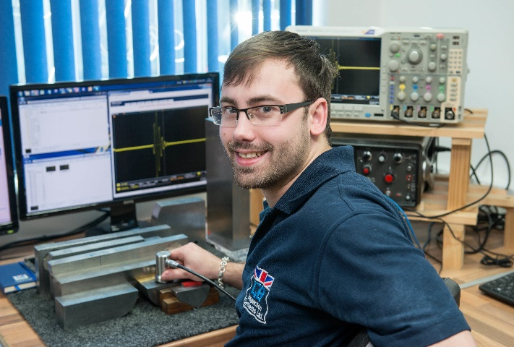
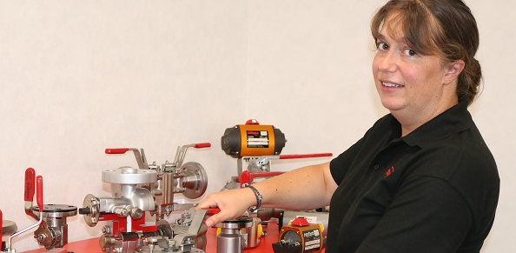
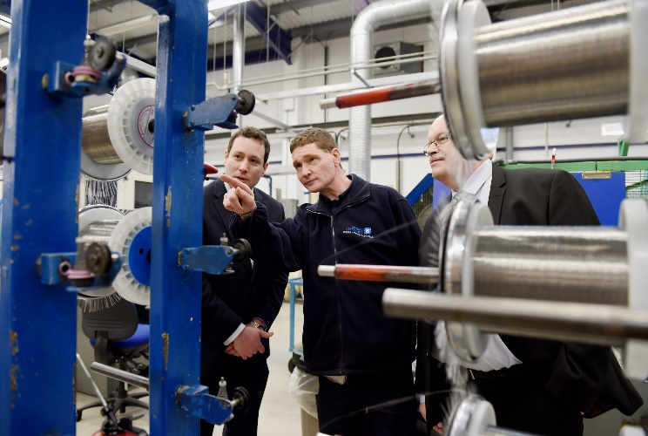
Apprenticeship Information Session

Slide 2
Agenda
About us
Your resources
How you will be supported
End Point Assessment (EPA)
Q&A

Slide 3
Introduction to Skills Training UK
Leading provider partner delivering apprenticeships in:
NHS
Quality Improvement
Digital Industries
Engineering and Manufacturing
Local/Regional Government
Local Education Authorities
Notes:
- Leading national training company
- Co-design and deliver large-scale bespoke apprenticeships programmes
- Understand business needs and work with employers to design and deliver apprenticeships which are relevant to what they want to achieve
WINNER: Tes ‘Apprenticeship Programme of the Year’ at Tes FE Awards 2020 for NDT
WINNER: Tes FE AWARDS 2019 “Training Provider of the Year”

Slide 4
Apprenticeships and you
Benefits of completing an apprenticeship Standard:
Build on your existing knowledge, skills and behaviours
Learn new concepts, models and theories to be a more effective
Achieve a nationally recognised qualification, transferable across sectors
Personal satisfaction of completing your qualification(s)
Promotes potential career progression

Slide 5
Your Apprenticeship
The Standard
Associate Project Manager Level 4 (18 months)
Improvement Technician Level 3 (14 months)
Improvement Practitioner Level 4 (14 months)
Functional Skills
Maths L2
English L2
Notes:
Your apprenticeship consists of 2 main components the standard and functional skills

Slide 6
Mentoring
You must be supported by a mentor/manager to help and support your learning of procedures and policies within your work environment
Mentors should possess a real interest in your development and learning
They help by giving advice through the benefit of their experience
They support your development of skills by creating opportunities, which will feed into your off-the-job training
This is a crucial role to support and encourage your development

Slide 7
Regularly Occurring Activities
Scheduled monthly training session
Update your OneFile learning journal every month
3-way progress review every 12 weeks
Notes:
Training sessions will be scheduled in advance, giving you the opportunity to plan ahead. If you are unable to attend a planned training session, you can either identify and attend that session on the wider remote delivery schedule, which your trainer will provide you with, or you can view the relevant video in the ‘course’ materials on OneFile. Whatever format you use, you must update your OneFile learning journal to reflect on what you learnt, which we’ll look at in the next section.
Progress reviews will be planned in advance on OneFile and will take place every 12 weeks, involving you, your manager/mentor and your trainer. This is a great opportunity to share your successes and challenges and to ensure all parties are on the same page with regards to your progress towards gateway. Gateway being the 12 or 30 month mark at which point you should have completed all the work for your apprenticeship required up to that point, (as for ODM you’ll then be required to work on your project) and your manager confirms that you are capable in your role, that you’ve completed all the work required for your apprenticeship and you can now proceed to your EPA to determine your final grade.

Slide 8
The Standard
Knowledge
Skills
Behaviours
Through attending the monthly training sessions you will acquire new knowledge and build on existing knowledge, which you will demonstrate through your case studies and other skills-based evidence
By applying the knowledge gained in your work, you will be able to demonstrate your skills/competencies via written case study, observations, discussion and witness testimony. This evidence will form your portfolio
Your portfolio of evidence will also showcase your behaviours, especially around contact with
others, team work and areas where you have exceeded the requirements of the role
Notes:
Both apprenticeships have been designed to provide access to development opportunities for as wide a range of individuals as possible. This includes individuals who are at the start of their career in leadership and management and who wish to take their first steps into professional management. It is also appropriate for those already in management roles who may already have developed practical experience, but who wish to develop their theoretical understanding of management skills.

Slide 9
Off-the-job Training

Slide 10
Delivery Model
Notes:
This example of a delivery model shows the monthly activities and reoccurring activities, such as 3 way progress reviews.

Slide 11
Technology and Systems
STUK utilise the following software solutions for all apprenticeship programmes:
OneFile – Market leading e-portfolio / virtual-learning environment; utilising live webinars, pre recorded presentations and learner resource libraries.
BKSB – Used by 85% of FE Colleges and Schools; delivers English and Maths Training from Entry to GCSE level.

Slide 12
Online portfolio - OneFile
We use an online portfolio system called OneFile that will be used to store, document, track and record evidence of your learning
It will record your progress and achievements all in one place
You can also use this facility to upload your evidence and ask your Trainer any questions that you might have
Notes:
Explain OneFile system and benefits. E-portfolio, tracking performance for both learner and line manager. If learners attend all online sessions and on site visits then progress should be consistent

Slide 13
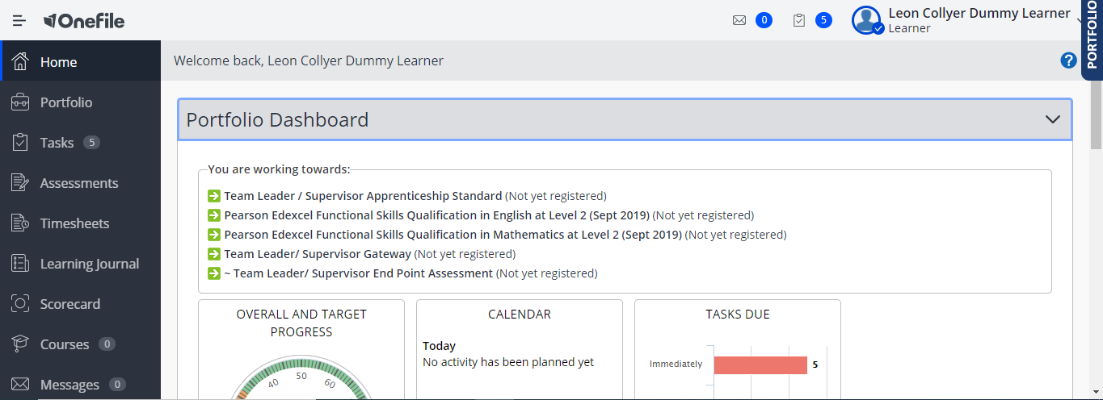

Slide 14
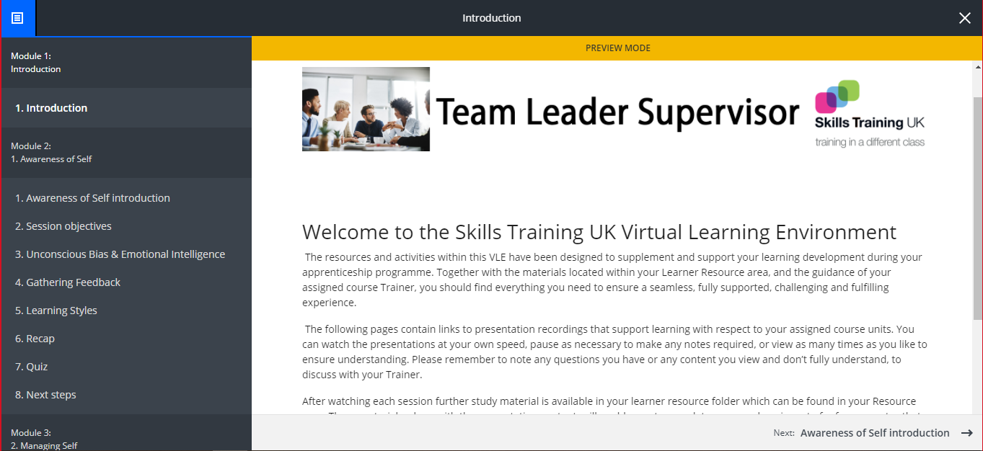
Notes:
Courses

Slide 15
Associate Project Manager Level 4
Applicable to anybody who manages projects
You will need to be in a position to get involved with real work based projects through to completion
Experience in the project management competence elements is not compulsory; but it is an advantage if you already have some project management knowledge or experience.
This apprenticeship will typically take up to 18 months

Slide 16
APM Knowledge Self-study Guide
APM, the Chartered body for the project profession, has created the APM KNOWLEDGE self study guide to help you Pass the APMP
At its core are 12 sections that include:
a clearly defined set of learning objectives;
a developing work-based exercise, designed to bring the theory to life;
a number of quick quizzes and sample exam questions.
The study guide also includes exam tips and a glossary of terms

Slide 17
APM Project Management Qualification Project Planned Schedule Months 1-5
Month 1 | Month 2 | Month 3 | Month 4 | Month 5
OneFile Navigation, Journal records, TLAP definitions, Tasks, Assignments, Product evidence including evidence matrix Review of self-study workbook and body of knowledge reference book overview detailing application to support program | 2.1.1 Project environment 2.1.2 Project, programme and portfolio management Session to determine self study options on session 2 Project environment/Programmes/Portfolio including how to log and record evidence | 2.1.3 Organisational structures 2.1.4 Project roles Session to confirm self study session 3 Organisational structures and project roles . Examination format questioning and development PROGRESS REVIEW | 2.1.5 Business case 2.1.6 Project life cycles Session to embed self study session 4 Project Life cycles, Organisations and governance. Examination format questioning and development | 2.1.7 Stakeholder engagement 2.2.1 Project management plan Session to introduce self study section 5 Stakeholder engagement and Project management planning Examination format questioning and development

Slide 18
Knowledge, Skills and Behaviour
Project governance -Different types of organisational structures and responsibilities and functions. Project monitoring and reporting cycle to track, assess and interpret performance. MoSCoW evaluation tool
Project stakeholder management - Stakeholders: their perspectives, different interests and levels of influence upon project outcomes. RACI matrix used for clarifying and defining roles and lines of communication in a project
Consolidated planning - Purpose and formats for consolidated plans to support overall management, taking account of lessons learnt and how the plans balance fundamental components of scope, schedule, resources, budgets, risks and quality requirements.

Slide 19
Knowledge, Skills and Behaviour
Project scope - Requirements management, and evaluation of alternative methods to learn from the past to improve delivery. Project scope change control, baseline change management, configuration management.
Project schedule - Scheduling and estimating for project activities including how they can be quality assessed.
Resource management - Resource analysis, resource allocation and resource acceptance.
Project risk and issue management - The need for and implementation of a risk management plan. Risk management methods and techniques to identify and prioritise threats or opportunities.

Slide 20
Knowledge, Skills and Behaviour
Budgeting and cost control - Develop and agree project budgets, monitor forecast and actual costs against them and control changes.
Collaboration and team work - Understand and be effective as part of an integrated team.
Leadership - Communicates direction, support the vision for project delivery.
Effective and appropriate communication - Working effectively with and influencing others, taking into account diversity and equality. Influence and facilitate effective team performance.
Drive for results - Demonstrate clear commitment to achieving results, and improving performance.

Slide 21
APM End Point Assessment
Around 15 months, you approach the Gateway
Pass at the PMQ Exam
Submission of Portfolio of evidence
Your Trainer will support you in preparing for your EPA by running mocks and helping you prepare your Presentation supported by portfolio of evidence and Professional Discussion supported by your portfolio of evidence.
You can achieve a Pass, Merit or Distinction

Slide 22
Improvement Technician L3
Improvement Technicians are responsible for delivery and coaching of improvement activity within an area of responsibility
Improvement Practitioners use a blend of Lean Six Sigma, project and change management tools and principles to identify and lead the delivery of change across organisational functions and processes
If you strive to deliver operational excellence and maximise performance
All Improvement apprenticeship programmes come with the opportunity to achieve Lean Six Sigma belted accreditation after successful completion of the End Point Assessment process.
This apprenticeship will typically take around 14 months to complete

Slide 23
Why Organisations Need Continuous Improvement
Increased consistency of service provision
Solving problems quickly, efficiently and with minimal customer impact
Increasing Profit by minimising and removing waste caused by error
Plus more hidden benefits;
Improved Customer Loyalty
Time Management / Man Hour Costs
Reduced Cycle & Service Delivery Times
Strategic Planning
Consistency of Supply Chain / Service Delivery Management

Slide 24
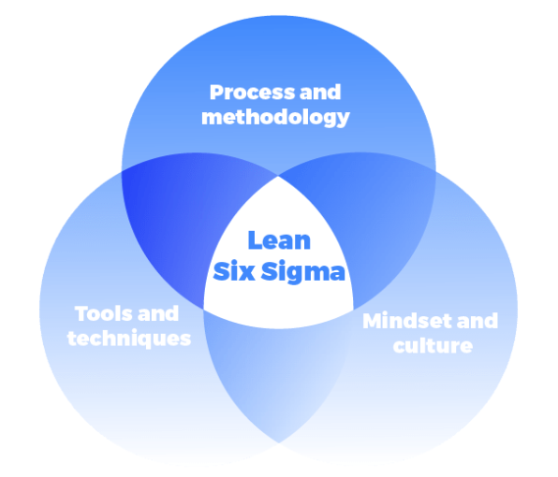
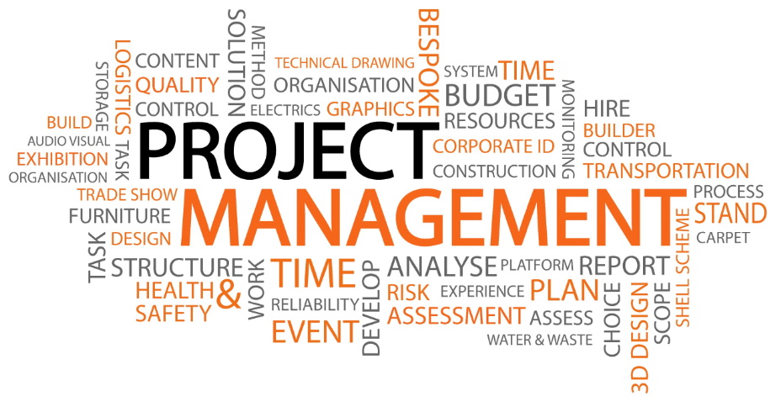
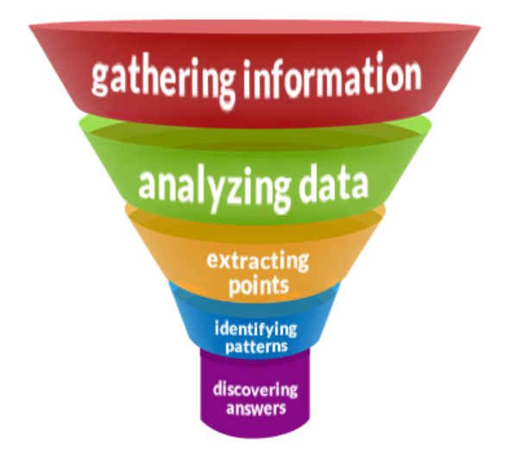
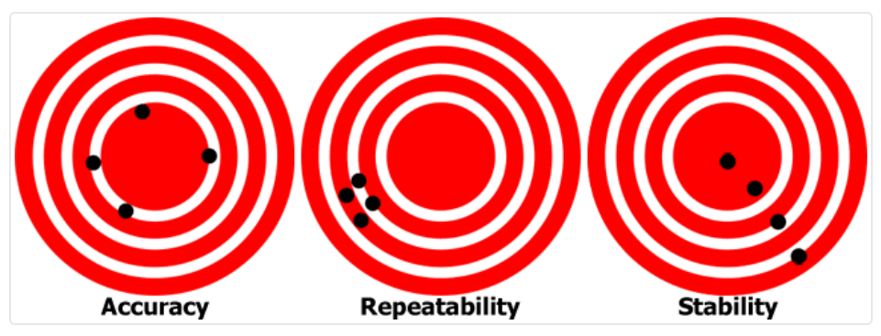
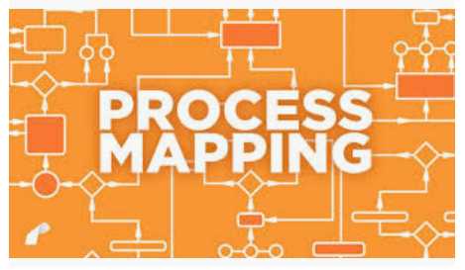
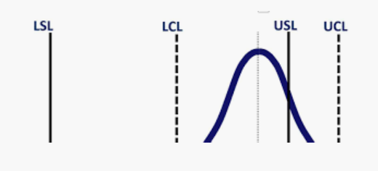
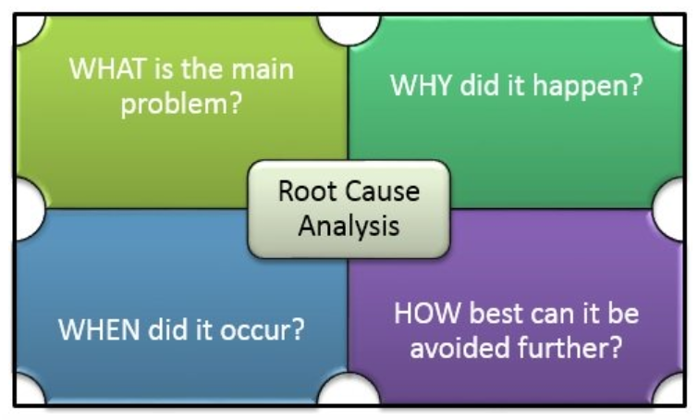
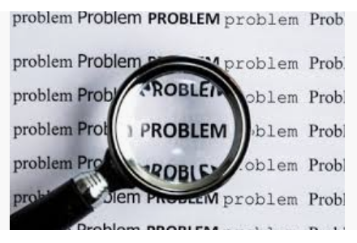
Improvement Technician L3 & Practitioner L4 Course Contents
Compliance
Team Formation & Leadership
Project Management
Presentation & Reporting
Change Management
Principles & Methods
Project Selection & Scope
Problem Definition
Process Mapping & Analysis
Data Analysis
Measurement Systems
Basic Statistics & Measures
Data Analysis, Statistical Methods
Level 4 includes the same topics as Level 3, but builds in extra content & management tools such as Statistical Process Control, Managing Project Teams, and Control Planning.
Process Capability & Performance
Root Cause Analysis
Experimentation
Identification & Prioritisation

Slide 25
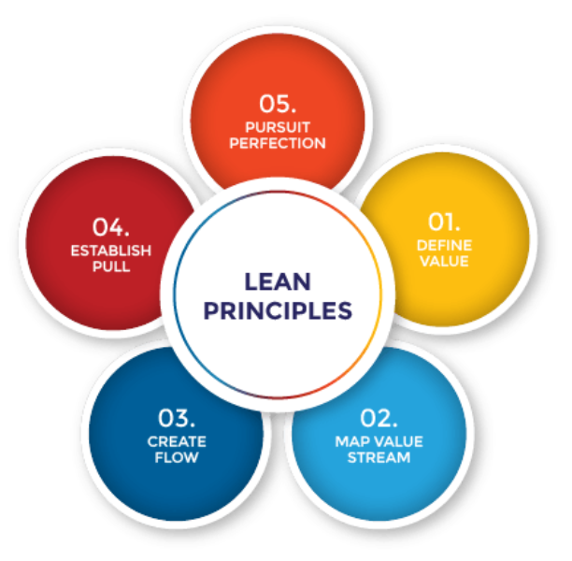
What is Lean?
The Lean approach is an ongoing effort to improve products, services, or processes, which require incremental improvement over time in order to increase efficiency and quality.

Slide 26
Lean & Six Sigma
Lean
Tools
Value Stream Maps
Physical Maps
Lead Times
Takt Time
Cycle Time
Load Levelling
JIT
Single Piece Flow
SMED
5S Improvement
Lean practices focus on reducing waste within a process. This could be in the form of time, resources or duplication of work.
Six Sigma looks to identify and address variation in processes. By aligning what is actually happening with what should be happening, greater efficiencies are achieved.
Define Value
Value Stream
Create Flow
Create Pull
Pursue
Perfection
Improved
Effectiveness
Common Tools
VOC
QFD
FMEA
Project Charter
Cost Benefit
Communication Skills
Data Collection
Metrics
Brain Storming
Pareto
Cause & Effect
5 Whys
Mistake Proofing
Visual Controls Testing
Brainstorm
SPC
Balanced Scorecard
Standard Work
Control Charts
Define
Measure
Analyse
Improve
Control
Reduced Variability
Six Sigma
Tools
Basic Statistics
Sigma Level
Process Capability
Sampling
Correlation
Multi-Variant
Regression
Hypothesis Testing
DOE
To achieve organisational success every colleague MUST contribute

Slide 27
Improvement Technician L3/L4 End Point Assessment
40 question multiple choice exam lasting 40 minutes.
Project portfolio of evidence demonstrating the practical application of course knowledge, skills and behaviours.
The portfolio of evidence will form the basis or a 30 to 40 minutes presentation, followed by a 25 to 35 minutes Q&A session.
30 to 40 minutes professional discussion for Level 3
50 to 60 minutes professional discussion for Level 4

Slide 28
End Point Assessment
Comprehensive coaching and preparation at every level
Use of our Subject Matter Specialists
Will only be taken when you, your trainer, and your line manager are confident of success
Reference materials and notes produced during programme can be taken into the End Point Assessment process for reference
Projects produced through programme participation add real organisational value and are not just theoretical
Pass, Merit, or Distinction grades can be achieved dependent upon standard of work and assignments produced
Everything we do is aimed at achieving Distinction Status
Regular 12 weekly reviews and our mock gateway approach to EPA means no surprises

