Slide 1
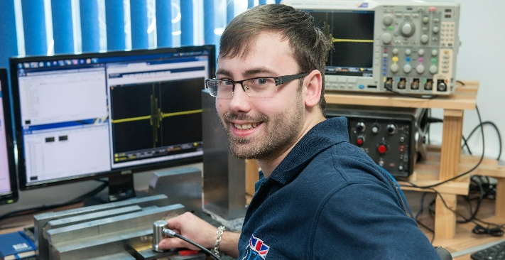
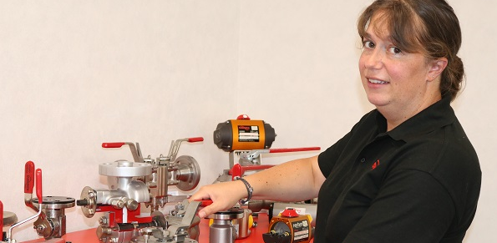
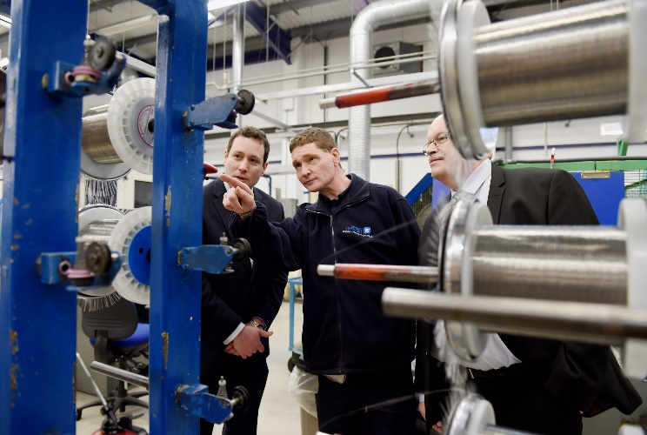
Facilities Services Operative Level 2

Slide 2
Agenda
About us
Your resources
How you will be supported
End Point Assessment (EPA)
Q&A

Slide 3
Introduction to Skills Training UK
Leading provider partner delivering apprenticeships in:
NHS
Quality Improvement
Digital Industries
Engineering and Manufacturing
Local/Regional Government
Local Education Authorities
Notes:
- Leading national training company
- Co-design and deliver large-scale bespoke apprenticeships programmes
- Understand business needs and work with employers to design and deliver apprenticeships which are relevant to what they want to achieve
WINNER: Tes ‘Apprenticeship Programme of the Year’ at Tes FE Awards 2020 for NDT
WINNER: Tes FE AWARDS 2019 “Training Provider of the Year”

Slide 4
Who are Skills Training UK
WINNER: TES FE AWARDS 2019 “Training Provider of the Year”
WINNER: AAC Awards Outstanding Contribution to the Development of Apprenticeships Award
FINALIST: Education Investor Awards 2018 “Skills Provider of the Year”
FINALIST: SEMTA 2019 “Training Partner of the Year”
WINNER: TES FE AWARDS 2020 “Apprenticeship Programme of the Year”
WINNER: Apprentice of the Year 2021
WINNER: Scientific Apprenticeship Programme of the Year 2021
Over 30 years of experience as a market leading CPD training provider

Slide 5
What is an Apprenticeship?
You can start an Apprenticeship whether you’re starting your career, changing position, or you're upskilling in your current job
An Apprenticeship combines hands-on work with the opportunity to train and obtain qualifications. 20% of the time is spent studying and applying new knowledge in the workplace
Training will be provided by STUK
The rest of the time is spent applying new knowledge and skills in the actual workplace. At the end of it, official certification is gained, which will be equivalent to traditional qualification

Slide 6
Your Apprenticeship
The Standard
Facilities Services Operative Level 2 (13 months)
Functional Skills
Must achieve level 1 English and mathematics and take the tests for level 2 prior to taking their EPA
Notes:
Your apprenticeship consists of 2 main components the standard and functional skills

Slide 7
Mentoring
You must be supported by a mentor/manager to help and support your learning of procedures and policies within your work environment
Mentors should possess a real interest in your development and learning
They help by giving advice through the benefit of their experience
They support your development of skills by creating opportunities, which will feed into your off-the-job training
This is a crucial role to support and encourage your development

Slide 8
Regularly Occurring Activities
Scheduled monthly training session
Update your OneFile learning journal every month
3-way progress review every 12 weeks
Notes:
Training sessions will be scheduled in advance, giving you the opportunity to plan ahead. If you are unable to attend a planned training session, you can either identify and attend that session on the wider remote delivery schedule, which your trainer will provide you with, or you can view the relevant video in the ‘course’ materials on OneFile. Whatever format you use, you must update your OneFile learning journal to reflect on what you learnt, which we’ll look at in the next section.
Progress reviews will be planned in advance on OneFile and will take place every 12 weeks, involving you, your manager/mentor and your trainer. This is a great opportunity to share your successes and challenges and to ensure all parties are on the same page with regards to your progress towards gateway. Gateway being the 12 or 30 month mark at which point you should have completed all the work for your apprenticeship required up to that point, (as for ODM you’ll then be required to work on your project) and your manager confirms that you are capable in your role, that you’ve completed all the work required for your apprenticeship and you can now proceed to your EPA to determine your final grade.

Slide 9
How your qualification is made up
Skills
Behaviours
Knowledge
Knowledge ( Supported by assignment writing)
Information, technical knowledge, and ‘know-how’ that the you need to have and to understand in order to successfully carry out your duties
Skills ( Supported by work based demonstration)
Practical application of knowledge needed to successfully undertake your duties that make up your role.
Learnt through on/off-the-job training or experience
Behaviours ( Supported by work-based witness testimony)
Mind-sets, attitudes or approaches required for competence, generally across your job role.
Behaviours tend to be very transferable

Slide 10
Off-the-job Training

Slide 11
Delivery Model
Notes:
This example of a delivery model shows the monthly activities and reoccurring activities, such as 3 way progress reviews.

Slide 12
Technology and Systems
STUK utilise the following software solutions for all apprenticeship programmes:
OneFile – Market leading e-portfolio / virtual-learning environment; utilising live webinars, pre recorded presentations and learner resource libraries.
BKSB – Used by 85% of FE Colleges and Schools; delivers English and Maths Training from Entry to GCSE level.

Slide 13
Online portfolio - OneFile
We use an online portfolio system called OneFile that will be used to store, document, track and record evidence of your learning
It will record your progress and achievements all in one place
You can also use this facility to upload your evidence and ask your Trainer any questions that you might have
Notes:
Explain OneFile system and benefits. E-portfolio, tracking performance for both learner and line manager. If learners attend all online sessions and on site visits then progress should be consistent

Slide 14
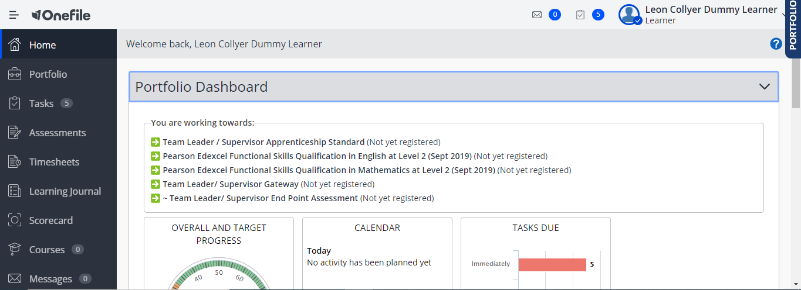

Slide 15
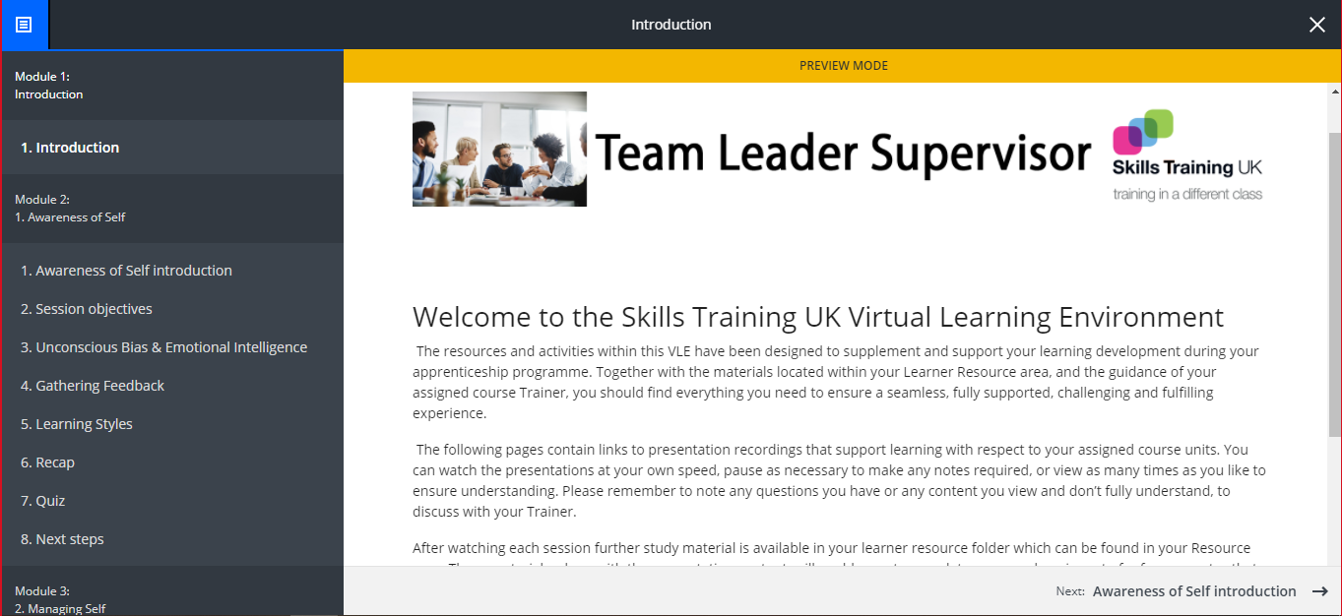
Notes:
Courses

Slide 16
End Point Assessment
The EPA consists of 3 discrete assessment methods.
The individual assessment methods will have the following grades:
Assessment method 1: Knowledge Test
· Pass · Fail
Assessment method 2: Observation
· Pass · Merit · Fail
Assessment method 3: Professional Discussion
· Pass · Merit · Fail

Slide 17
End Point Assessment
Knowledge Test
It will consist of 20 multiple-choice questions with pass rate (75%)
Apprentices must have a maximum of 40 minutes to complete the test.
Observation
Workplace observation that will take 2 hours and follow up Q&A (max 3-5 questions)
Professional Discussion
60 minutes with minimum of 6 open questions to ensure that apprentices’ skills, knowledge and behaviours are demonstrated. The

Slide 18
Observation
To achieve a pass grade apprentices must meet all the following criteria:
comply with relevant health, safety and environmental legislation, as well as other legislation relevant to the workplace, e.g. GDPR
follow organizational procedures
exceed customer expectations, e.g. gains positive feedback that an issue was resolved quicker than expected or a problem resolved to a high standard
respond to customers’ queries and incidents in accordance with SOPs in collaboration with others
Manage the repairs and maintenance of equipment to ensure correct functioning of services in accordance with SOPs
carry out inspections to ensure the correct functioning of buildings and plant equipment in accordance with SOPs

Slide 19
Professional Discussion
To achieve a pass grade apprentices must meet all the following criteria:
comply with relevant health, safety and environmental legislation, as well as other legislation relevant to the workplace, e.g. GDPR
follow organizational procedures
exceed customer expectations, e.g. gains positive feedback that an issue was resolved quicker than expected or a problem resolved to a high standard
respond to customers’ queries and incidents in accordance with SOPs in collaboration with others
Manage the repairs and maintenance of equipment to ensure correct functioning of services in accordance with SOPs
carry out inspections to ensure the correct functioning of buildings and plant equipment in accordance with SOPs

