Slide 1
Infection, prevention and control

Slide 2
Infection, prevention and control
Chapter 2: infection, prevention and control
Chapter 2: infection prevention and control - GOV.UK (www.gov.uk)
Schools COVID-19 operational guidance
Schools COVID-19 operational guidance (publishing.service.gov.uk)
Living safely with respiratory infections, including COVID-19
Living safely with respiratory infections, including COVID-19 - GOV.UK (www.gov.uk)

Slide 3
IPC
Hand hygiene
Respiratory and cough hygiene
Staying away when ill
Ventilation
Cleaning

Slide 4
Hand hygiene
Hand washing is one of the most important ways of controlling the spread of infections, especially those that cause diarrhoea and/or vomiting and respiratory infections.
As often as possible for at least 20 seconds:
Using soap and warm water
Alcohol gel otherwise (allow to dry)
Definitely
- After coughing/sneezing
- Before food preparation
- After toileting
Correct technique is essential
- Includes wrists and forearms
Recommend that hand hygiene posters are displayed for staff and pupils, acting as a guide and a prompt

Slide 5
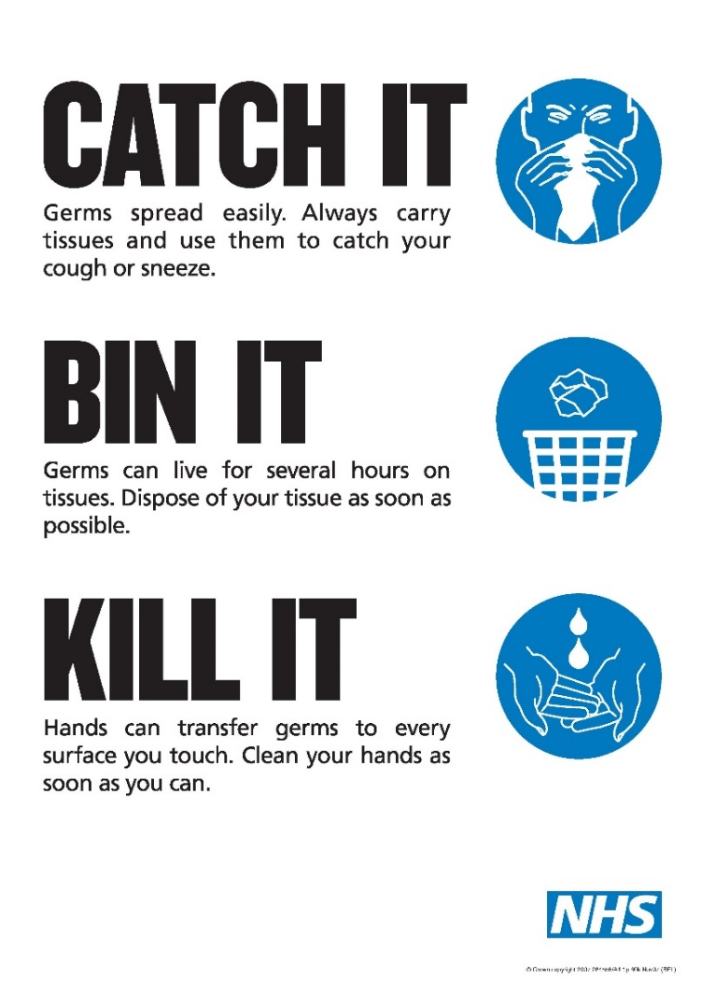
Respiratory and cough hygiene

Slide 6
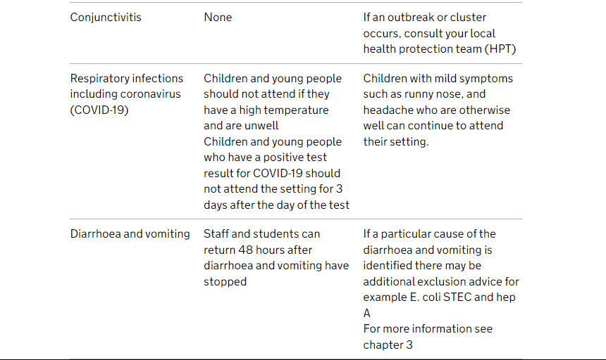
Staying away when ill
Ensure that any children and young people who have a high temperature and are unwell do not attend the education or childcare setting until they no longer have a high temperature and are well enough to attend.
Chapter 3: public health management of specific infectious diseases - GOV.UK (www.gov.uk)
Exclusion table - GOV.UK (www.gov.uk)
e-Bug | England Home

Slide 7
Ventilation
Research shows that being in a room with fresh air can reduce your risk of infection from particles by over 70%, as fresh air dilutes the particles.
Opening windows and doors
Open windows for short, sharp bursts of 10 to 15 minutes regularly throughout the day
Leave windows open a small amount continuously
Ventilation of indoor spaces to stop the spread of coronavirus (COVID-19) - GOV.UK (www.gov.uk)
New film shows importance of ventilation to reduce spread of COVID-19 - GOV.UK (www.gov.uk)

Slide 8
Cleaning
Cleaning with detergent and water is normally all that is needed as it removes the majority of germs that can cause disease
Clean regularly (especially high touch points, toilet flushes, hand rails, door handles)
Cleaning equipment used should be disposable or, if reusable, disinfected after each use.
Consideration should be given to situations where additional cleaning will be required including during term time (for example in the event of an outbreak) and how the setting might carry this out.
A nominated member of staff should monitor cleaning standards and discuss any issues with cleaning staff, or contractors employed by the education or childcare setting.

Slide 9
Increase in cases? – to consider (for all infectious diseases)
Increasing cleaning – classrooms, lunch halls, toilets flushes, taps, door handles, high touch points
Risk assess open days, visits, performances, other group activities
Social distancing – reduce numbers in ‘pinch points’, online staff meetings, reducing numbers in assemblies and other spaces
Face mask - not required, could be advised by the Local Authority Public Health Director
PPE - Most staff in schools will not require PPE beyond what they would normally need for their work
Isolation – not legally required (but if have test positive recommended 3 days pupils, 5 days adults)
Contract tracing – not required
Testing – not required

