Slide 1
D&V Outbreak Management Early Years Settings
Dr Maha Saeed
Consultant Health Protection

Slide 2
Webinar Tips
Keep yourself on mute at all times unless contributing to the discussion
Utilise the chat function which will be monitored
Please use the ‘hands up’ function to contribute to the discussion
We will be recording this session.

Slide 3
You will learn …..
What is D&V Causes
Duty of Care - Planning
Duty of Care - Outbreak
What’s an Outbreak of D&V?
Infection Control Measures
Cleaning of a Spillage

Slide 4
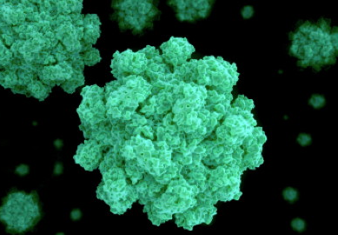
Vomiting & Diarrhoea
Diarrhoea and/or Vomiting (D&V) can be caused by infectious or non-infectious agents; however, all cases of gastroenteritis or D&V should be regarded as infectious unless good evidence suggests otherwise.
Norovirus (also called stomach flu or winter vomiting disease) is probably the most common cause of D&V outbreaks and therefore will be discussed in more detail in this presentation.

Slide 5
What is Norovirus?
A group of viruses with many strains;
Extremely contagious;
Spread through person-to-person contact with an infected person or by touching infected surfaces such as door, toilet and toys etc.
Norovirus can survive on surfaces for up to two weeks.
Excretion of virus in faeces begins a few hours before the onset of symptoms and can continue for up to 7-10 days with maximum shedding occurring 24-72 hours after exposure.
An individual must stay away from setting 48 hours free of V&D and is well enough to return to setting.

Slide 6
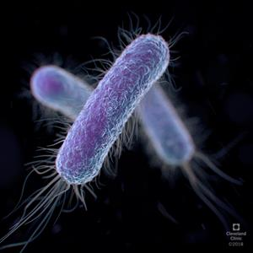
What is Escherichia coli O157:H7- STEC?
Young children are most likely to be infected and become seriously ill, and transmit to others
About 5 to 10% of people with STEC infection develop a potentially life-threatening complication known as haemolytic uremic syndrome (HUS).
Cause diarrhoea (often bloody), and vomiting
Lead to hospital admission
Shedding of STEC in young children can be prolonged – can be anything up to 5-6 weeks in very cases
Cases and contacts require potting
Notes:
STEC = Shiga toxin producing E.coli
HUS = haemolytic uraemic syndrome
STEC O26 have more than doubled from 48 to 104 per annum, whilst STEC O157 has fallen by 31% from 532 to 365 in England
a strain replacement event occurring in the animal reservoir

Slide 7
Duty of Care- Planning
The Headteacher/Manager is responsible for ensuring the following:
Planning checklist for norovirus season using the actions to prepare for norovirus season.
Comprehensive cleaning contract include daily, weekly and periodic cleaning schedules, based on national guidance.
All staff are aware and comply
IPC measures in place- effective hand hygiene, enhanced cleaning and prompt exclusion of cases to minimise onward transmission.
Spillage Kit - ensuring that adequate supplies of equipment, particularly consumables (for example – gloves, paper hand towels, liquid soap) are provided for all staff and children.

Slide 8
Planning checklist for norovirus season
Actions to prepare for norovirus season
Infection control precautions
Reporting to the local health protection team
Diarrhoea and/or vomiting outbreak control measures

Slide 9
Duty of Care- during an outbreak
Prompt notification of cases to HPT/LA
High standards of record-keeping.
Excluded/isolated until 48 hours after normal bowel habits have returned and any vomiting has stopped – the ‘48-hour rule’.
Communication- all staff, parents and visitors to the childcare setting should be advised about the outbreak
Cleaning and disinfection
Declare an outbreak over- 48 hours since the resolution of symptoms in the last known case AND AT LEAST 72 hours after the initial onset of symptoms in the last new case.
Deep/terminal cleaning after the outbreak.

Slide 10
What is an Outbreak?
Two or more cases with similar symptoms, or more cases than would normally be expected).
Is there anyone with blood in stools?
Has anyone affected been admitted to hospital or died?
Is there evidence of a symptomatic food handler or food source?
Were there any events or trips in the last few days/week prior to the start of the outbreak ?

Slide 11
End of an Outbreak
The end of an outbreak is defined as 48h after the resolution of vomiting and/or diarrhoea in the last known case and at least 72h after the initial onset of the last new case.
This is also the point at which terminal cleaning has been completed

Slide 12
Infection Prevention (IPC) Control Measures

Slide 13
IPC Measures
Hand Hygiene
Isolation & Exclusion
Cleaning
https://www.gov.uk/government/publications/health-protection-in-schools-and-other-childcare-facilities/chapter-6-cleaning-the-environment

Slide 14
Management of Body Fluids Spillage Guidance
20200520_COVID-19_Infection prevention ...ent blood body fluid spillages (1).pdf (publishing.service.gov.uk)

Slide 15
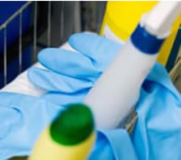
Guidance on Cleaning
Cordon the spillage off - clear staff and children from exposed area
Put on PPE— disposable gloves, mask and plastic apron to reduce your exposure to the virus.
Use disposable absorbent material to soak up visible vomit and/or stool.
Scrape up vomit and/or stool with suitable material.
Dispose of soiled items/waste/gloves in a plastic trash bag.
Clean the area using a product which combines detergent and disinfectant.

Slide 16
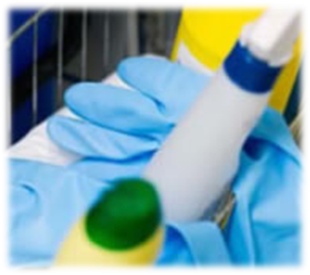
Guidance on Cleaning
Decontamination should include all exposed surfaces in an area within a 25 feet circle of vomit
Clear away any food, toys and other materials.
Isolate the contaminated area for two hours as norovirus particles can remain in the air for two hours after an incident.
Don't vacuum area before cleaning as this will cause pathogens to become airborne and spread.
https://www.gov.uk/government/publications/health-protection-in-schools-and-other-childcare-facilities/chapter-6-cleaning-the-environment

Slide 17
Personal Protective Equipment (PPE)
All staff should wear personal protective clothing when cleaning:
Disposable gloves
Disposable aprons
Goggles - If there is a risk of splashing
Staff must wash their hands with soap and water after removing PPE

Slide 18
Cleaning & Disinfecting
Miltons (safe to use around children )
Contains chlorine which can be made into a solution at:
1,000 parts per million (dilution of 1 in 20, e.g. 50 ml of Milton in 1 litre of water);
10,000 parts per million (dilution of 1 in 2, e.g. 100 ml of Milton in 200 ml of cold water) OR as manufacture guidance
Chlorine releasing granules
Clearwater a brad which make chlorine releasing granules.

Slide 19
Main Messages

Slide 20
Thank you!

