Slide 1
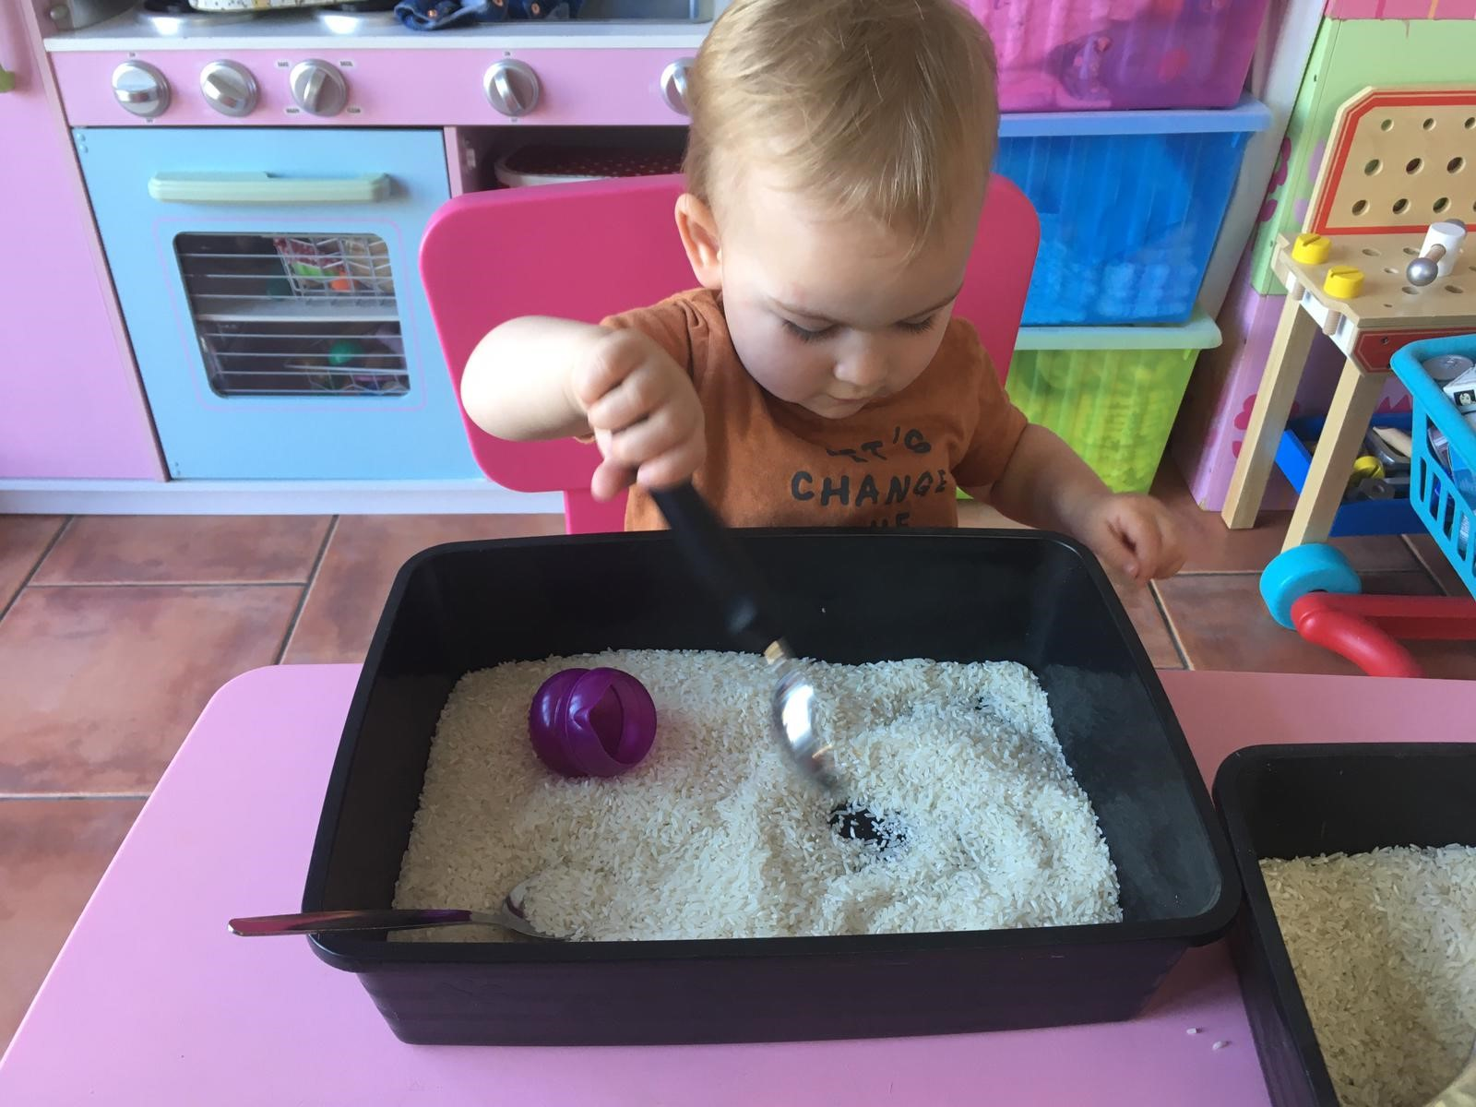
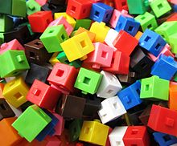
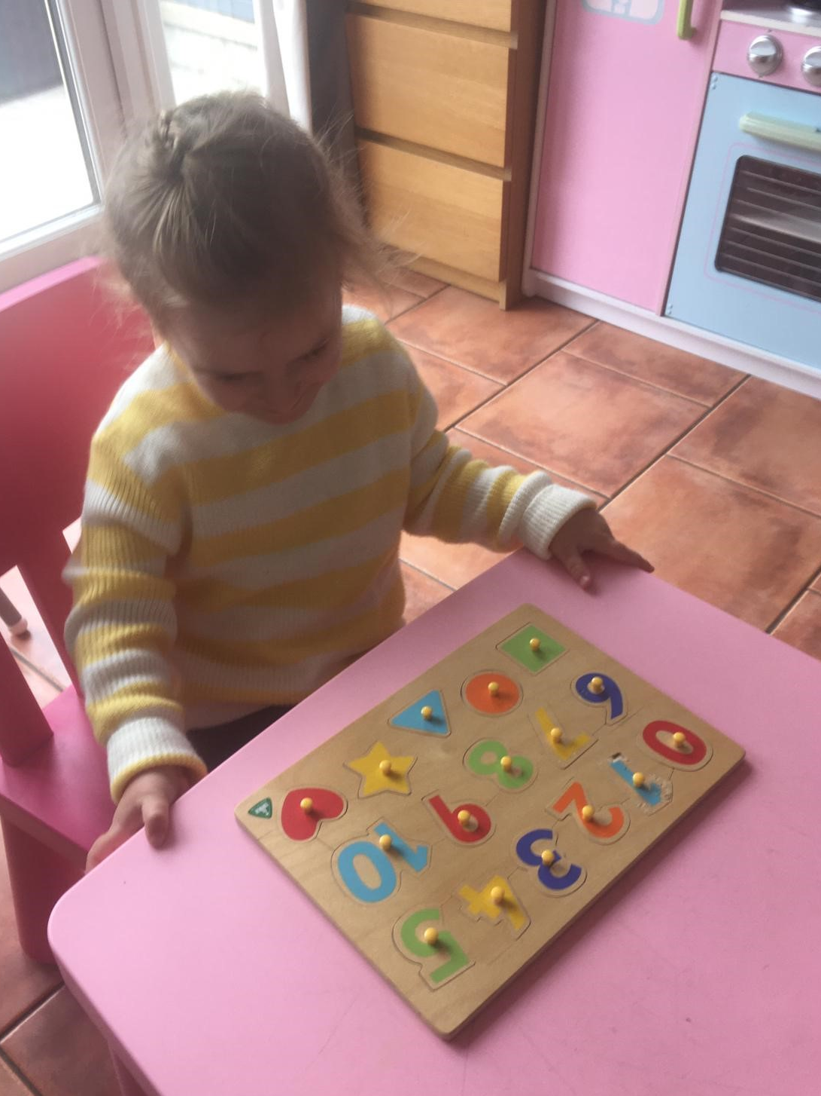
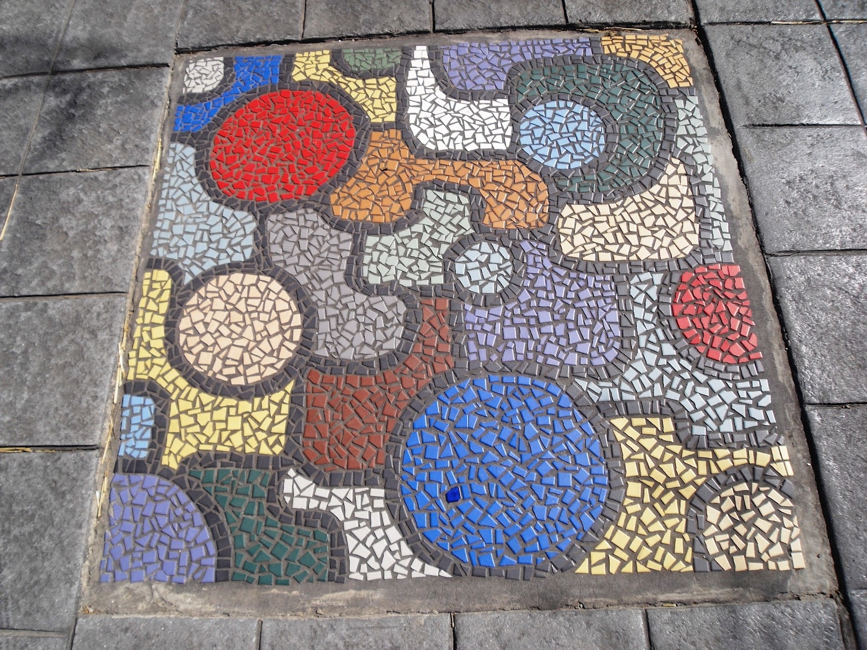
This week we are Counting, Finding Shapes and Measuring Together!
Counting, Finding Shapes and Measuring Together is about developing skills such as problem solving, understanding and using shapes and measures.
Monday
Measure with me Activity Card
Thumbs Up
Thursday
Friday
Making Patterns
Activity
Card
Share Day
Saturday
Wednesday
Shape Hunt
Activity
Card
Top Tips
Tuesday
Is your child starting school in September? Look out for our ‘Starting School Together Challenges’ throughout the week!
chitchatpitterpatLBWF
chit_chat_pitter_pat

Slide 2
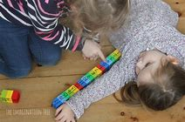
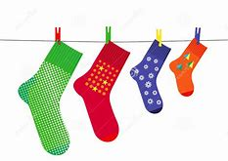
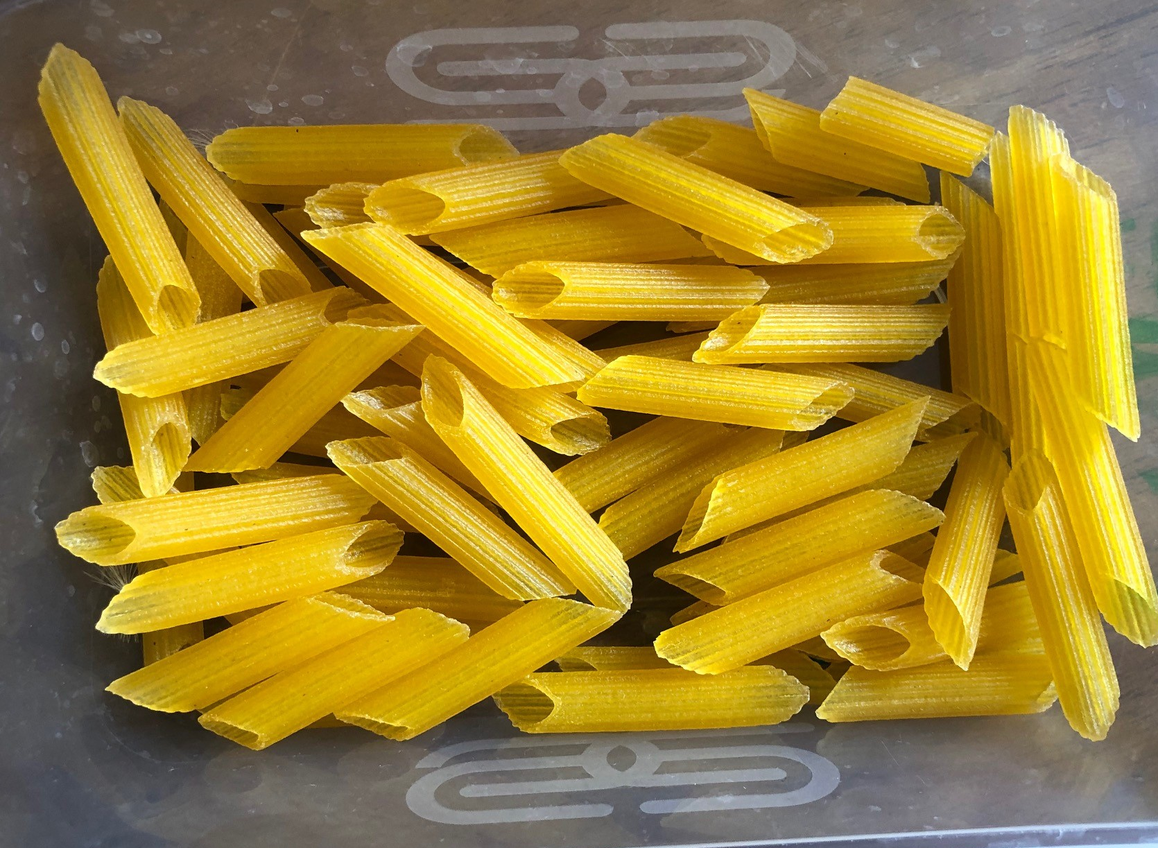
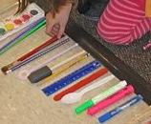
Did you know?
Talking and introducing new words to children is key in supporting and developing their and thinking! Eventually young children’s sense of measurement develops to include new skills. They build on their abilities to compare and learn to order 3 or more objects.
Counting and Measuring Together
Let’s Get Measuring!
We could draw around our hands and/or feet and measure things around the house and outside with them!
How you can help me…
Set up a washing line with me (between two chairs with string and pegs or with masking tape) help me to find items to count and order from smallest to biggest.
Let’s make a simple washing line and order objects from the smallest to the biggest! (E.g. teddy bears, socks, pants…)
*Starting School Together challenge* Can you put 3 or more objects in order from the smallest to the biggest?
What I like to do…
I like to explore and find items to order. I like to talk about which items are the biggest/ smallest. I like to learn new words (longer, shorter, taller, bigger, smaller, wider…)
chitchatpitterpatLBWF
chit_chat_pitter_pat

Slide 3
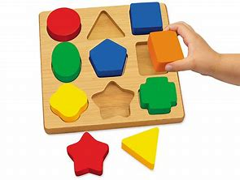
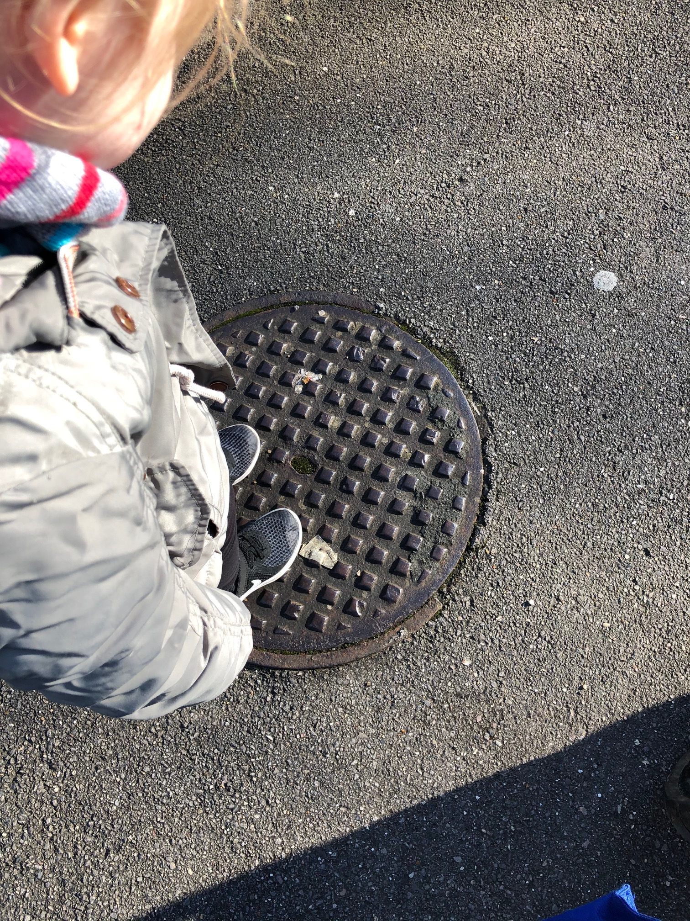
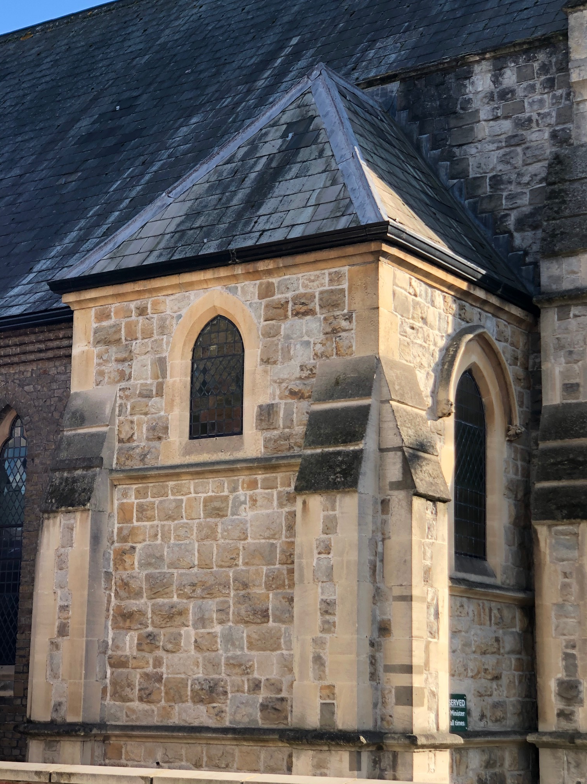
Did you know?
When Children attempt to place a puzzle piece in its place it will only fit if it is placed properly in the right space. The act of turning each piece and testing the fit, is the way children learn to problem solve and develop critical thinking.
Counting and Finding Shapes Together
Let’s Go on a Shape Hunt!
We could make a shape puzzle using cardboard. Or cut pictures into different shapes to put back together again!
How you can help me…
You can help me to use language to describe the different shapes and help me to spot new shapes.
.
We could go on a shape hunt inside or when out and about and take photos of different shapes that we see!
*Starting School Together challenge* Can you make a picture using
Cut out shapes. Can you name any of the shapes you have used?
What I like to do…
I love to go on shape hunts and find different shapes inside and outside! I like to learn the names of different shapes and count the number of sides they have!
chitchatpitterpatLBWF
chit_chat_pitter_pat

Slide 4
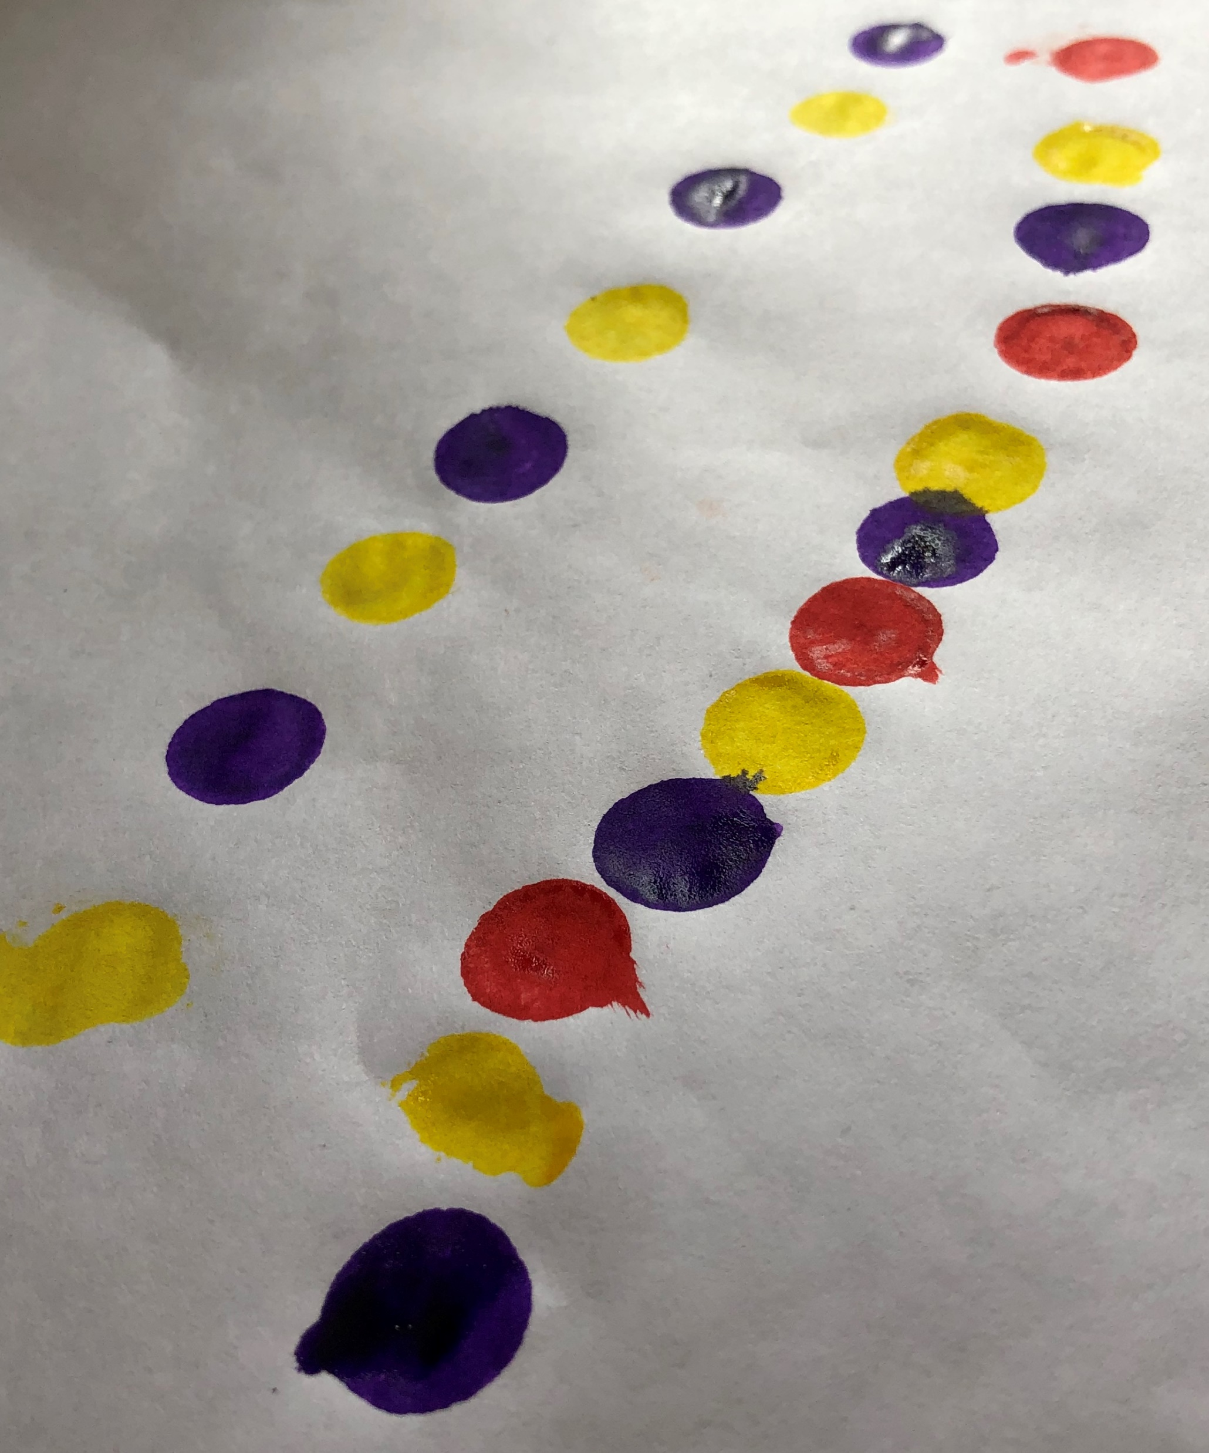
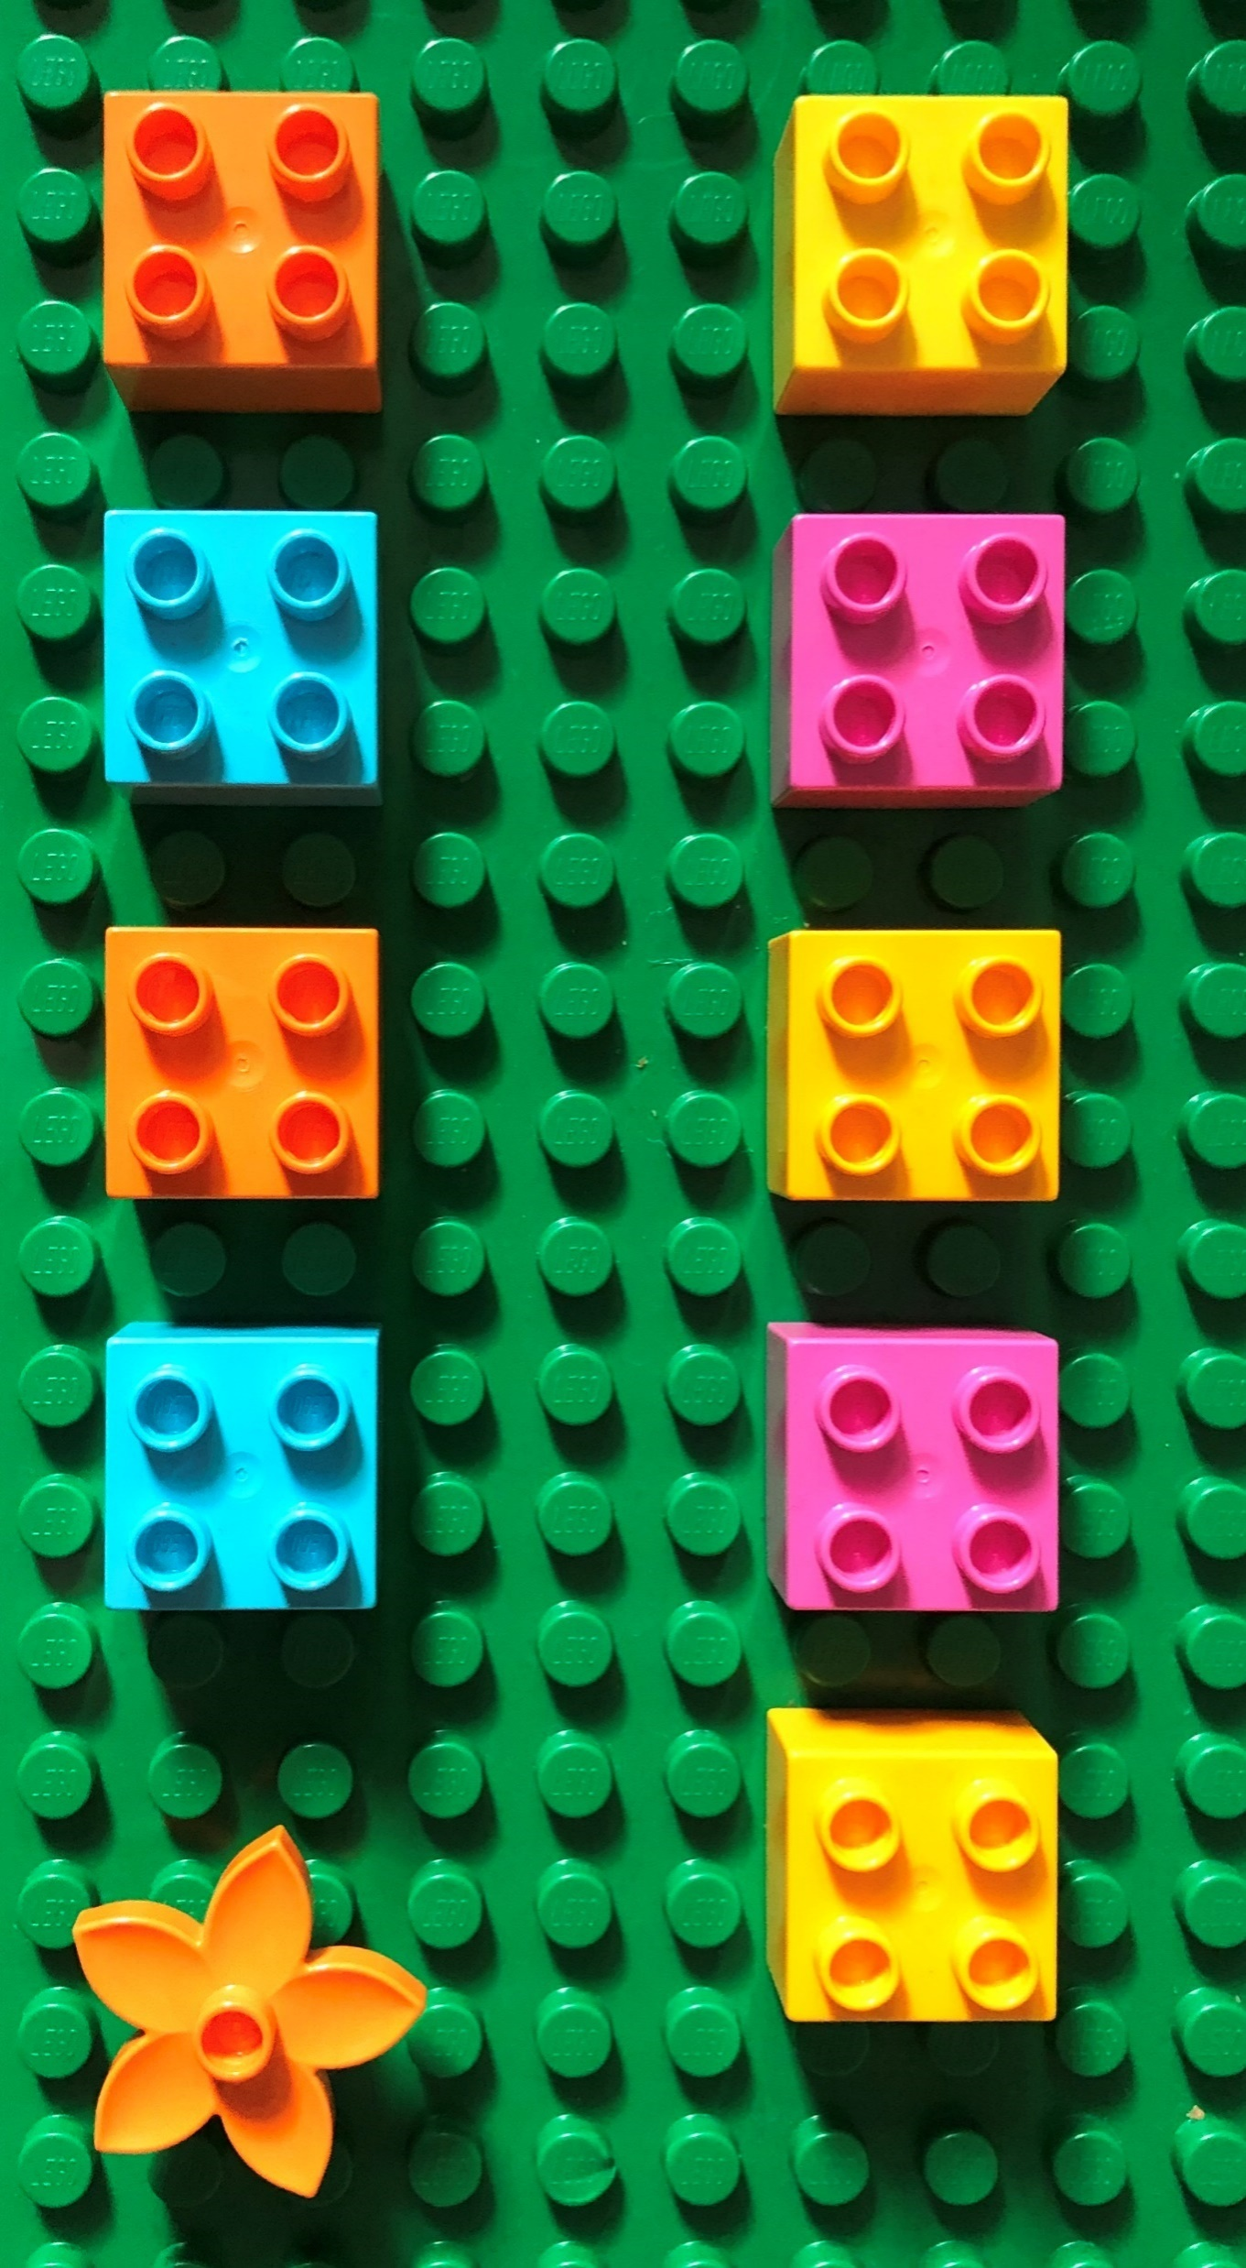
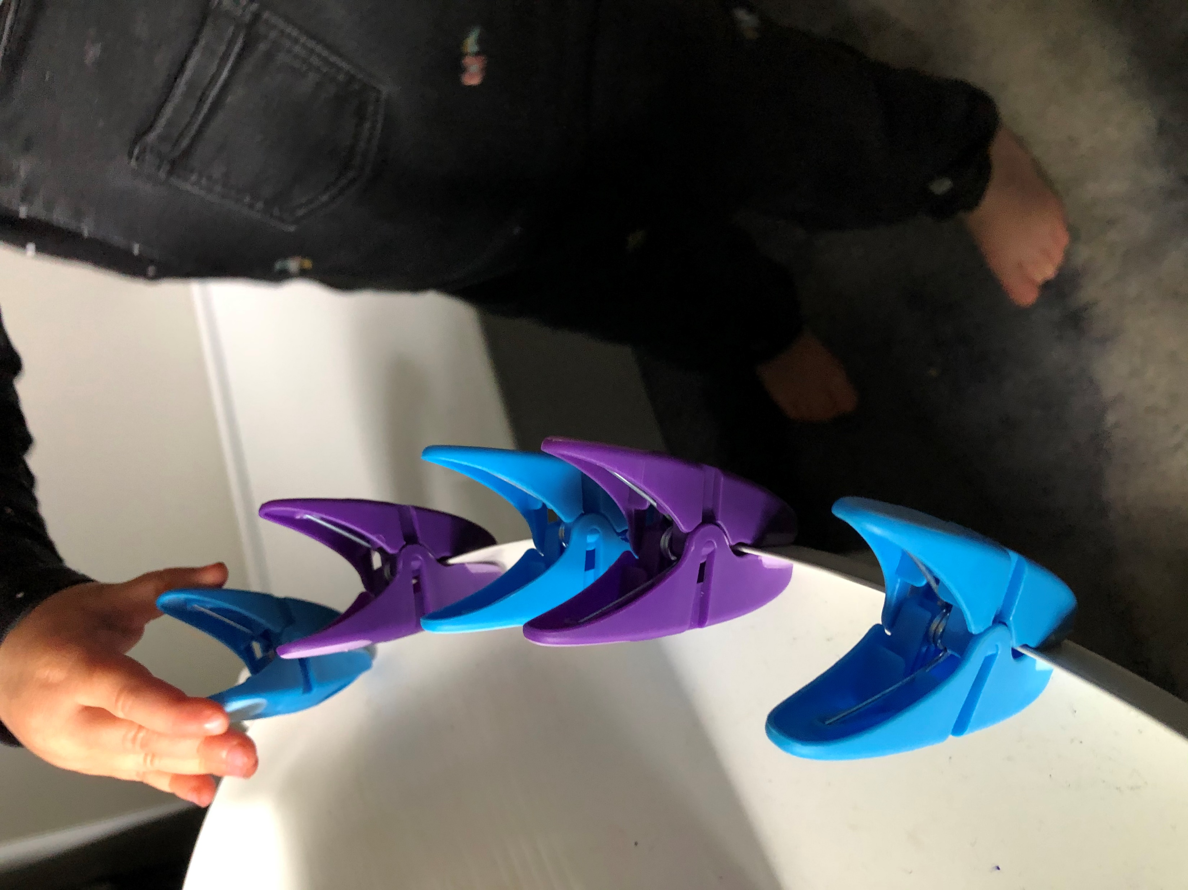
Did you know?
Patterns provide a sense of order in what might otherwise appear chaotic. Understanding and being able to identify repeating patterns allows your child to make sensible predictions. It helps children to develop important skills of critical thinking and logic.
Counting and Making Patterns Together
Let’s Make Some Patterns!
We could use different colours to make patterns. We could use crayons, felt tips, our fingers in paint…
How you can help me…
You can show me examples of repeating patterns with items around the house. Ask me what colour comes next! Leave objects or colours out for me to make patterns with!
.
We could use our washing line to make patterns using e.g. the pegs, socks, other clothing, bottle tops,
*Starting School Together challenge* What else can you find around the house or outside to make patterns with? Can you use 3 different colours to make a pattern?
What I like to do…
I like to choose different colours to make patterns with. I like counting and pegging different objects onto my washing line.
chitchatpitterpatLBWF
chit_chat_pitter_pat

