Slide 1
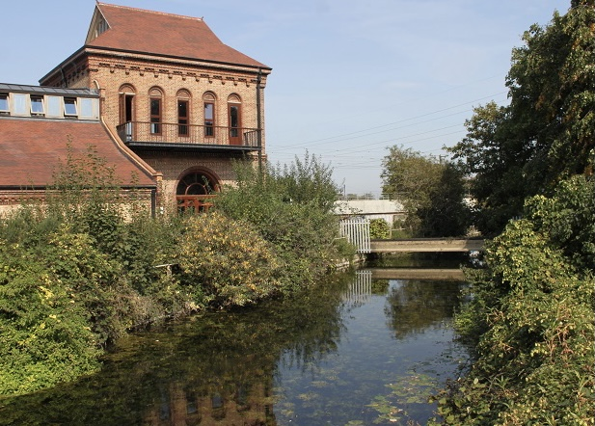
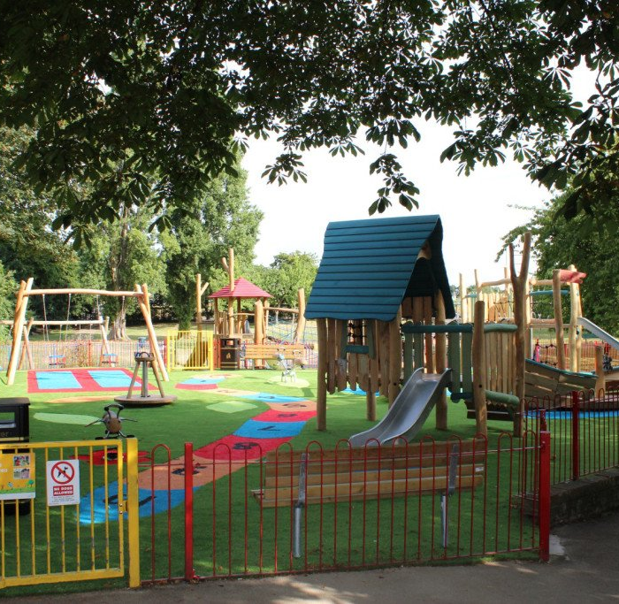
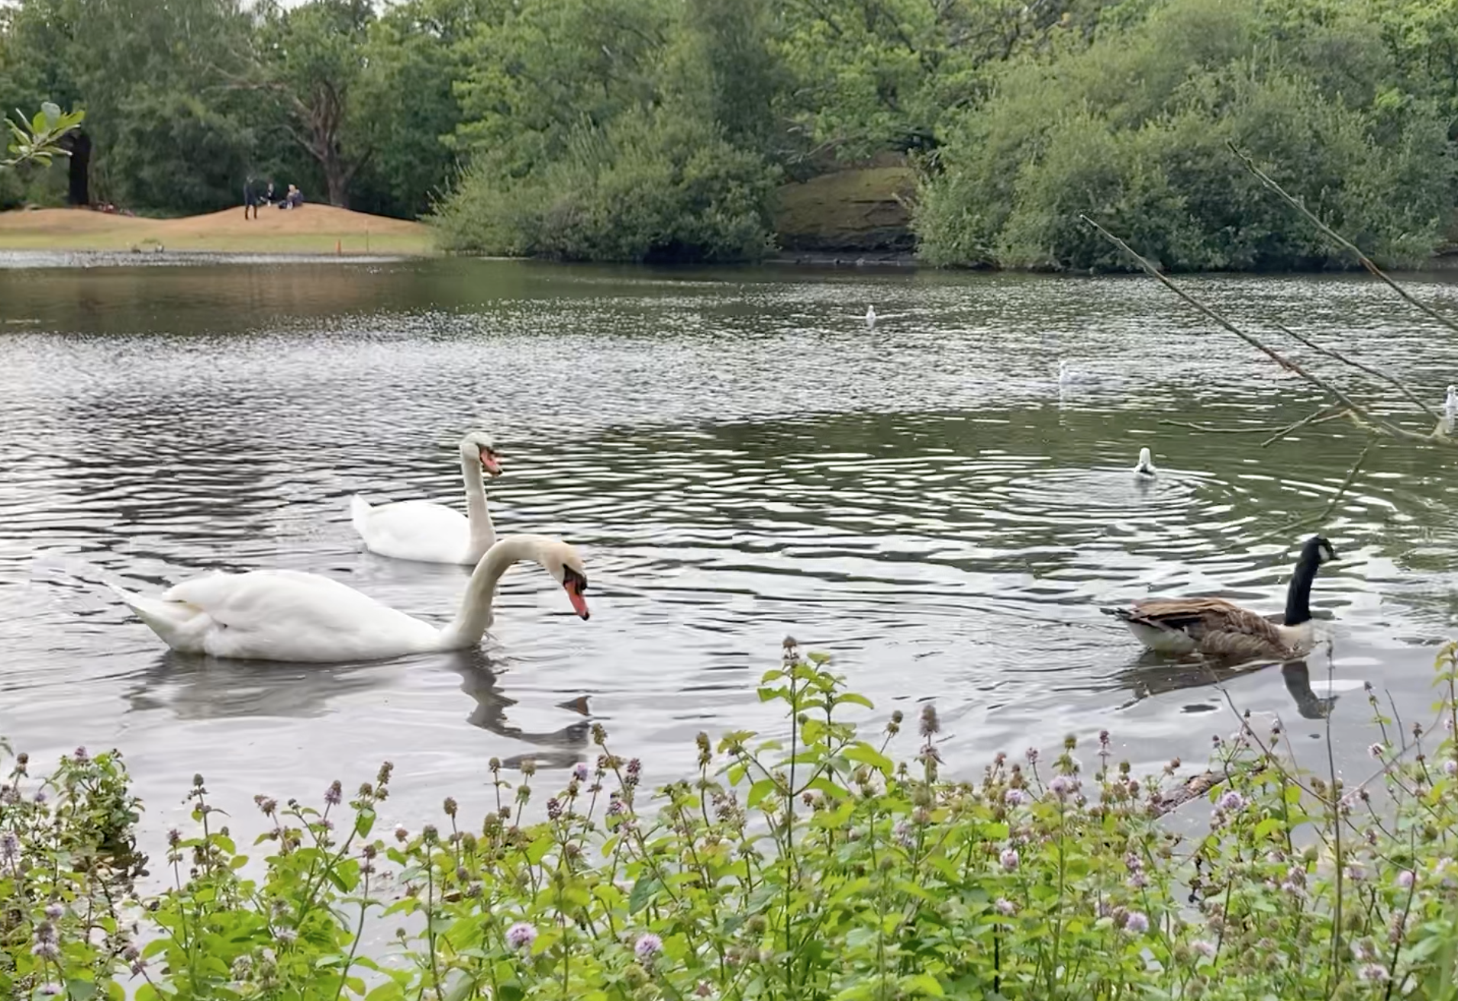
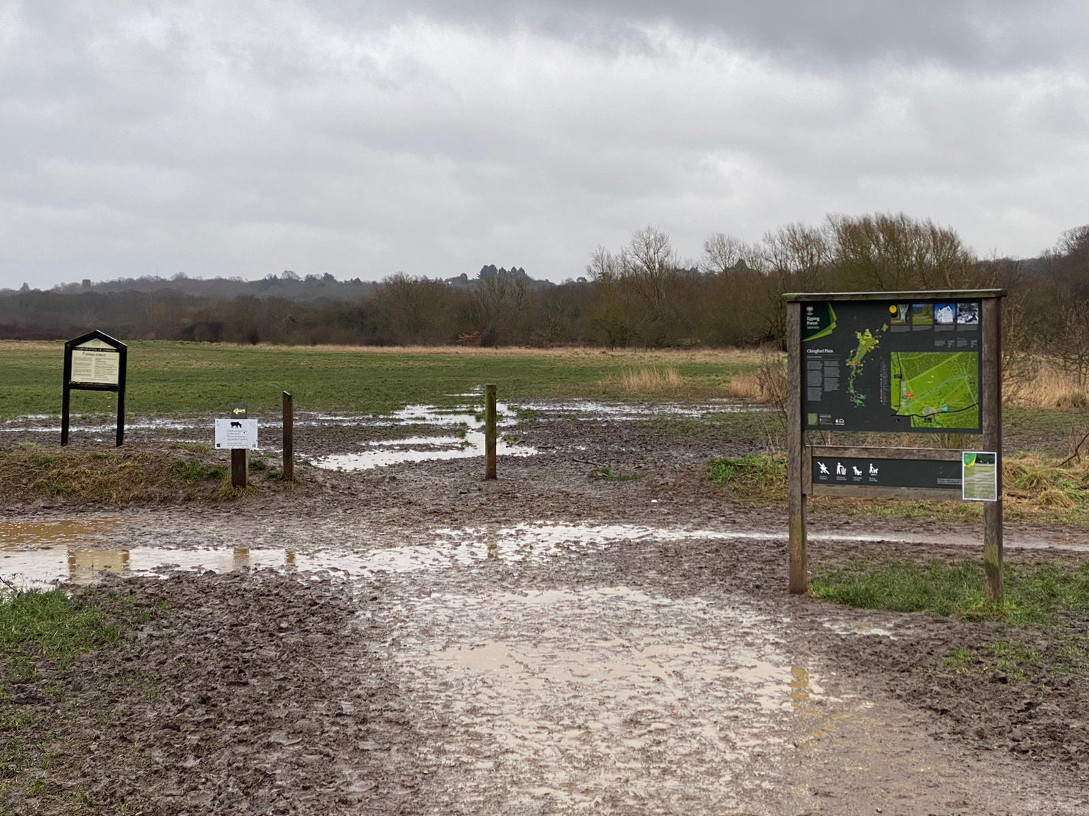
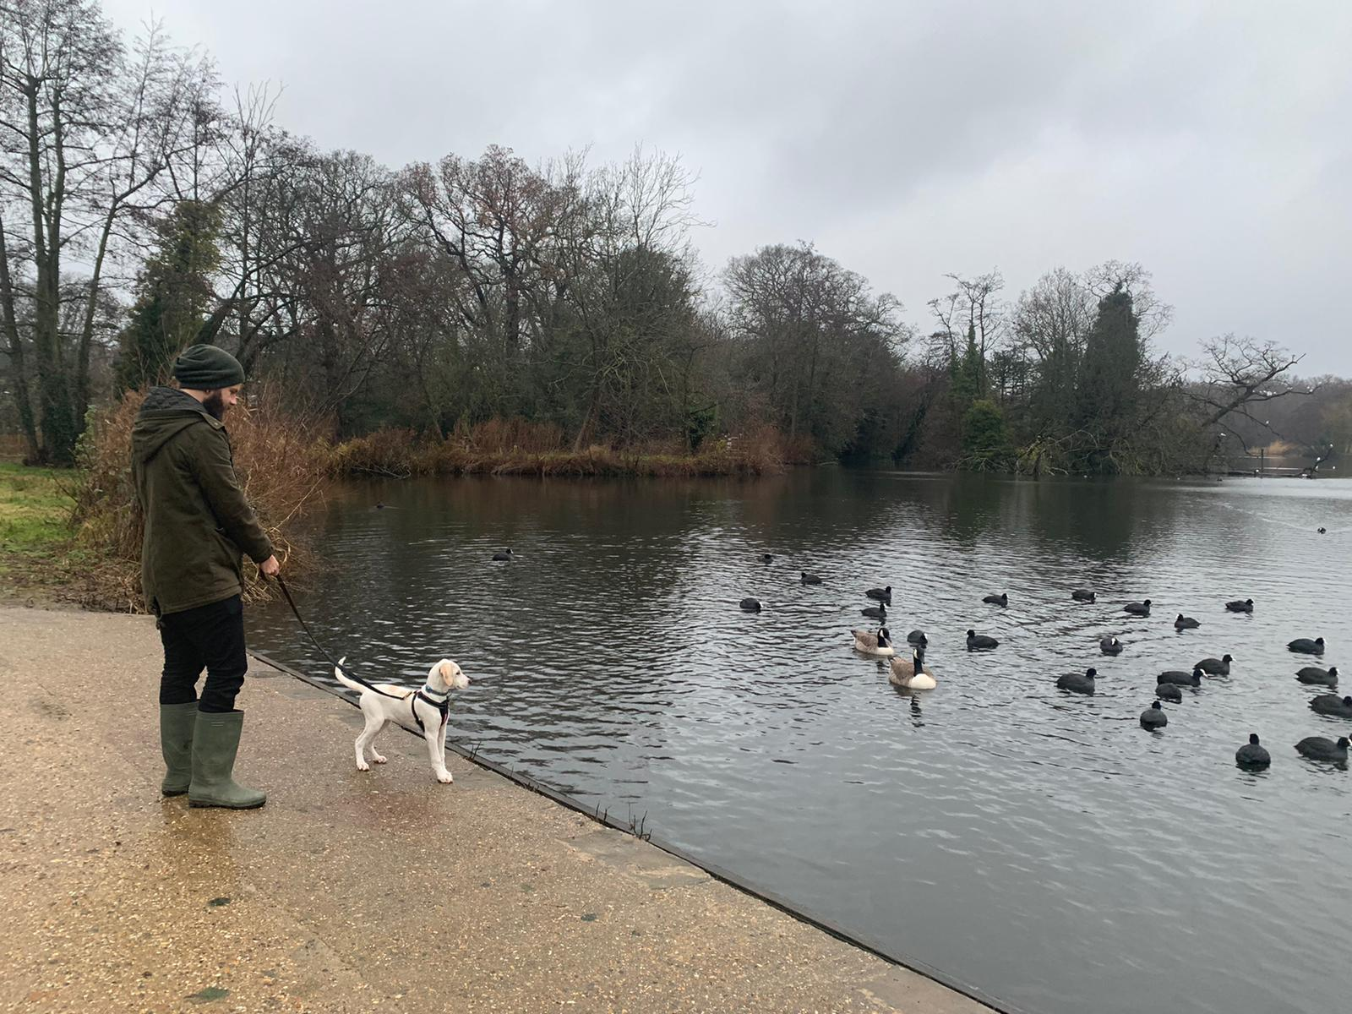
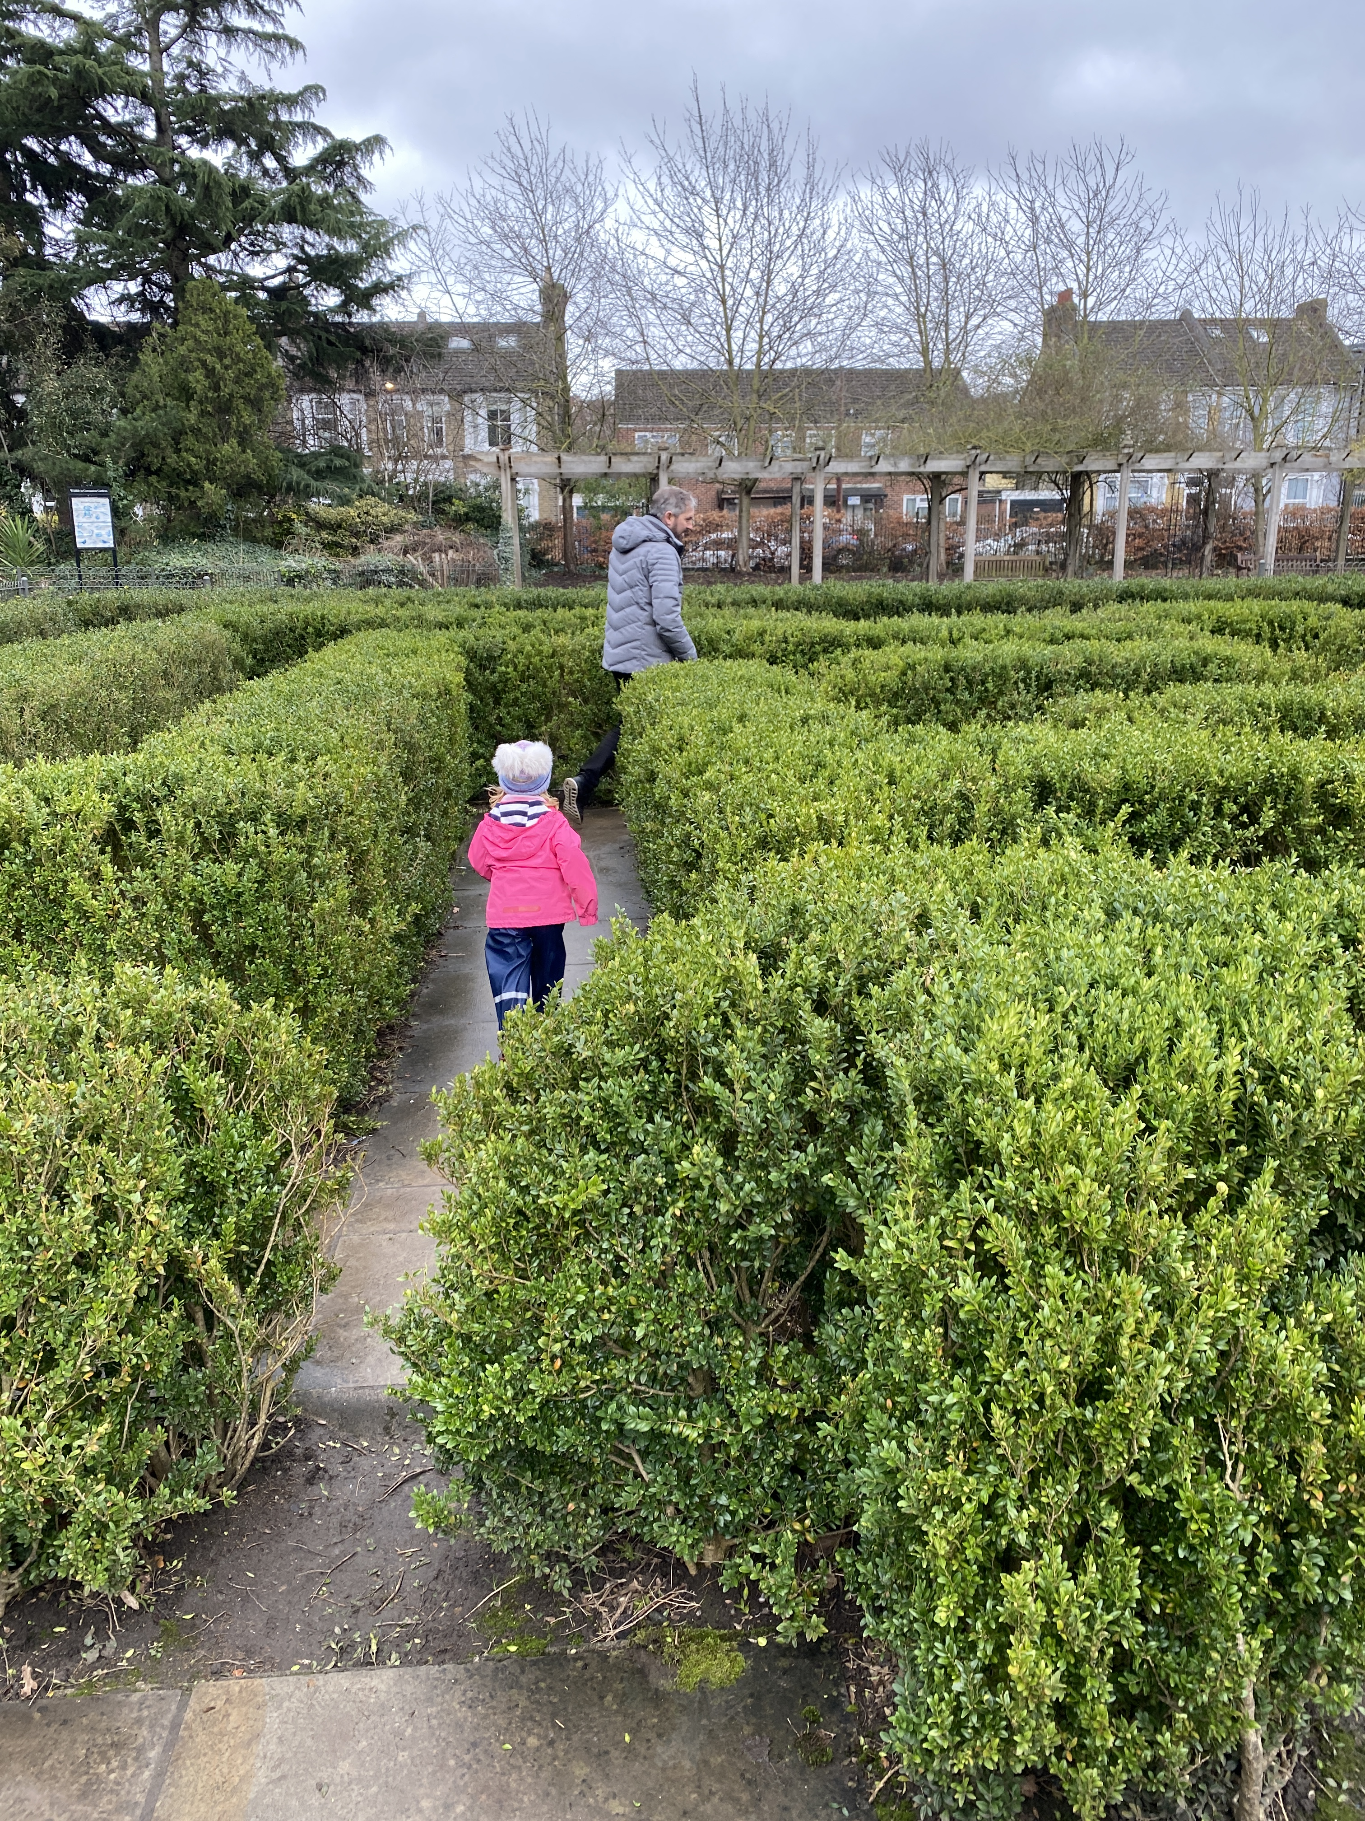
Let’s get outside and explore!
Roll a dice and play the game together! Where will you end up visiting in Waltham Forest?
Run,
jump, hop, skip, or
twirl to finish
Let’s go on a treasure hunt. What exciting things can you find?
What types of birds can
you spot?
Find out their names?
Time for
a listening walk…
What can you hear?
Hollow Ponds
The Wetlands
Henry Reynolds
Visit the
bug hotel. What minibeasts
can you find?
Chingford Plain
Wellies on! Splash in puddles! Squelch in mud!
Spot prints in the mud.
Make your own marks using a stick!
Can you balance
along a log?
Find a tree to hug or climb.
What trees
live here?
How many fallen leaves can you collect?
Find the maze.
Where is the middle?
Collect objects, tie them to
a stick with string!
Count the ducks.
Can you
draw
one?
Highams
Park Lake
Coronation Gardens

Slide 2

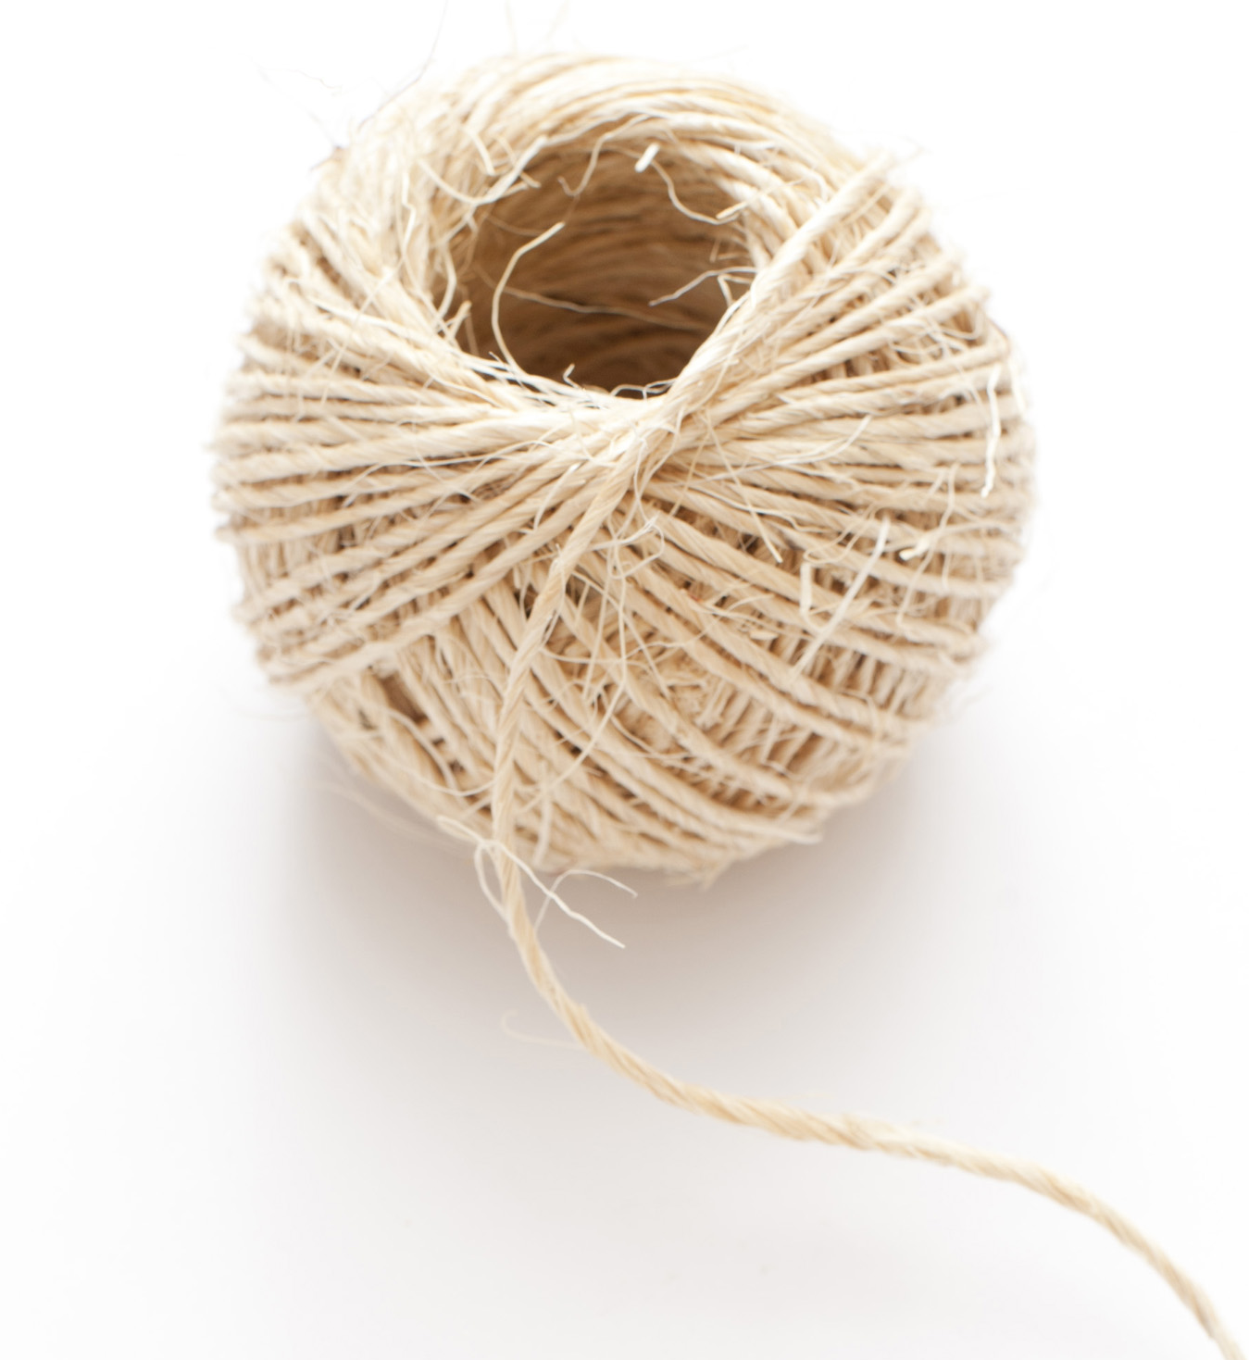

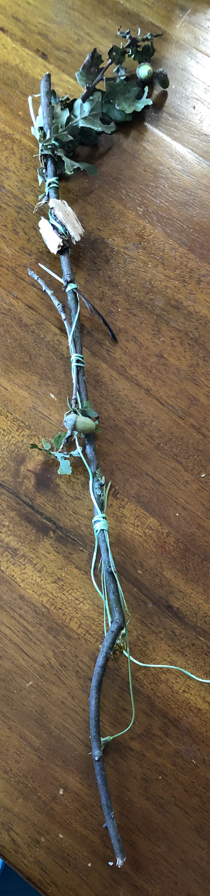
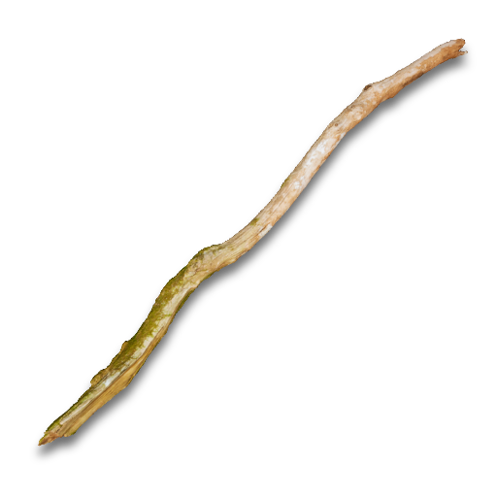
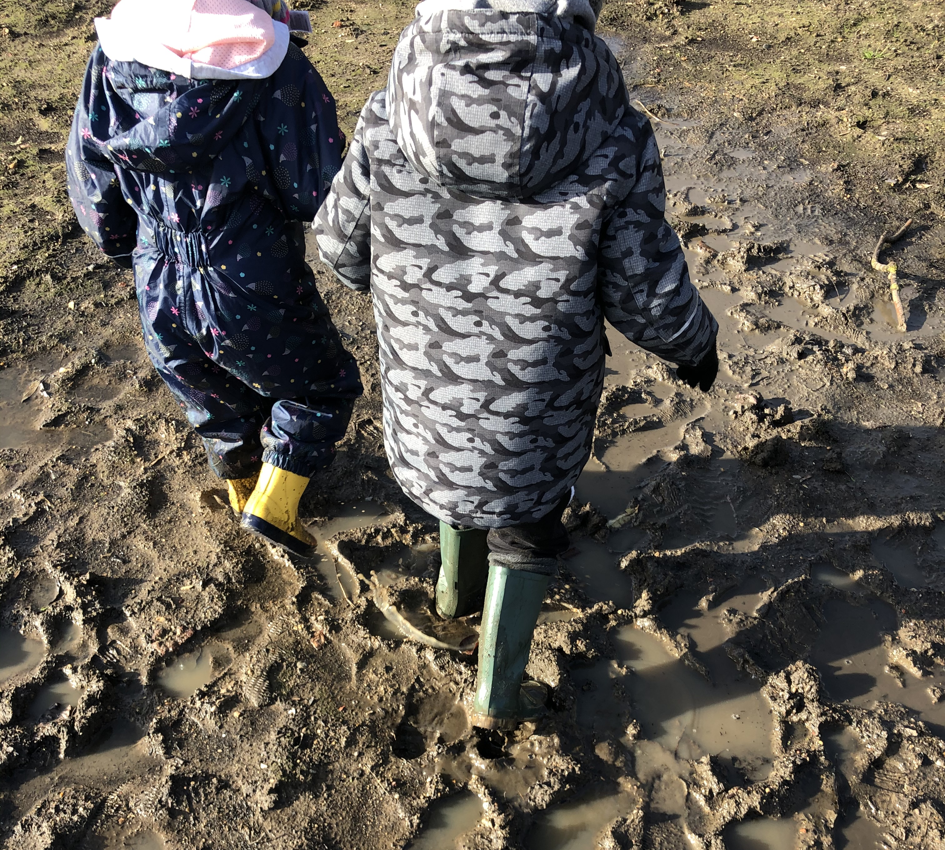
Let’s explore
CHINGFORD PLAIN
Return
to game
Make a journey stick! Collect objects, tie them to your stick with string! You could hang it up to remind you of your journey!
Wellies on! Splash in
puddles! Squelch in mud!

Slide 3
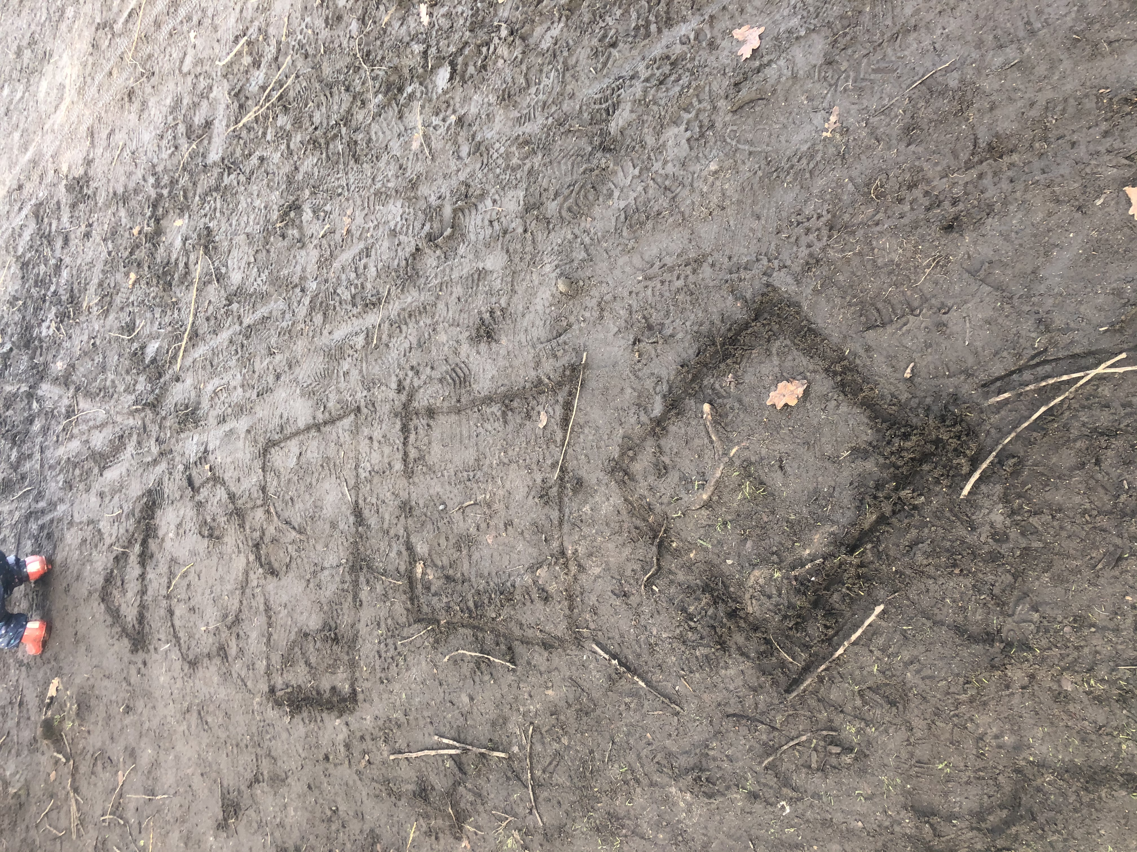
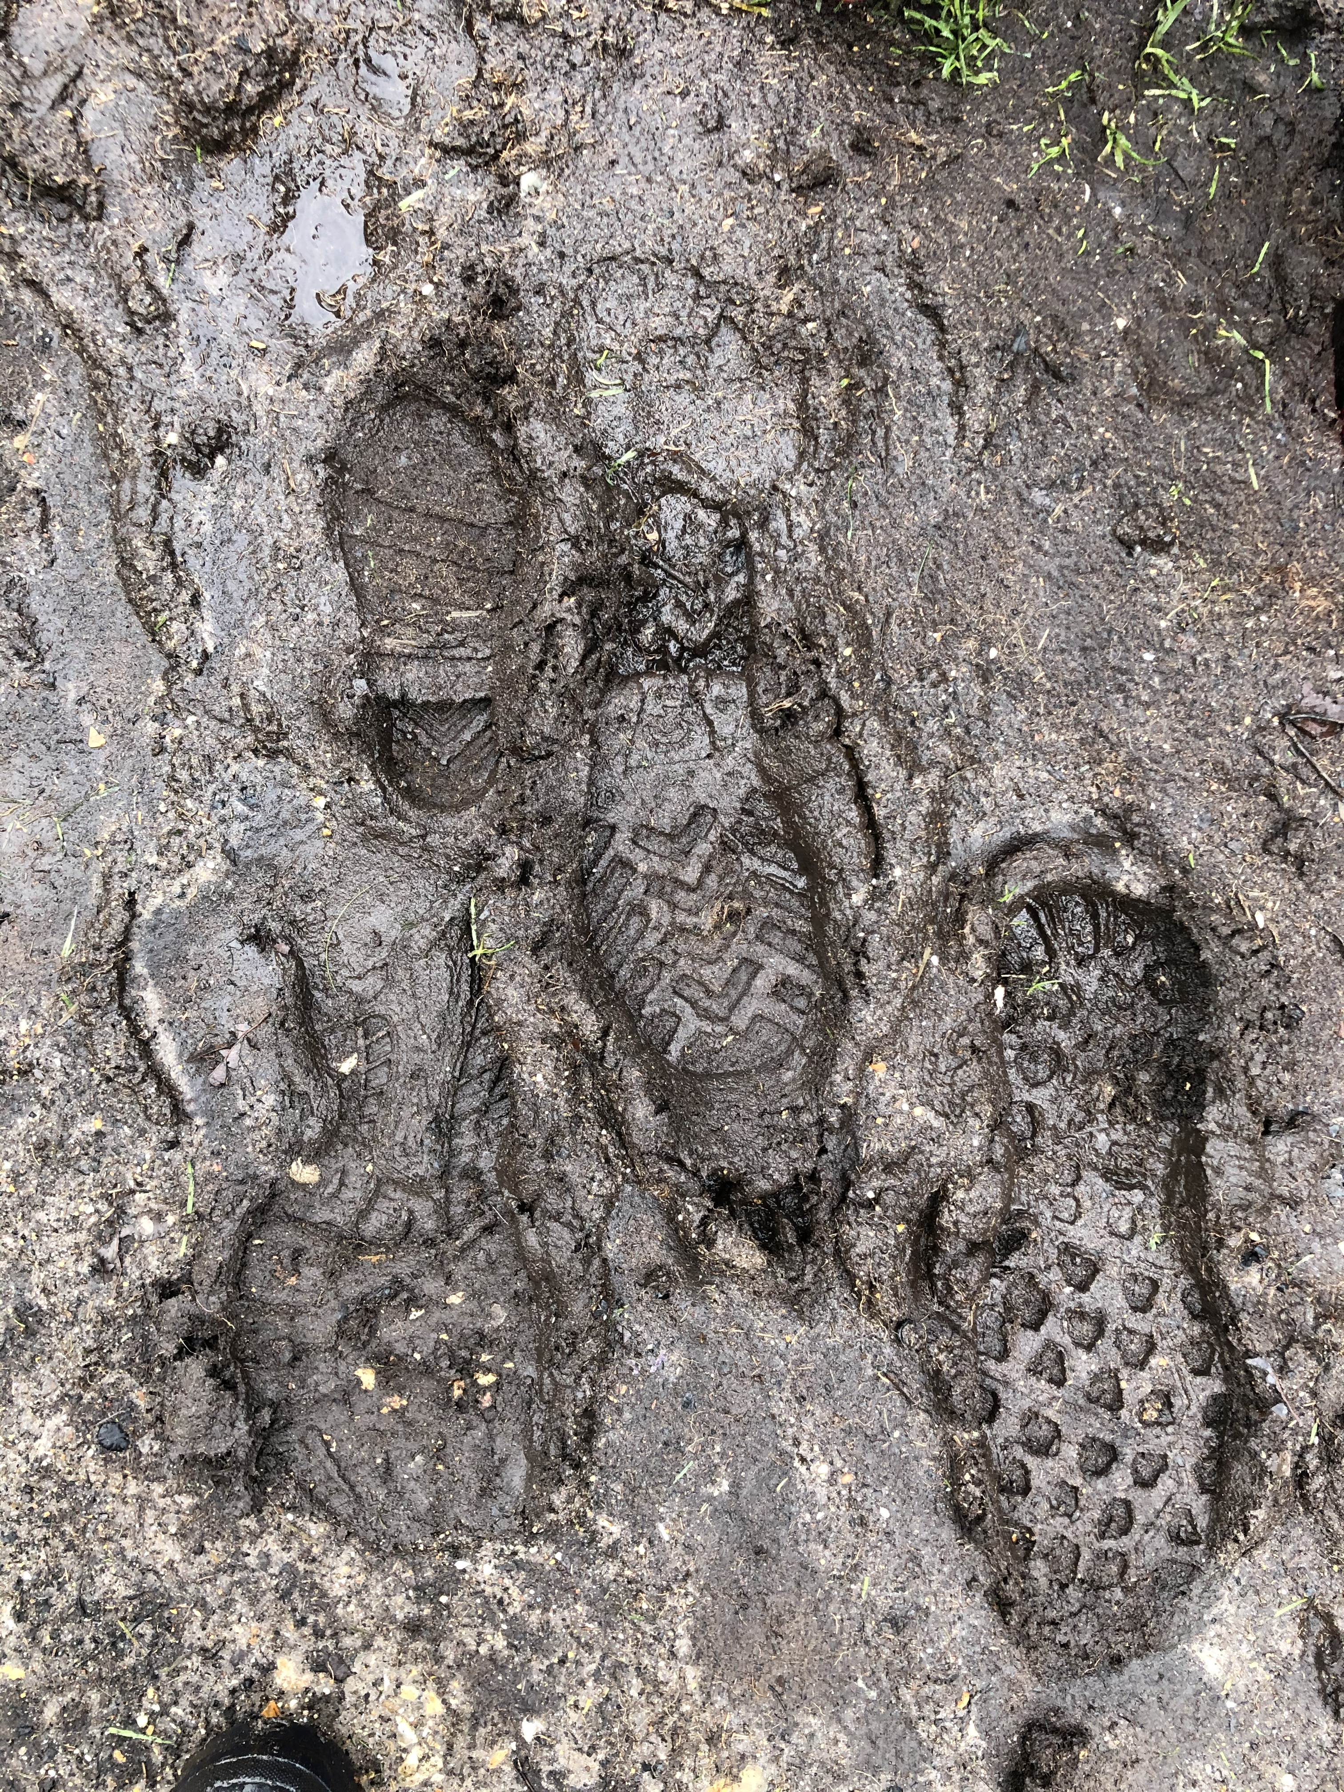
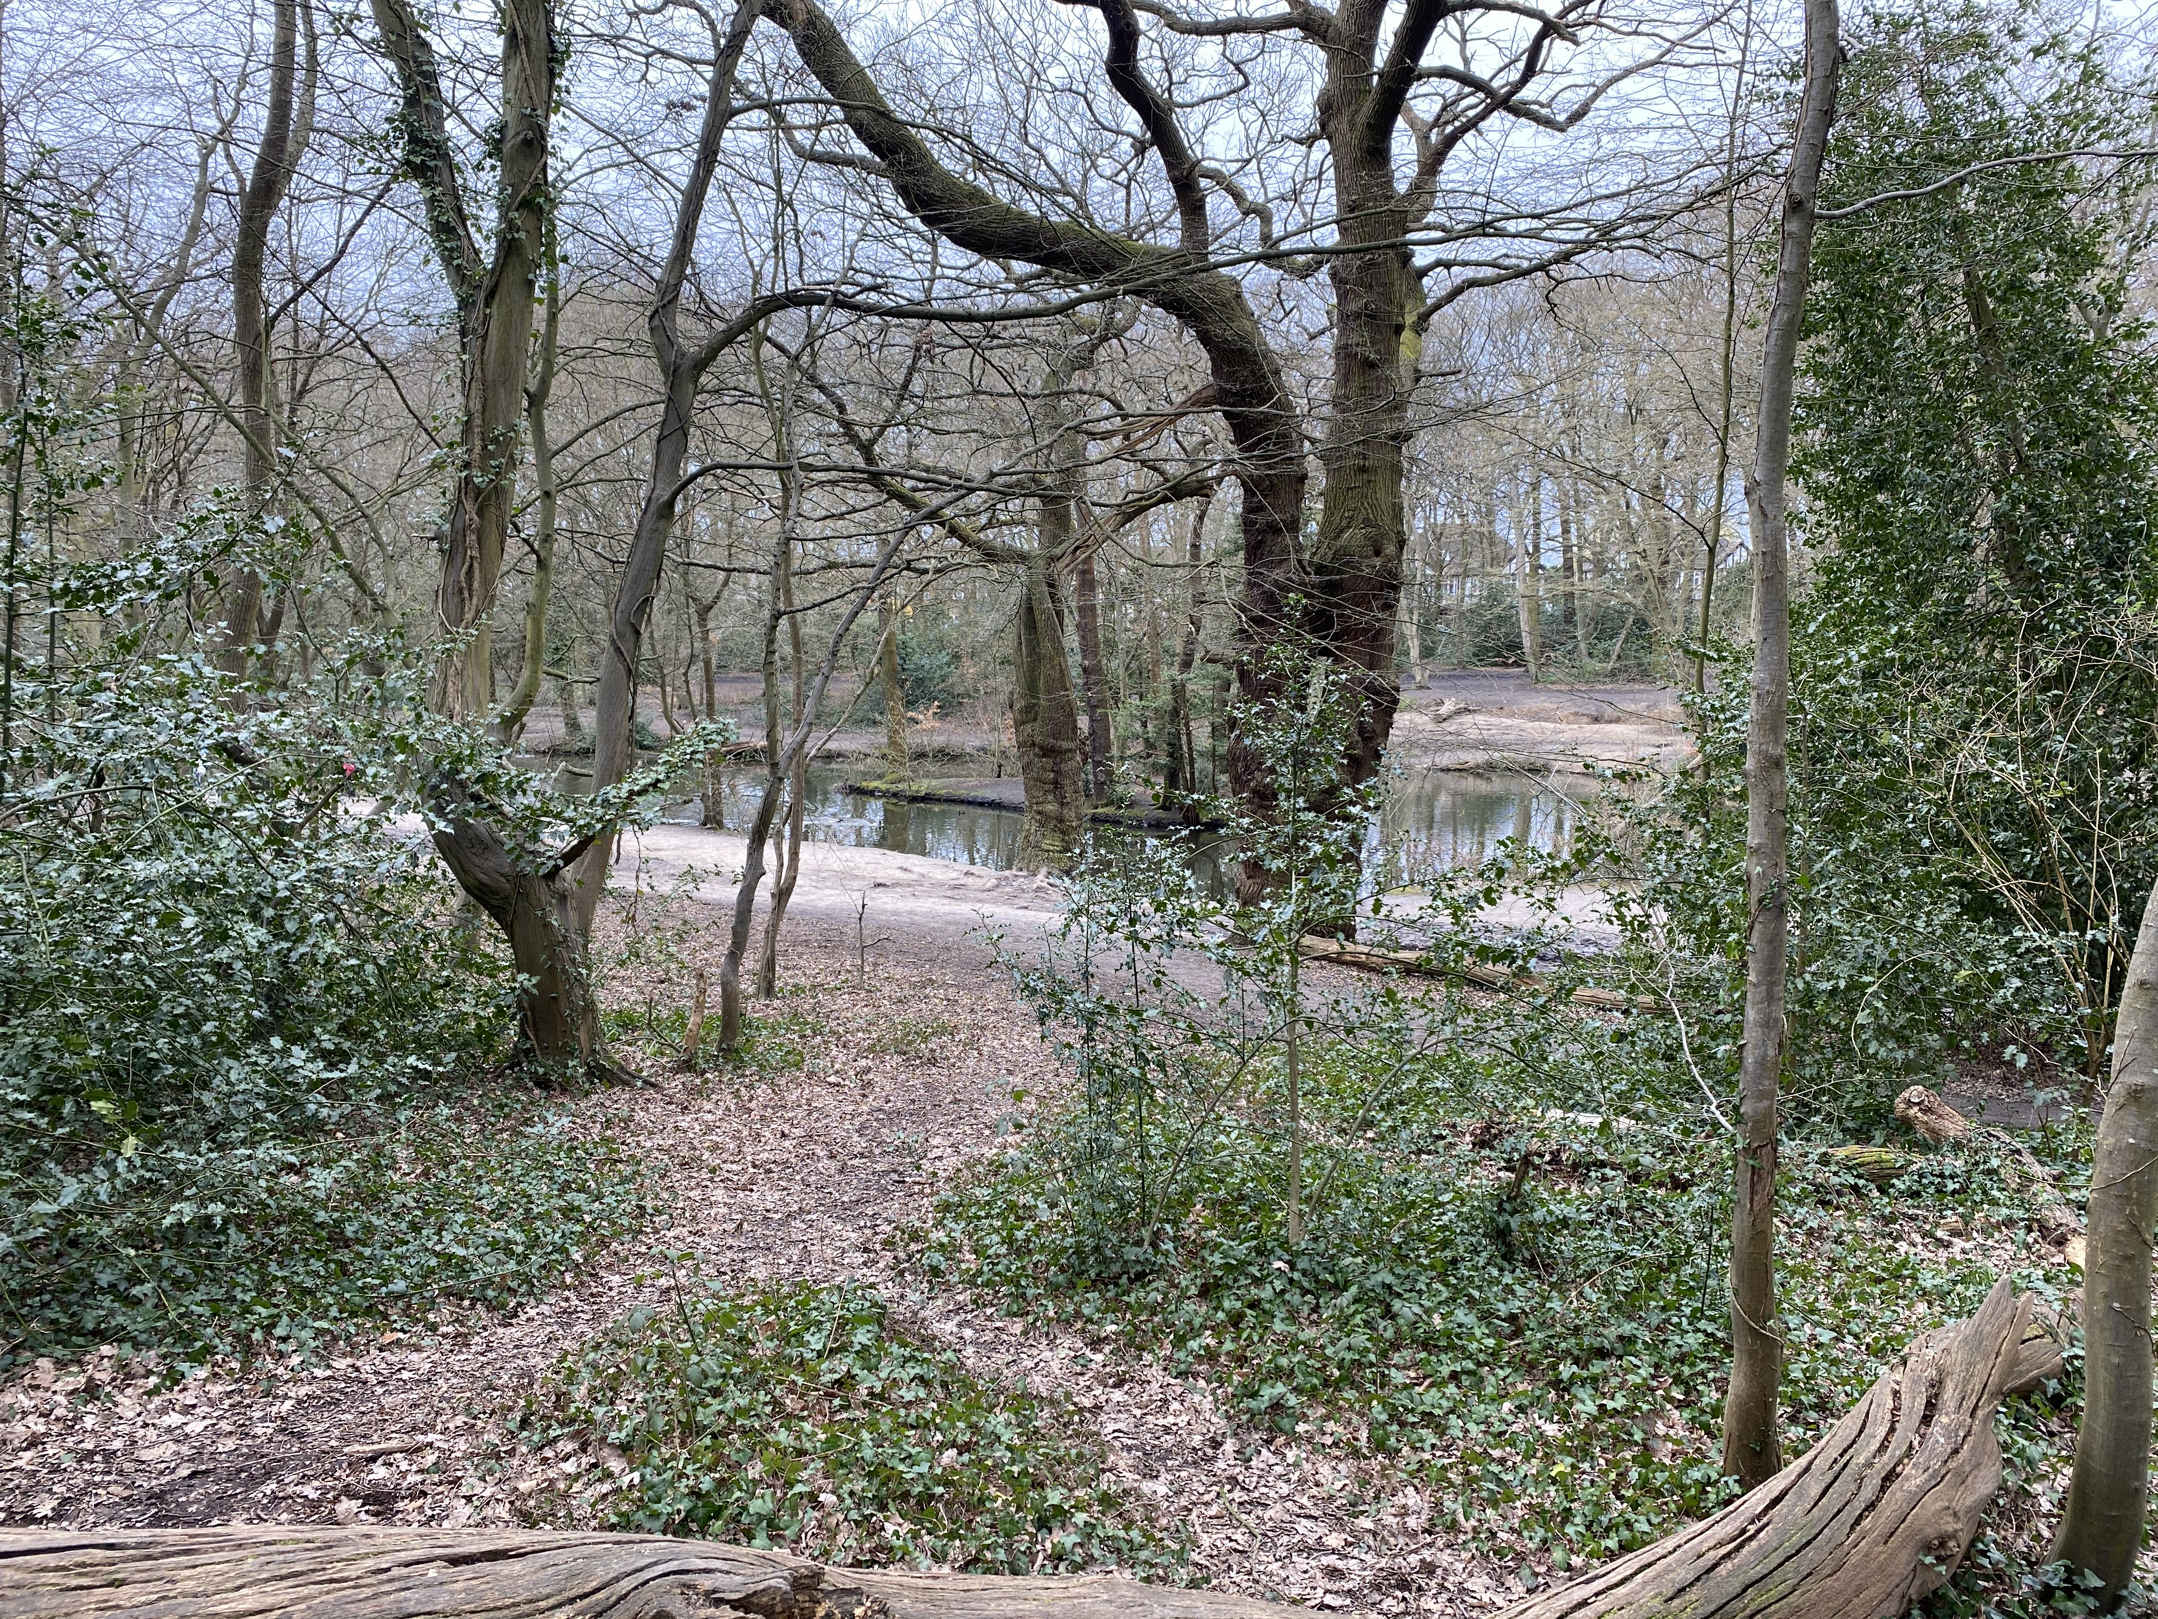
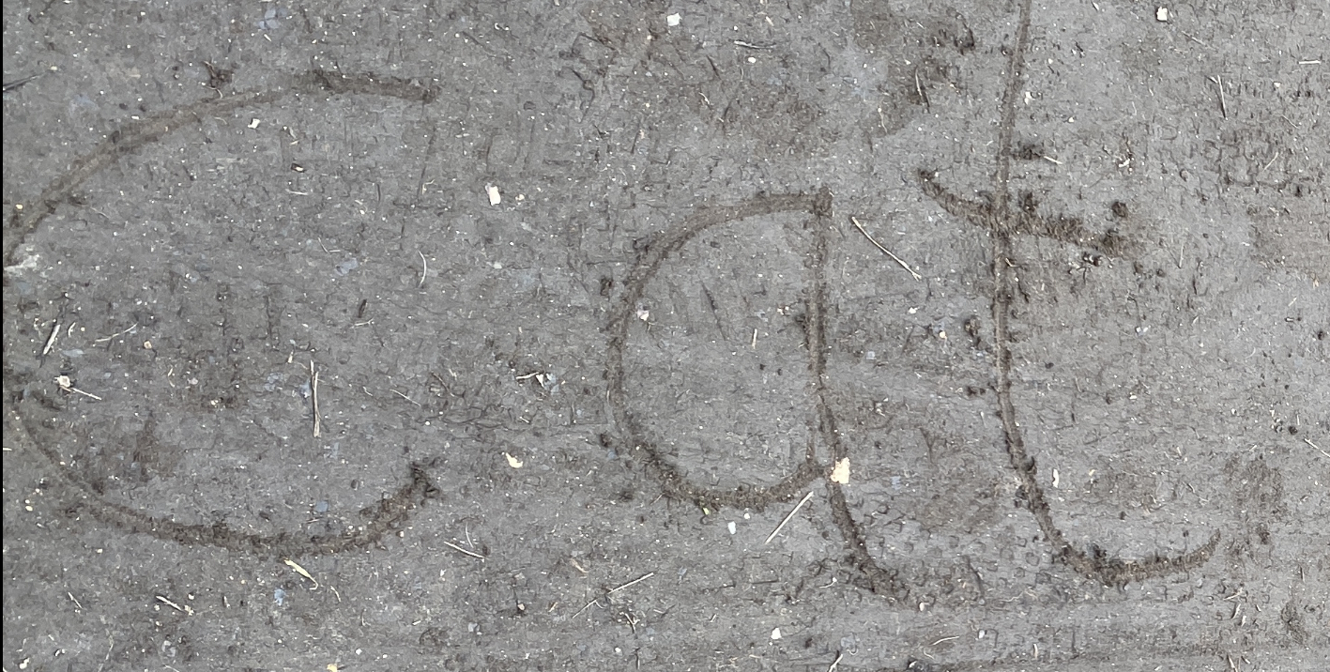
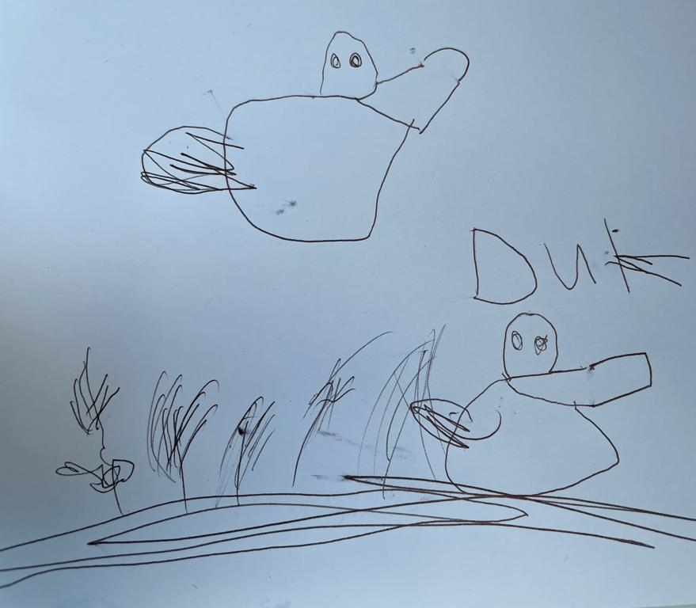
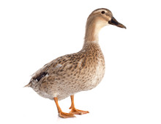
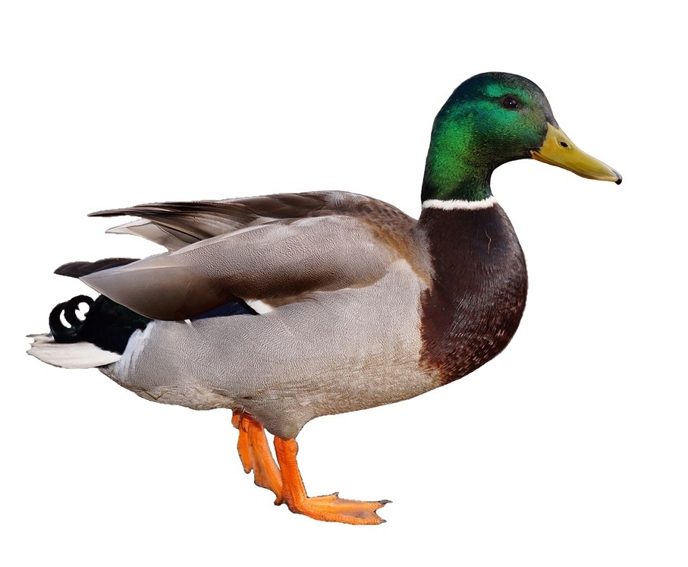
Let’s explore
HIGHAMS PARK LAKE
Spot prints in the mud. Make
your own marks using a stick!
Count the ducks.
Can you draw one?
Return
to game

Slide 4
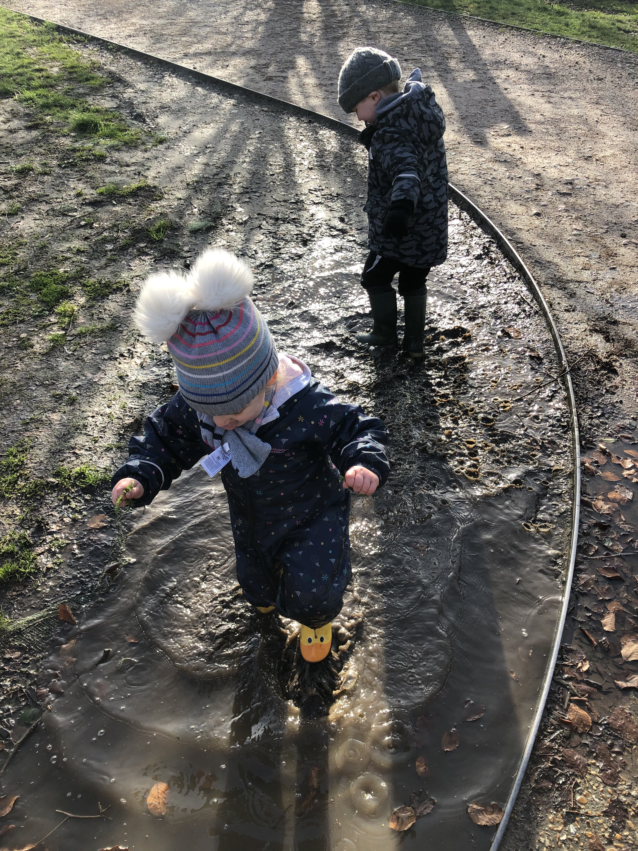
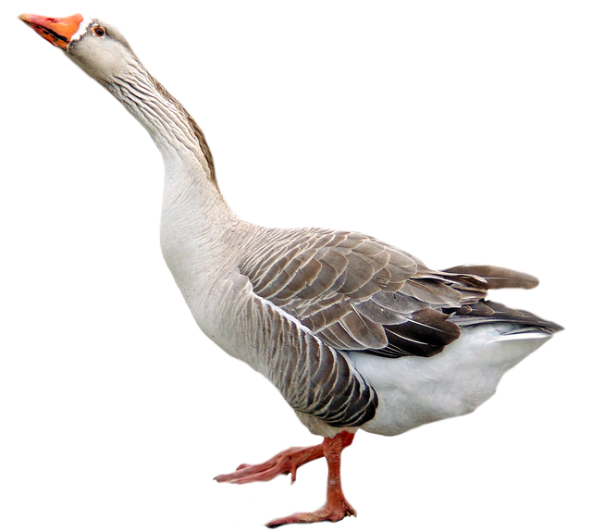
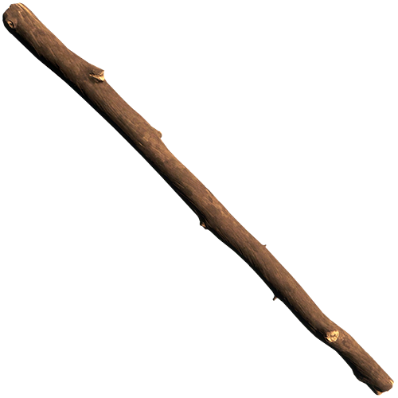
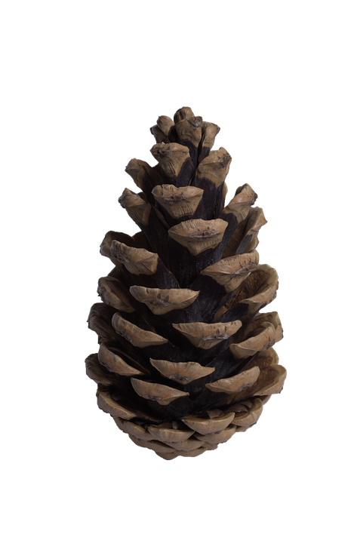
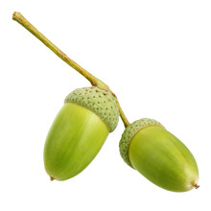

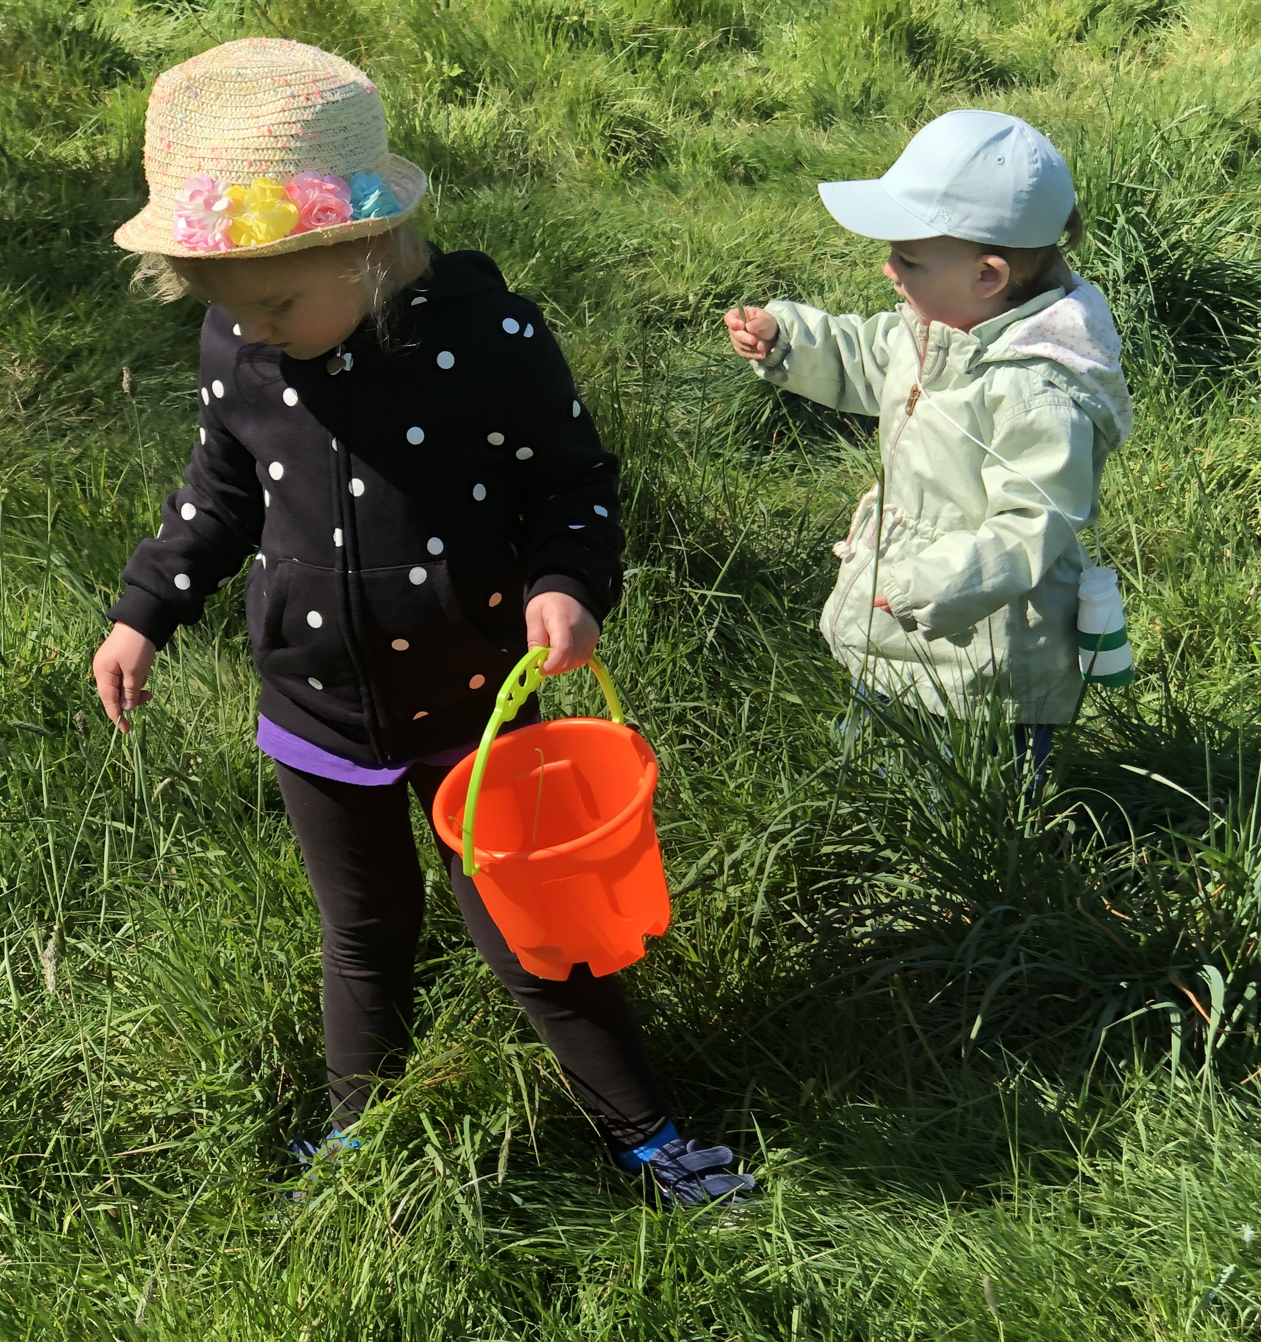
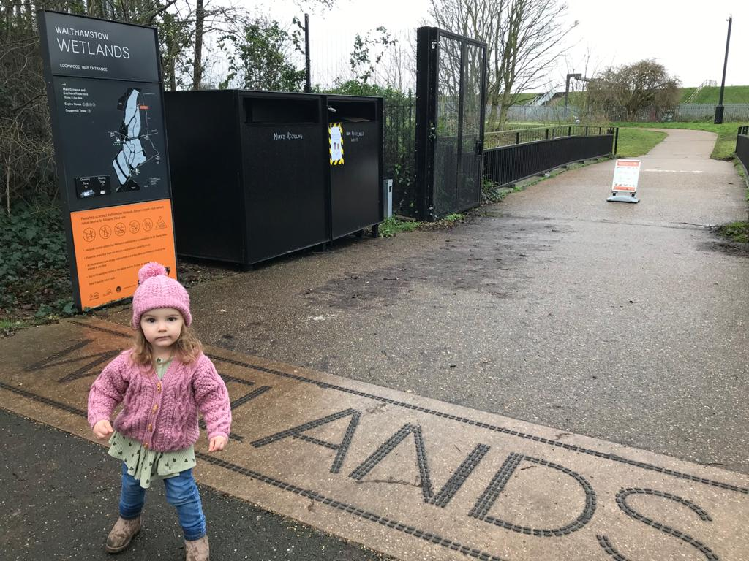



Let’s explore
THE WETLANDS
Time for a
listening walk…
What can you hear?
Let’s go on a
treasure hunt.
What exciting things
can you find?
Return
to game

Slide 5
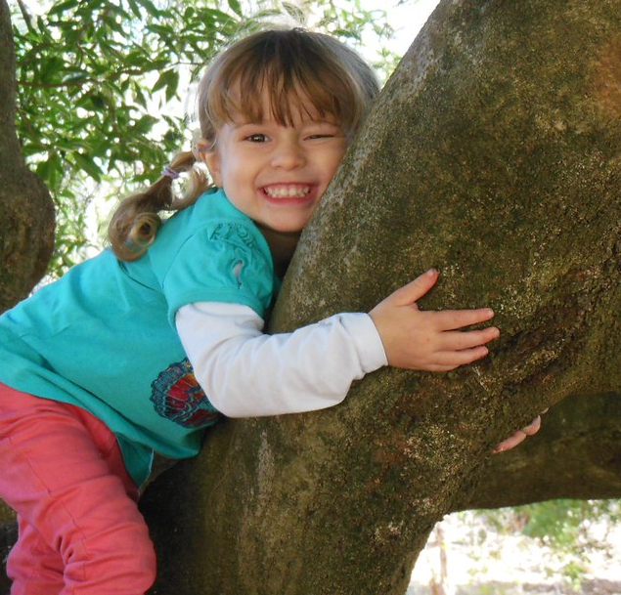
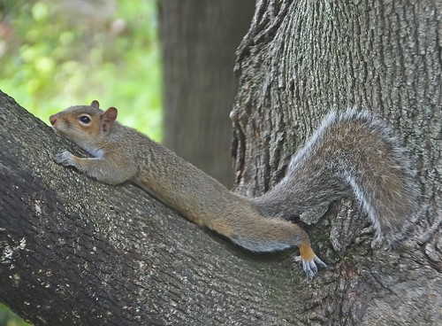
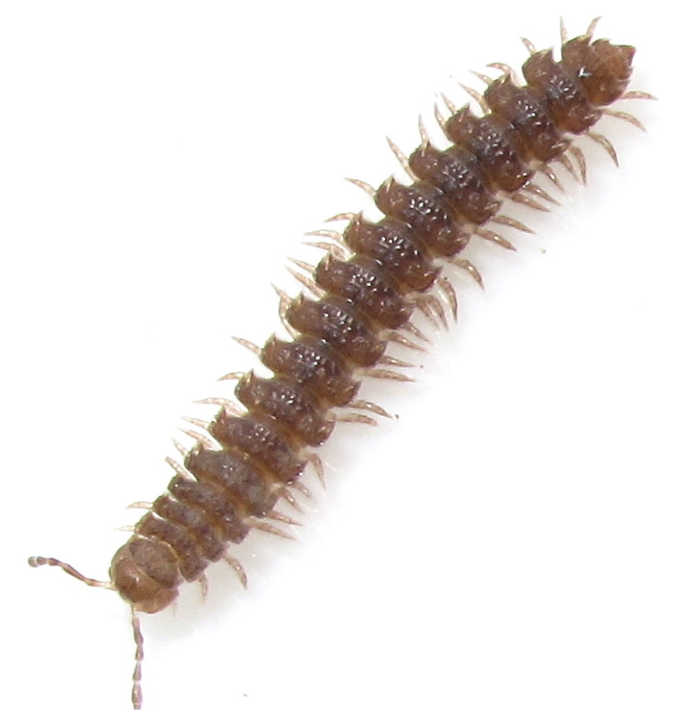
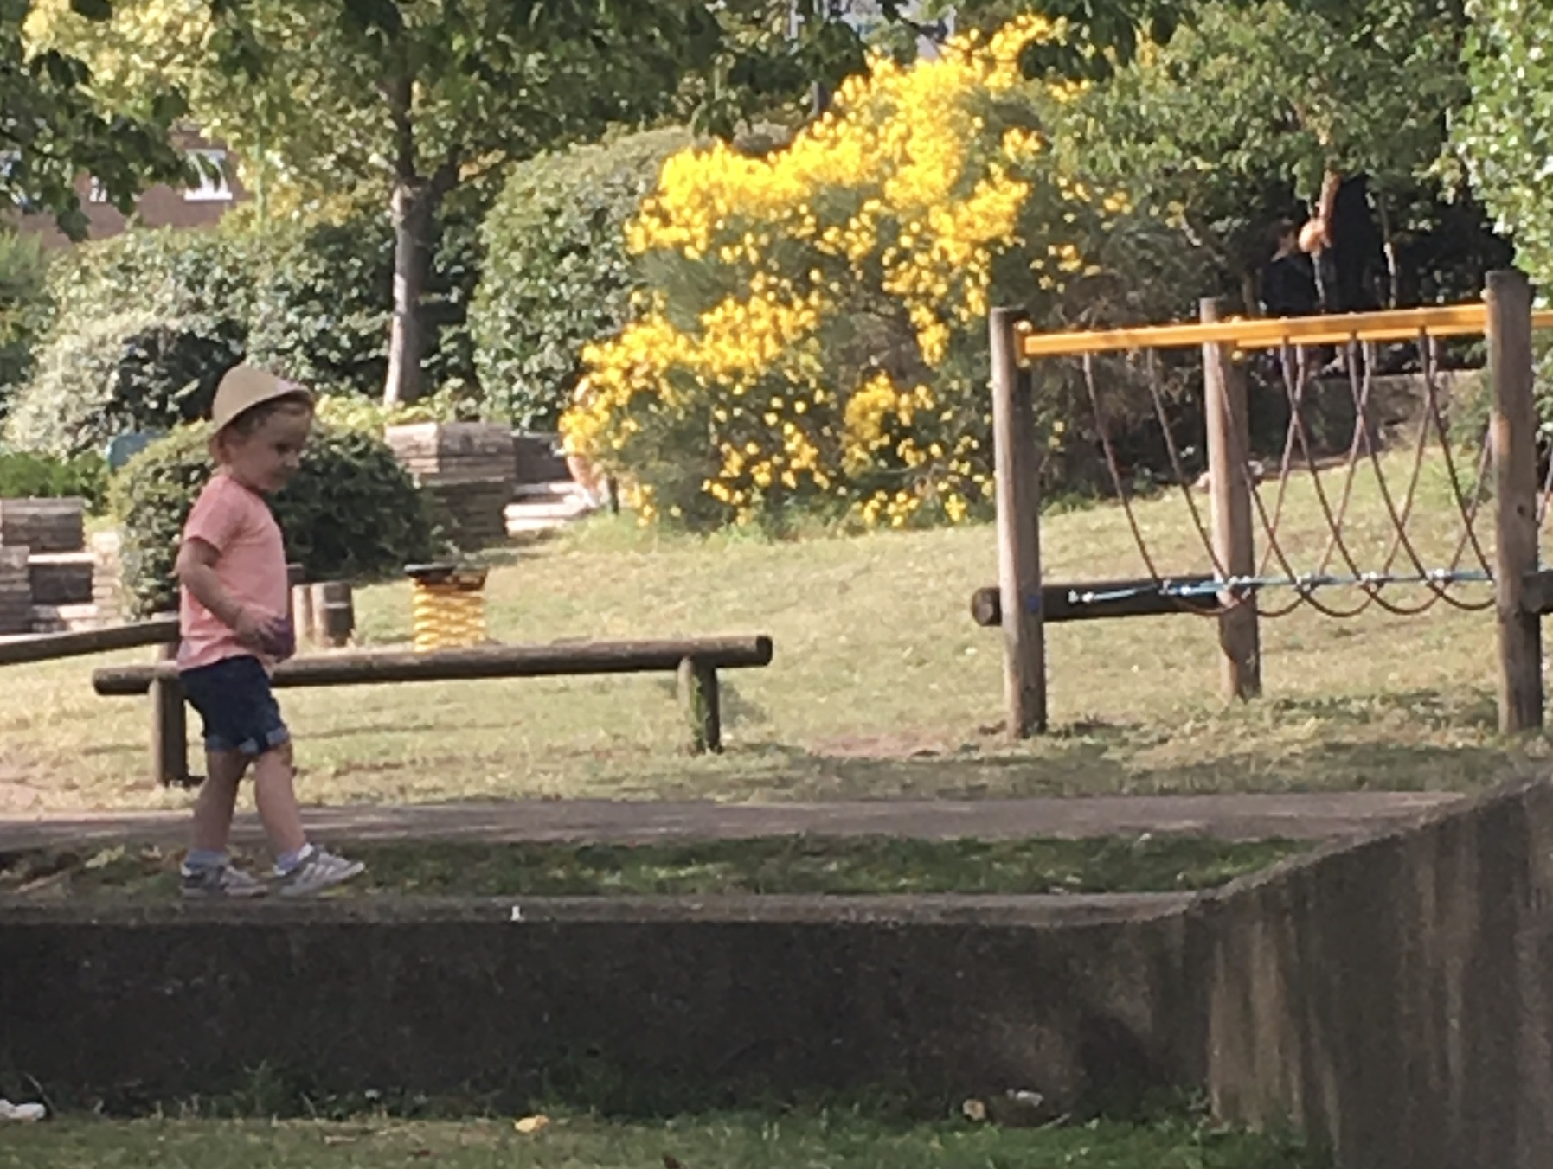
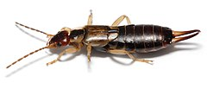
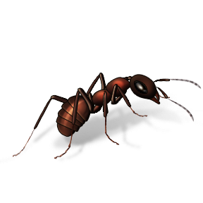
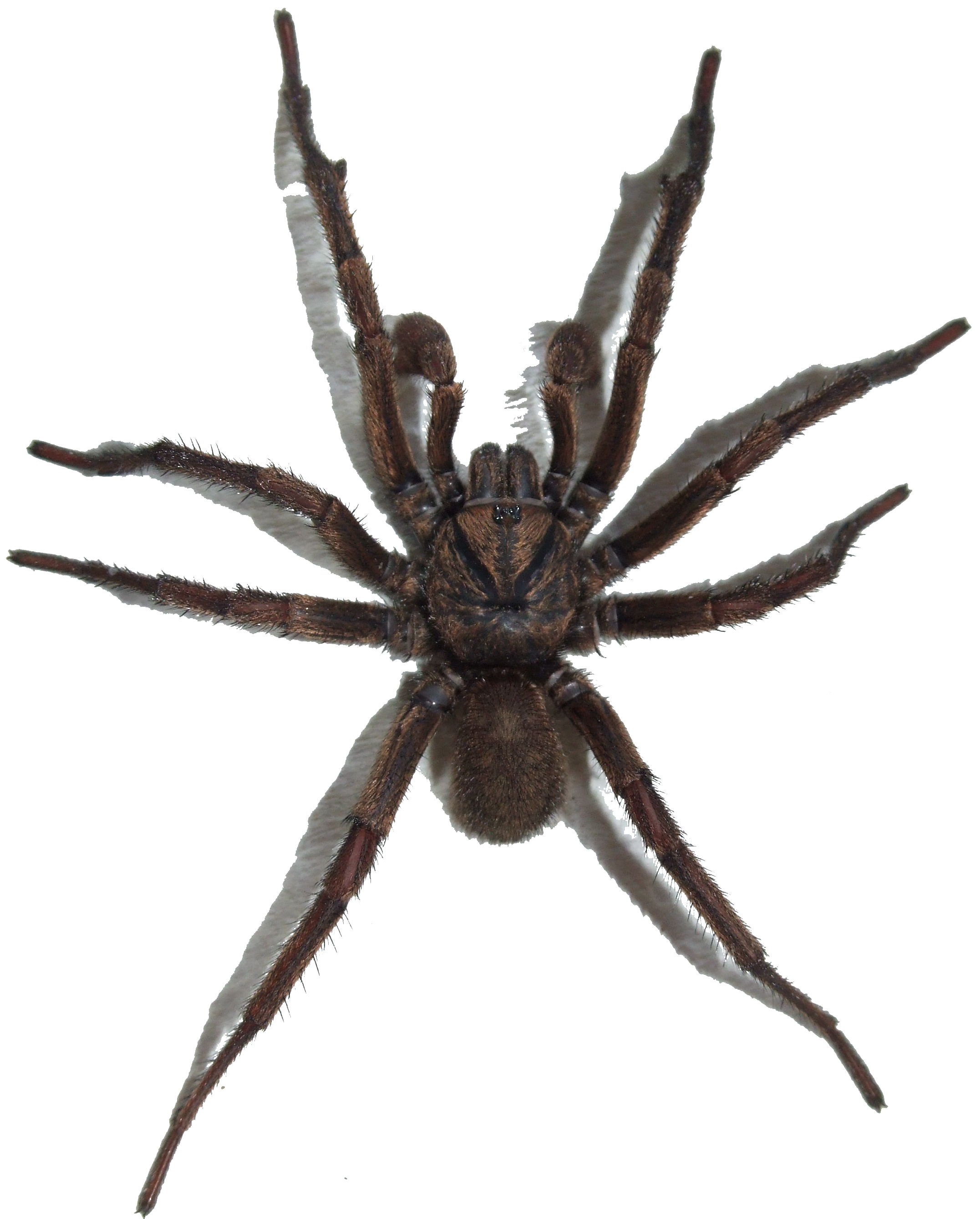
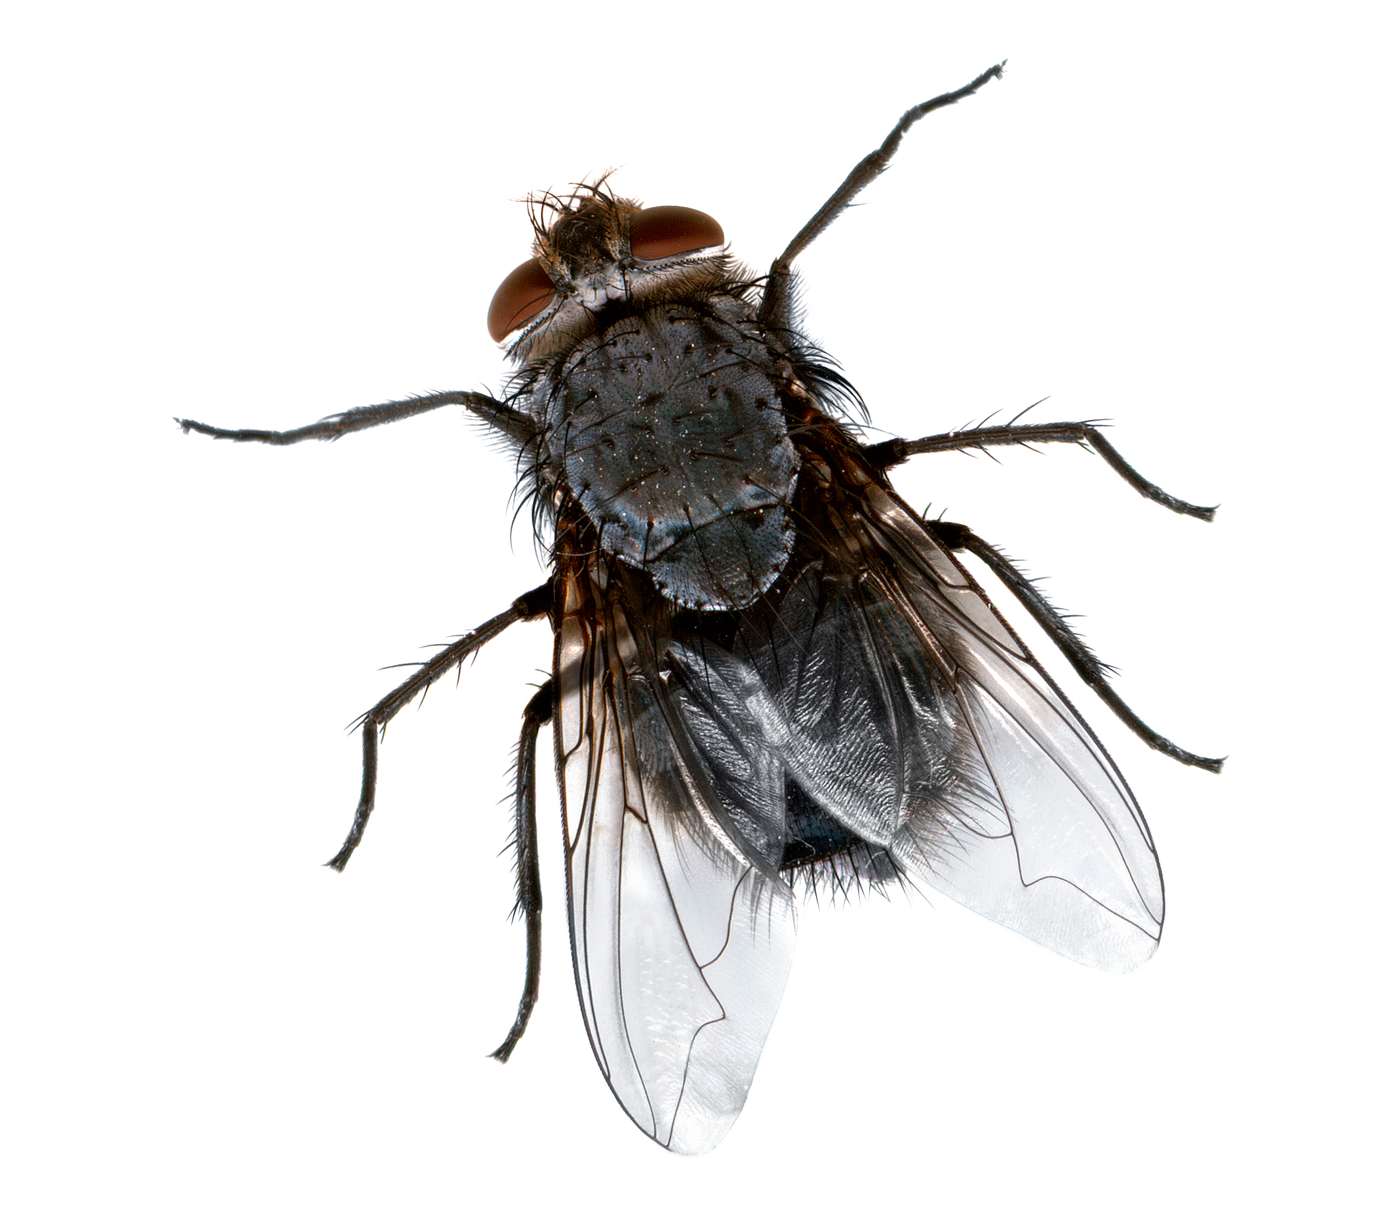
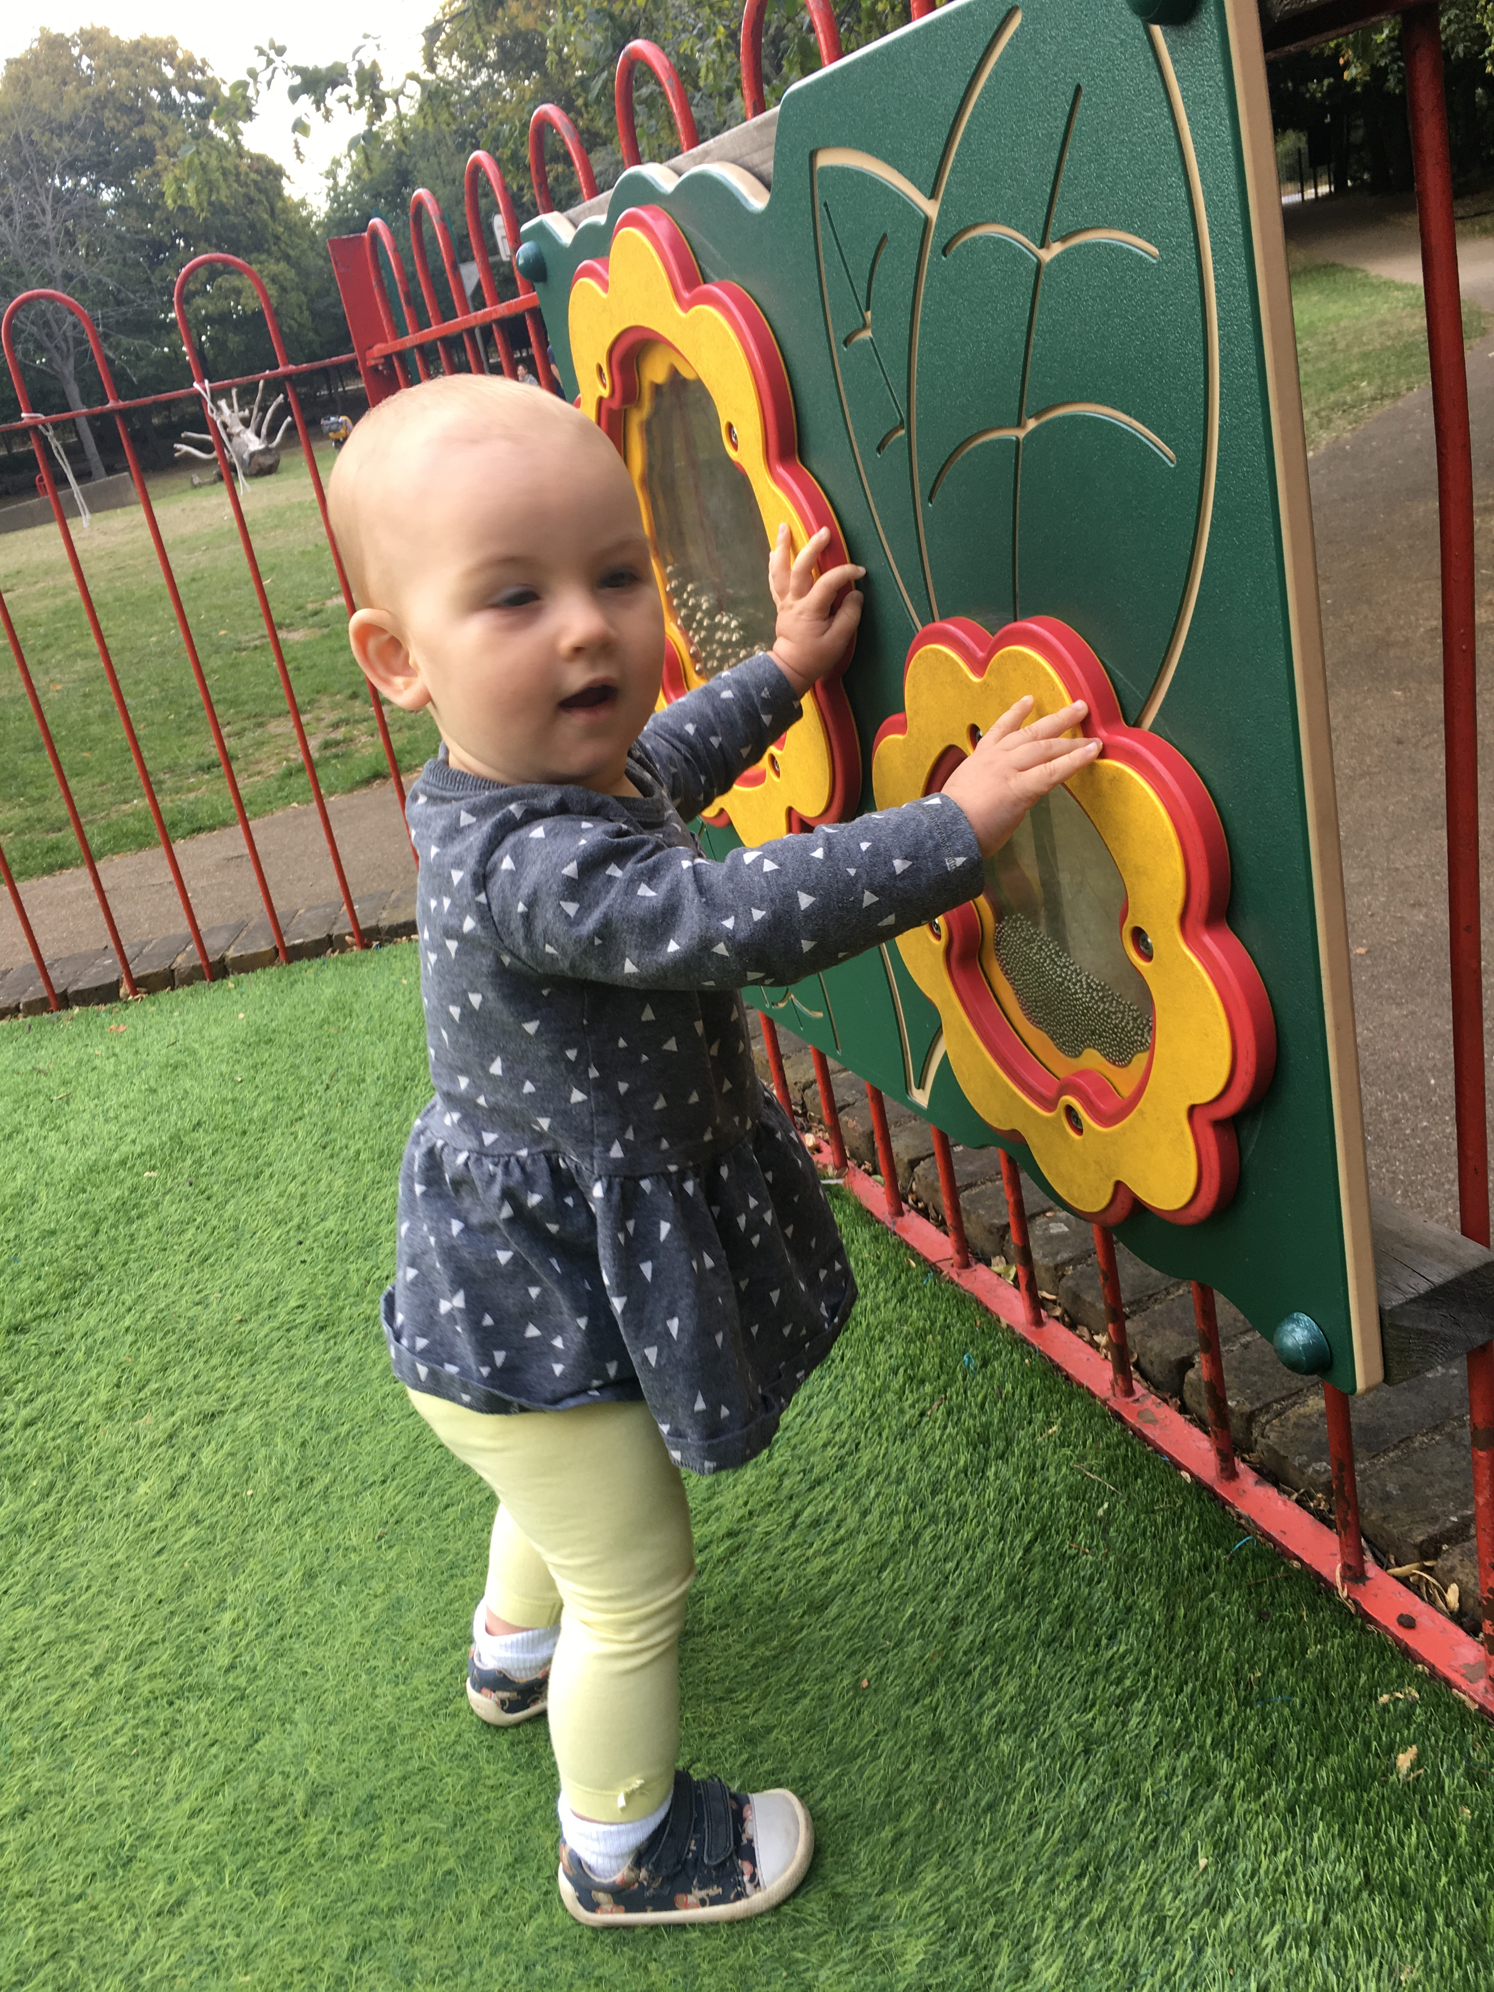
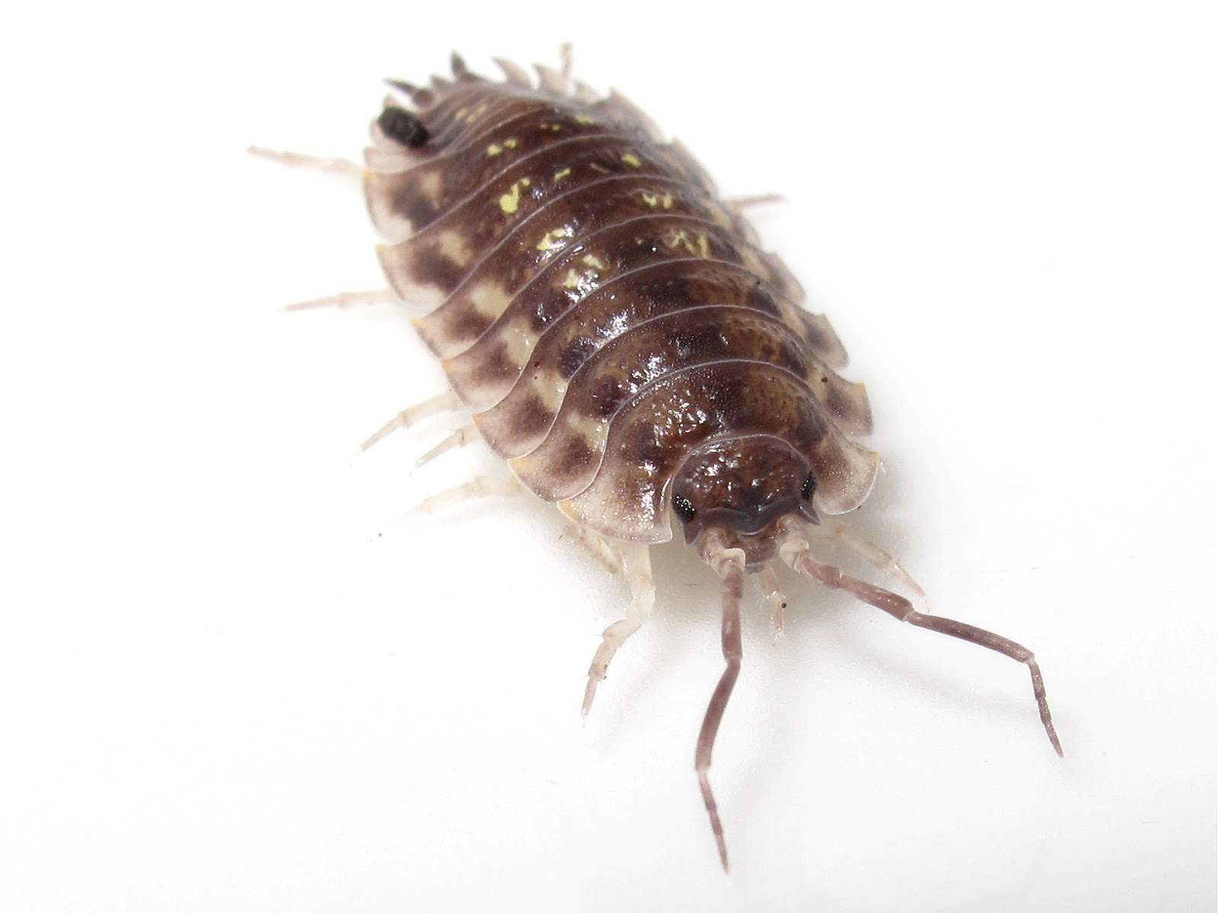
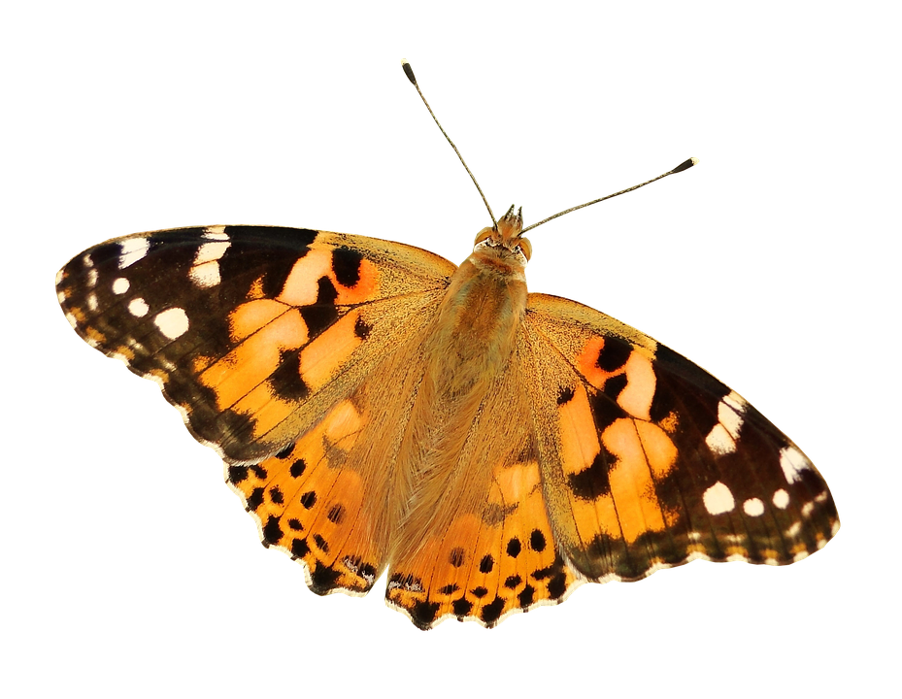

Let’s explore
HENRY REYNOLDS PARK
Return
to game
Find a tree to
hug or climb
Visit the bug hotel.
What minibeasts
can you find?
Can you balance along a log?

Slide 6
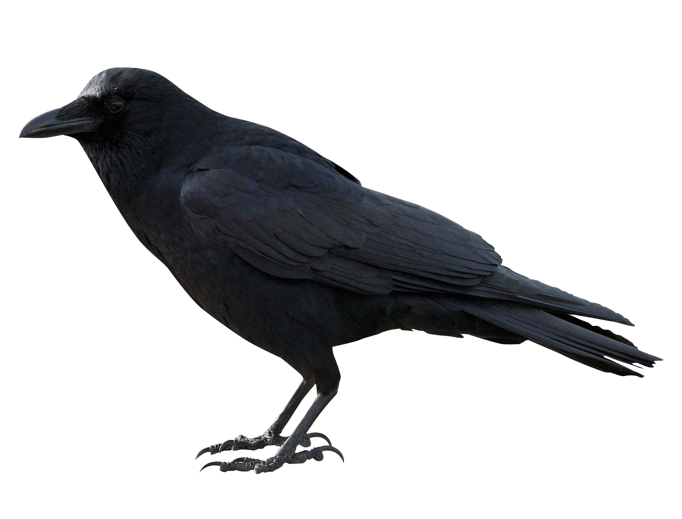
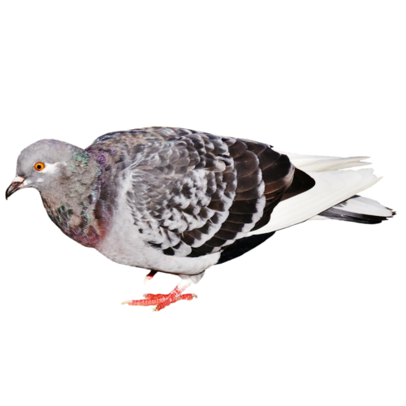
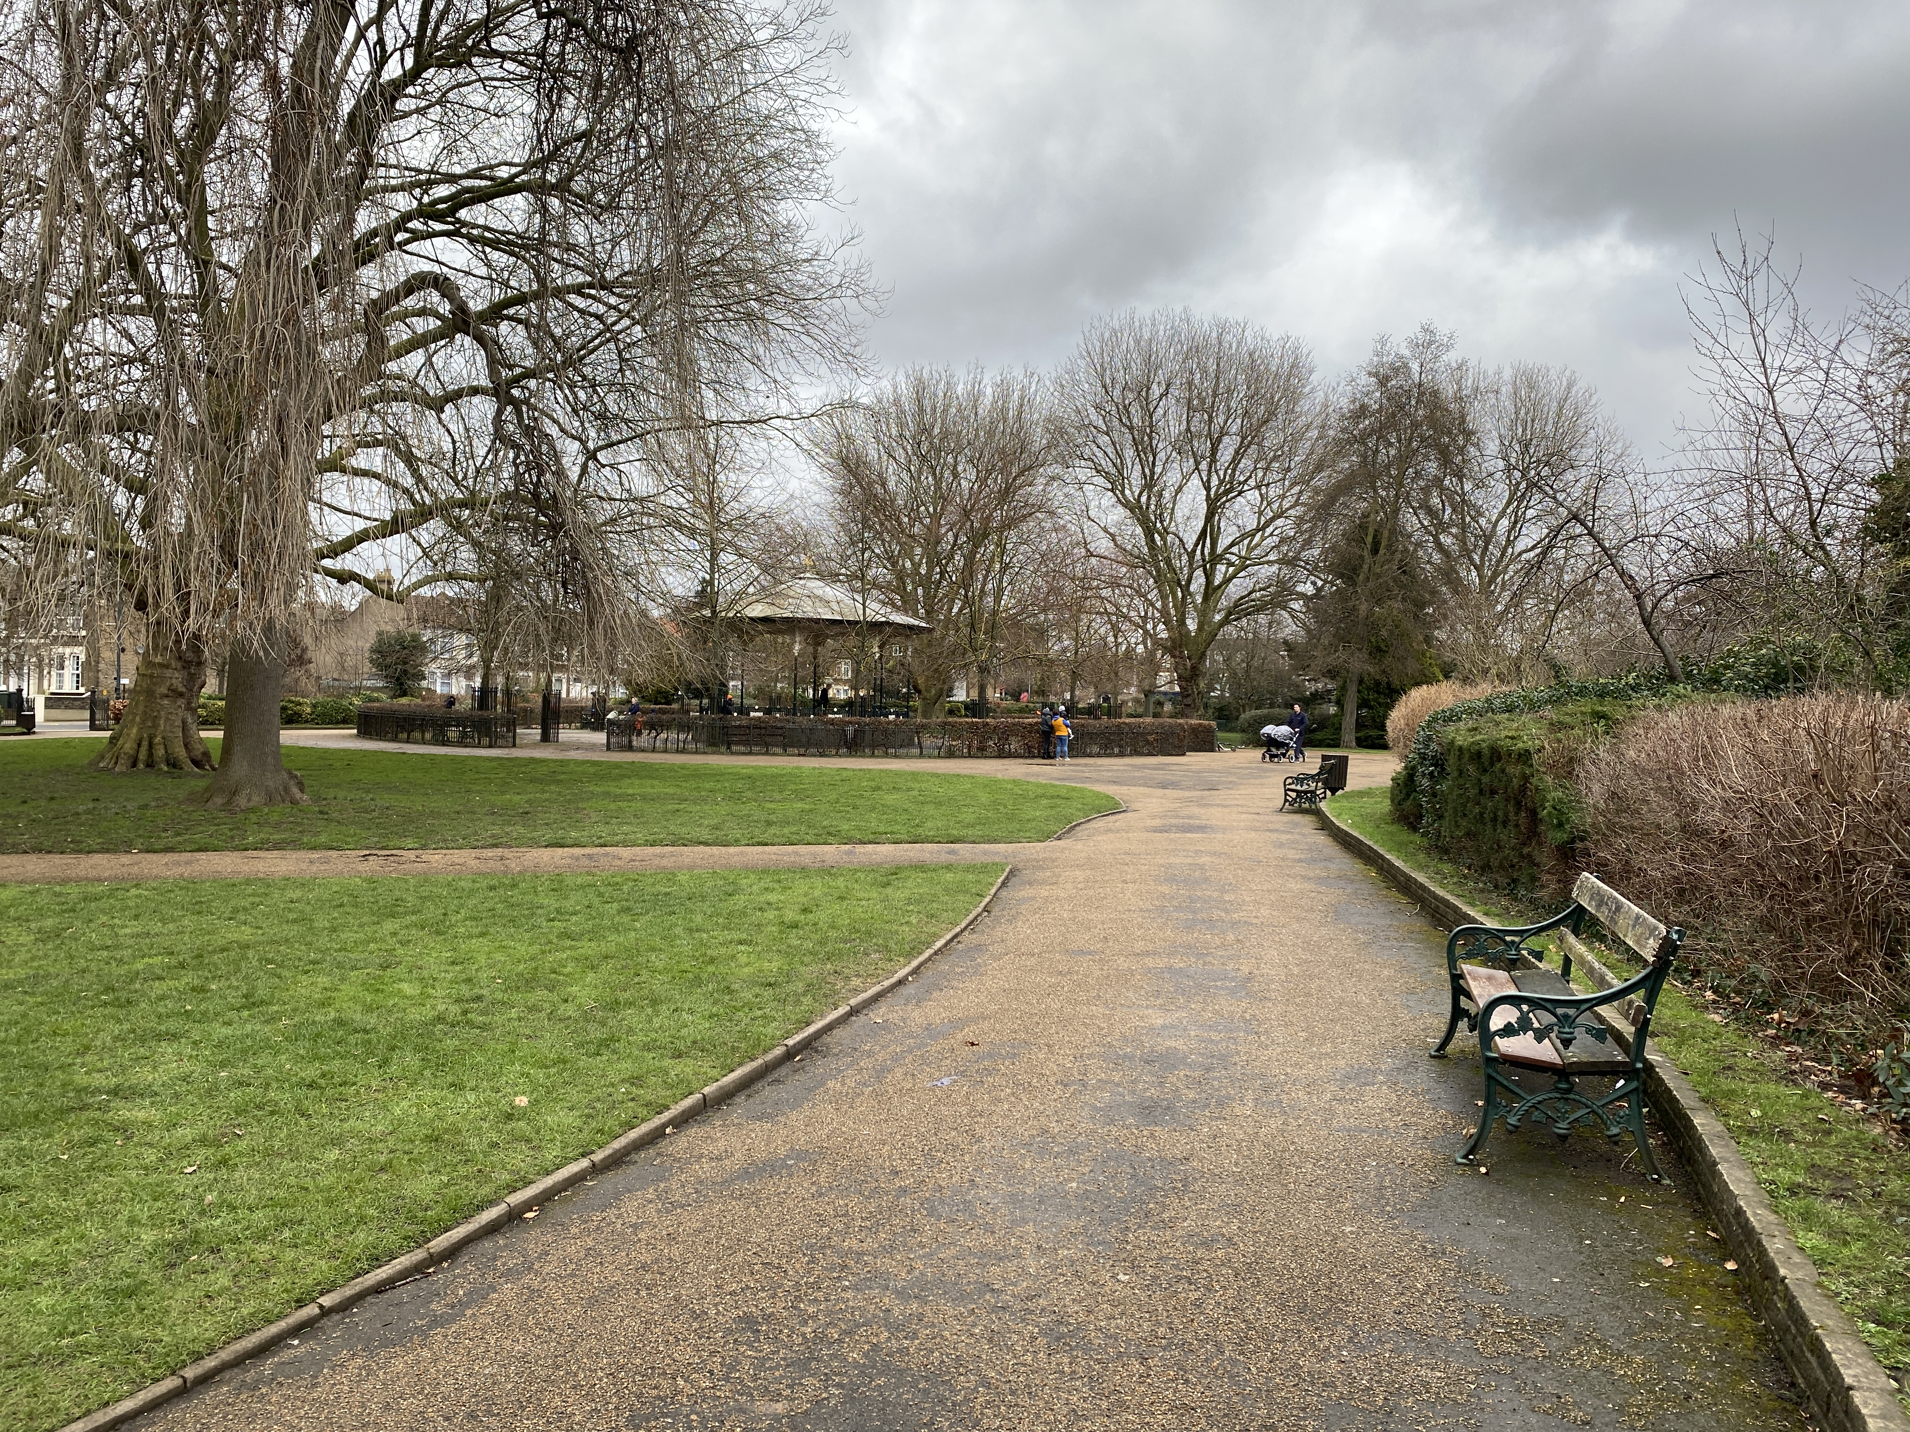



Let’s explore
CORONATION GARDENS
What trees live here?
How many fallen leaves
can you collect?
Find the maze.
Where is the middle?
Return
to game

Slide 7
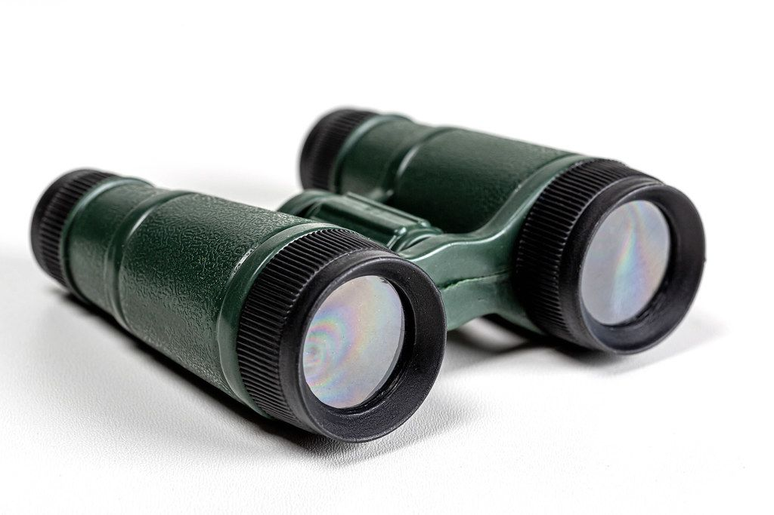
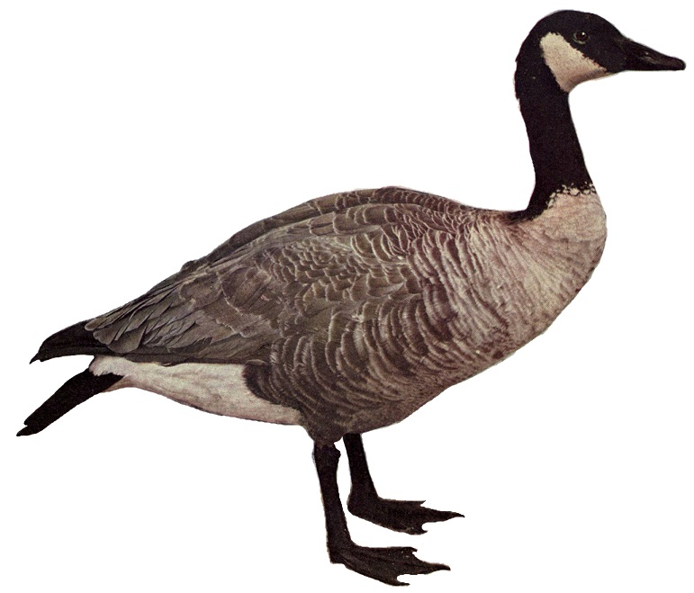


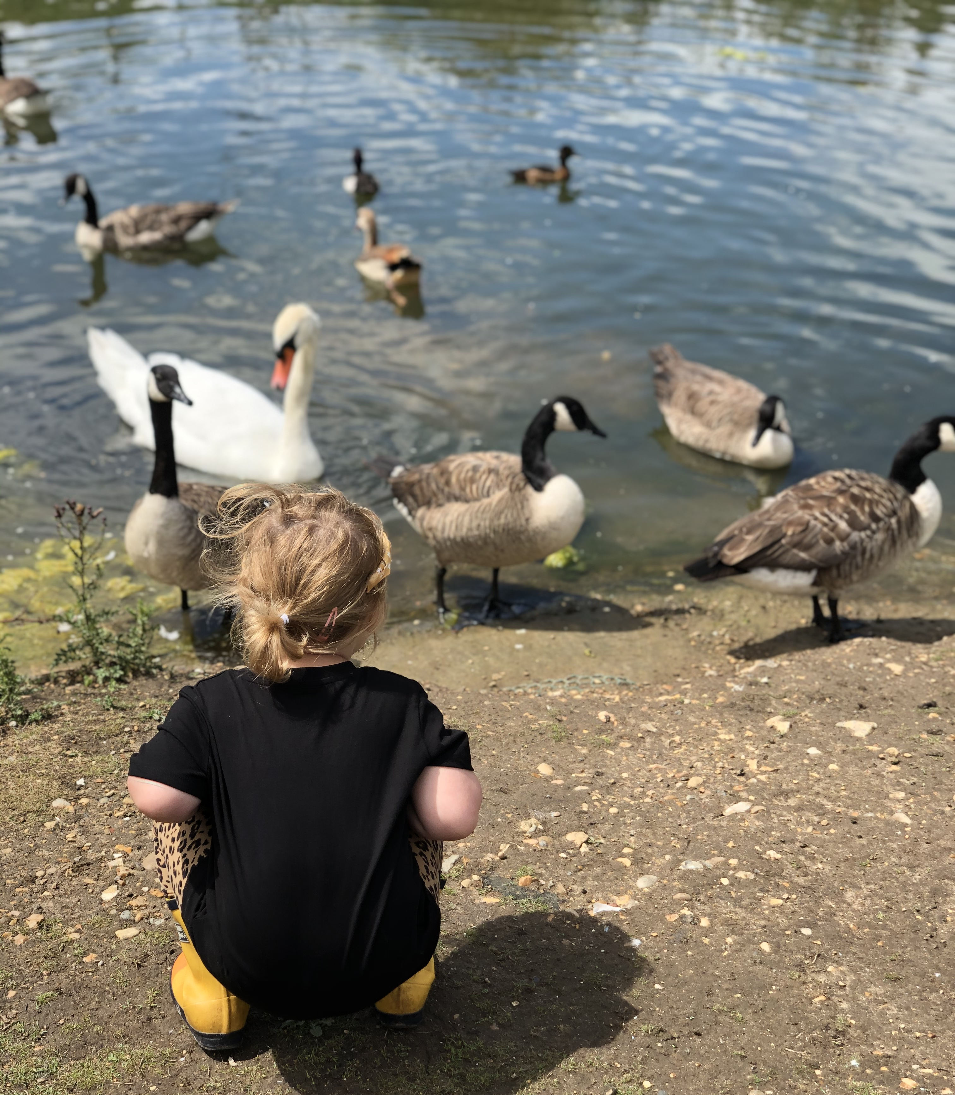
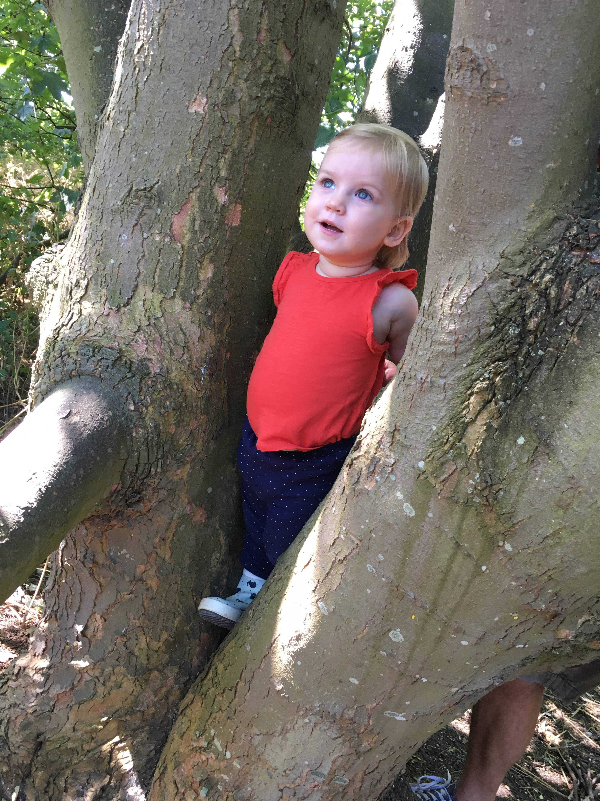
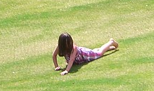
Let’s explore
HOLLOW PONDS
Can you run, jump, hop, skip, or twirl? Why not have a race with somebody?
What types of birds can
you spot? Find out
their names?
Return
to game

