Slide 1

www.walthamforest.gov.uk
Education Performance & Information
Schools Admin Data Group
18th September, 2019

Slide 2
www.walthamforest.gov.uk
Education Performance & Information
AGENDA
1.10 – Welcome & Introduction
1.20 – School Census
2.00 – Vacancy & Destinations Reporting
2.30 – School Workforce Census
2.45 – Assessment Collections
3.00 – Issues from Schools
3.30 – PA Report
3.45 - Close

Slide 3
www.walthamforest.gov.uk
Education Performance & Information
DIARY DATES
School Census:
Autumn Headcount Date = Thurs 3rd Oct ’19, Deadline = Tues 8th
Spring Headcount Date = Thurs 16th Jan ’20, Deadline = Tues 21st
Summer Headcount Date = Thurs 21st May ’20, Deadline = Fri 22nd (1/2 term)
Academies follow DfE deadlines – please submit well in advance of final DfE deadline
School Workforce Census:
Headcount Date = Thurs 7th Nov ’19, Deadline = Tues 12th
Assessment Collections:
EYFSP, KS1 & Phonics = midday Tues 23rd June (to be confirmed)
KS2 TA = Thurs 25th June (to be confirmed)
KS5 provisional aggregated data = Thurs 13th Aug by midday
KS4 provisional aggregated data = Thurs 20th Aug by midday

Slide 4

www.walthamforest.gov.uk
Education Performance & Information
HUB
New version of the website now running
Sign up for the newsletters

Slide 5
www.walthamforest.gov.uk
Education Performance & Information
GENERAL REMINDER
Pupil information (including identifiers such as UPN) should not be sent via unsecured email
Use mimecast email or Anycomms+

Slide 6
www.walthamforest.gov.uk
Education Performance & Information
School Census

Slide 7

Thank you
    We appreciate the care you take over the return and in getting back to us to answer queries
    May – St Patrick’s & Walthamstow SFG 1st in
    Dawlish no queries

Slide 8
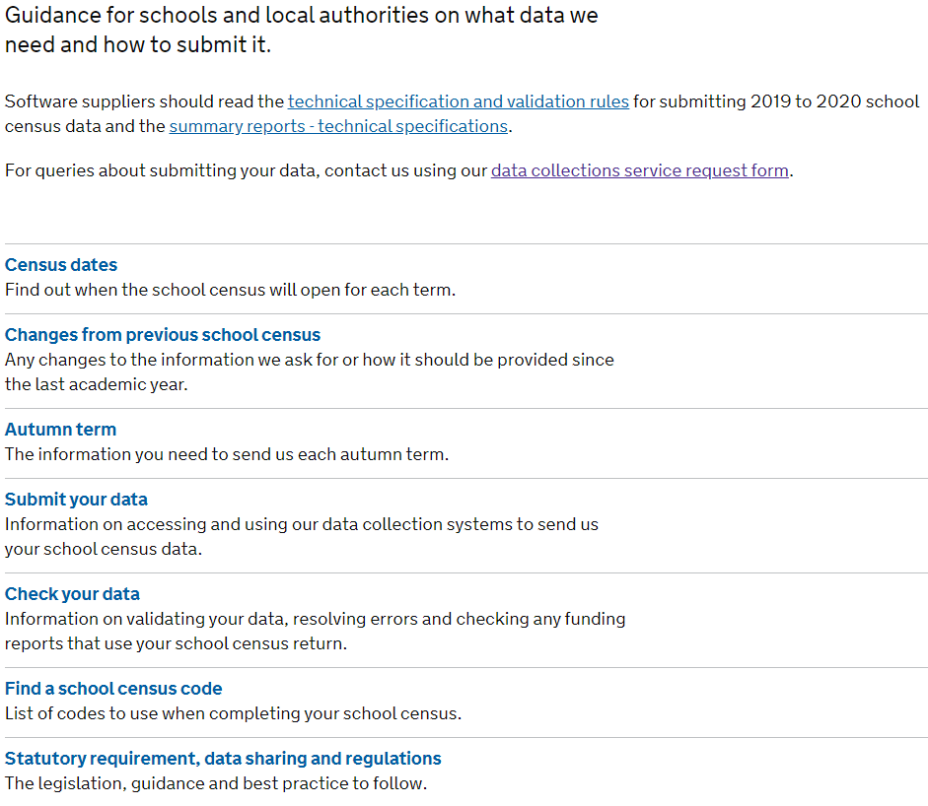
DfE Guidance
    Format of guidance has changed from word/pdf to more interactive https://www.gov.uk/guidance/complete-the-school-census

Slide 9
REMINDERS
  FSM
    Transitional Protection period still in place
    No FSM end dates should be recorded unless
      parent states they do not wish to take up whilst understanding child is eligible
      a parent notifies the school that their support under the Immigration & Asylum Act 1999 or the pension credit has ended
      New pupils – FSM history should be in CTF from ex-school. Can also use Key to Success to search
    Grant for increase in FSM based on Oct SC
  Early Years
    Is full time/part time status correct?
    30 hour codes checked/validated?
    2 YOs without valid code should have zero funded hours recorded
    Funding starts term AFTER birthday (this term age is as at 31st Aug)
    Attending multiple providers – universal and extended hours need to be shared out such that they do not exceed the max for the child

Slide 10
REMINDERS
  SEN Unit / Resourced Provision
    Schools with this provision should check that all pupils have been recorded
    Schools without a unit should not record any pupil as in unit/RP
  Pupils moving from Nursery to Reception or Y11 to Y12 at same school should not have a leaving date in between
    Start date should be date they started nursery/Y7 not a date this September
    Please correct these if you have done this
  Classes (not until January)
    If infant classes go over 30 we need a valid legal reason
    Classes are at a selected period and therefore both am and pm nursery cannot be in class
    Classes should balance with numbers in each NCYR (apart from ones in reconciliation boxes)

Slide 11
DUPLICATES
  Please help us reduce duplicate queries by…
  Where a pupil on your roll is attending a school elsewhere, please make every effort to locate and off roll them in advance of census day
  Ensure you import CTF from previous school to get correct UPN
  Ensure for managed moves etc that both schools agree which school has dual main and which dual subsidiary registration
    Agree review dates
    Agree when one school can off roll and the other change to single registration
    Remember that attendance code D (not B) is used if dual registered and expected to attend the other school that session

Slide 12
DUPLICATES
  Managed move from School A to School B
  School A=dual main registration
  School B=dual subsidiary reg
  Trial end date A off rolls, B makes single registration
  Permanent Exclusion from school to PRU
  School = dual main registration, marks Ds in register from start date at PRU, possibly few days of Es before that
  PRU = dual subsidiary reg, marks present/absent in register
  Appeal end dates school off rolls (on that date, not exclusion date), PRU makes single registration
, marks Ds in register
, marks present/absent in register

Slide 13
DUPLICATES
  Move from school to AP arranged by Hawkswood group
  School keeps single registration, marked Bs in register for days attended AP and absent other days
  AP has guest registration
  This continues unless school is told can remove from roll – destination should be ‘Confirmed move to Hawkswood AP’

Slide 14
ACADEMY School census returns
You can buy into our checking and support service (just £45)
If you don’t, please ensure your data is submitted along with notes that the DfE will accept (list is online) before the deadline
There should be no reason for DfE to phone academies – they simply ‘OK’ the note and authorise return
We can’t see the data and therefore cannot check your data on behalf of Early Years if not authorised by DfE
Remember to run the 2 duplicate reports throughout census – these do not come up as validation queries
  If you don’t, funding could be lost or child given wrong UPN

Slide 15
Changes IN school census
New Data Items
Sixth Form Learning
Planned learning hours (qualification hours) previous year
Planned employability, enrichment and pastoral hours (non-qualification hours) previous academic year
Maths GCSE highest prior attainment previous year
English GCSE highest prior attainment previous year
Classes
Number of infant class teachers on planning and preparation time (PPA) or learning manager time (LMT) at the selected time.
Exception categories - the number of pupils admitted to an infant class under the relevant exception category.

Slide 16
Changes IN school census
Exclusions:
Exclusion review date
Exclusion review result
Exclusion reinstatement date
Exclusion review SEN expert (Whether a SEN expert was requested as part of the pupil’s exclusion)
Existing Data Items
Exclusions:
Termly exclusion – type ‘LNCH’ (lunchtime exclusion) no longer collected
Termly exclusion – collection period now one term behind instead of two
  Autumn Census 2019 will collect both Spring and Summer

Slide 17
EXCLUSIONS
Statutory guidance: https://www.gov.uk/government/publications/school-exclusion
Census guidance: https://www.gov.uk/guidance/complete-the-school-census
What is collected for Census?
Exclusion Category – Fixed Period or Permanent
Exclusion Start Date - date headteacher asked pupil to leave the school
Actual number of sessions excluded from (for Fixed)
  Each full school day counts as 2 sessions - a half school day counts as 1 session. Non-school days not counted (e.g. weekends/holidays)
  Exclusions that go across 2 census collection periods should be counted as 1 exclusion in the first collection period
SEN Provision at time of Exclusion

Slide 18
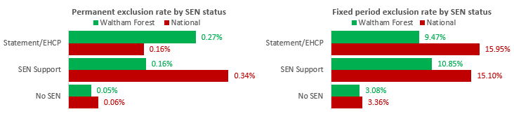
Tangent: SEN and Exclusions

Slide 19
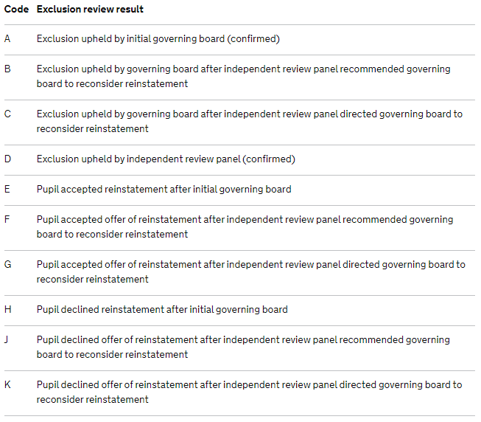
EXCLUSIONS
Exclusion review date (date of the review, when the final outcome decided) Note that pupils cannot be removed from roll before this date
Review result (code list >)

Slide 20
EXCLUSIONS
Exclusion reinstatement date
  date pupil was reinstated at the school following the governing board or IRP’s review of the decision to exclude
SEN expert requested
  Further to the outcome of a review of the decision to exclude, in the case of an IRP, schools must record if a SEN expert was requested during the review. This should be recorded as ‘Y’ if requested and ‘N’ if not requested.

Slide 21
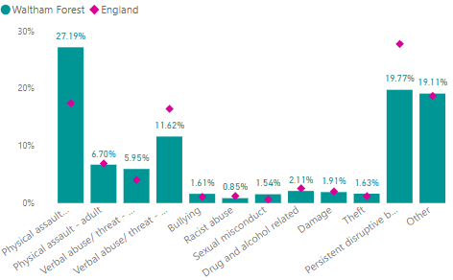
EXCLUSIONS
Exclusion reason
Around 1 in 5 recorded as ‘Other’

Slide 22





quiz
Which code if…
Selling stolen property
Setting fire to a desk
Swearing at a teacher
Smoking behind gym
Carrying a knife
Homophobic abuse
Racist Graffiti
Theft
Damage
Verbal abuse/threatening behaviour against adult
Drug and alcohol related
Verbal abuse/threatening behaviour against pupil
Bullying
Racist abuse

Slide 23
EXCLUSIONS & ABSENCE
E absence code: Authorised absence as pupil is excluded, with no alternative provision made
Responsibility for suitable full time education from 6th day of exclusion
D code: Dual registered (at another establishment)
  not counted in possible attendances
  not collected in school census as not a possible session
B code: Approved education activity as pupil being educated off site (not dual registration)
  not collected in school census as statistically ‘present’

Slide 24
www.walthamforest.gov.uk
Education Performance & Information
Vacancy/Destinations Reporting

Slide 25
Responsibilities
CME statutory guidance 2016 https://www.gov.uk/government/publications/children-missing-education
Schools must provide LA with data on joiners and leavers within 5 days
If we know joiners and leavers we can “kill two birds” and know school vacancies
Replaced old “weekly returns” with “vacancy report”

Slide 26
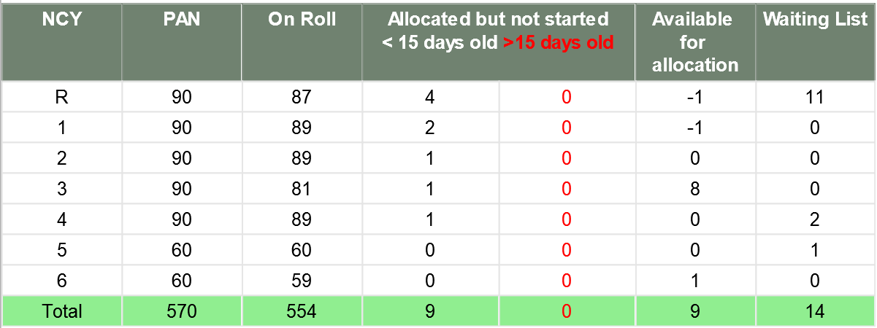
Vacancy report
Report currently sent every Wednesday lunchtime
In addition to admissions reasons, if roll numbers are correct, we can be confident the flow of joiners/leaver info is working & therefore LA is not missing safeguarding info.
Allocations on LA admissions system not yet on roll on the day report ran. Use both to safeguard pupils and calculate empty places.
Available = PAN – Roll – Allocations

Slide 27
Vacancy report
What do schools need to do?
Check on roll numbers against MIS
Check allocated numbers
Reply by midday Friday at the latest
  Either put ‘agree’ at end of email subject
  Or highlight and numbers disagree

Slide 28
Possible issues
Data is at snapshot time – if pupil has moved from allocated to on roll between receipt/reply this is ok as no effect on vacant places
Roll number still different?
  We ignore dual subsidiary pupils – have you?
  Could be an out of year pupil we don’t know about or incorrectly recorded?
  Could be a back-dated leaver not yet identified?
Allocations still different?
  Admissions cannot remove has letter/email from parent or permission from BACME (CME followed)
  Could be admission made just before report sent and therefore unknown to school
  SEND allocations may not be known to admissions – we are working on this

Slide 29
Destinations of leavers
Captured either via B2B (SIMS schools) or via CML (schools with other MIS)
  Note sometimes destination does not come through if back-dated leave date 4 months+
We issued the following guidance last September on what should be typed in the ‘destination’ free text field…

Slide 30
Destinations of leavers - Guidance
Situation | Destination in MIS
If the pupil is confirmed as starting at a new school in England/Wales | Confirmed move to 7 digit school number
If the pupil has moved out of the area, within UK but has not yet started a new school and the LA has confirmed they have taken on responsibility for the pupil | Confirmed move to LA Name
If the pupil is confirmed as starting at a new school abroad | Confirmed move to Name and address of the school
If you have been informed that the pupil has moved abroad but you have been unable to confirm the school they have started at | Moved to Name of Country (as much detail as possible) & CMFE completed
If the pupil went missing but you have had permission to remove them from roll having gone through the CMFE process | Unknown & CMFE completed
If you have been informed by the parent that the pupil will be electively home educated | EHE form and letter sent to BACME

Slide 31
Destinations of leavers
Thank you to the schools that have been following this guide
Made it much easier for us to analyse where children are going and give confidence that schools are safeguarding pupils
Lots of schools not following guide

Slide 32
Quiz
These are all destinations recorded last academic year
Which fit with the guidance?
If not, what should they be?

Slide 33
Quiz
Only two of these examples have been recorded in the way requested

Slide 34
Quiz

Slide 35
Destinations of leavers
Will be monitoring closely this year
Hope to add more detail from this to School Information Dashboards (our traded service reporting) categorising destinations

Slide 36
www.walthamforest.gov.uk
Education Performance & Information
School Workforce Census

Slide 37
School Workforce census CHANGES
CHANGES TO ROLES
Added
‘Apprentice Teacher’ – has same data requirements as teacher posts
‘Leadership - Non Teacher’
‘Other Support Staff’
Removed
'Support Staff'

Slide 38
School Workforce census
Last Year
All schools had at least one issue to fix, 24 had 10+
Well done Kelmscott – only 1 query
The most comment errors were
  Missing qualifications for teachers - 285 (41%)
  TRN missing/wrong – 104 (15%)
  Missing contract – 94 (13%)
  QTS status conflict – 72 (10%)
  Missing pay review – 45 (6%)

Slide 39
SWFC Reminders
Missing qualifications | As min all teachers should have their ITT qualifications recorded. For teachers with PGCE, prior degrees are also expected. For support staff all level 4 and above quals should be included.
TRN missing /wrong | A 7 digit teacher reference number should be available for all teachers who • have Qualified Teacher Status (QTS) • entered final or only year of teaching training but who do not qualify • are working towards QTS on employment based training schemes • participate in the Teachers’ Pension Scheme
Missing contract | Contract information should be included for all staff: a) with an open contract on the census reference date which is expected to last 28 days or more b) whose contract ended 1 September of the previous year to census day
QTS status conflict | The QTS and/or EYTS status for these teachers is different to that recorded in the Database of Qualified Teachers (accessible from DfE Sign-in).
Missing pay review | Pay review dates should be added "even if this did not result, or could not have resulted, in a change to the teacher’s pay".

Slide 40
www.walthamforest.gov.uk
Education Performance & Information
Assessment Collections

Slide 41
Primary Assessments
Thank you to all for submitting files
Especially Coppermill (1st for EYFSP, Phonics & KS2 TA)
Reminders following the collections 2019
EYFSP – ‘A’ code should be used with permission from moderation team
Phonics – several Y2 pupils took the test again unnecessarily – use CTFs and double check KtS
KS1 – D=disapplied from curriculum - unusual
KS2 – Pupils with B codes on test register for reading/maths should have pre-key stage or p-scales on TA

Slide 42
Primary Assessments
NCA Tools being replaced with “Primary Assessment Gateway”
Due to be open beginning October
NCA Tools will remain open until Friday 29 November for schools to access 2019 key stage 2 test results, including the outcomes of marking and clerical reviews

Slide 43
A level & GCSE
New online form this year
Results shared with HT & exams officers shortly after submission
GCSE national estimates added
  From LAs sharing aggregated data
  These are for around 70% of Y11s
  Not to be published, just internal info
  Thanks to all, especially Willowfield (1st in)

Slide 44
www.walthamforest.gov.uk
Education Performance & Information
ISSUES FROM SCHOOLS

Slide 45
Transfer Files
ATF and CTFs from the LA went to schools via S2S and Anycomms+ on 18th June
CTFs should have been sent to secondary schools from primary before end of term
  Primary schools need to put leaving date of end of term before sending CTF
  Ensure all assessment data is imported before sending CTF (if you use a separate tracker product, you MUST also put data into your MIS)
In-Year transfers – CTF should be sent in timely way
If no CTF schools miss the FSM history, school history, assessment outcomes and waste time typing data in

Slide 46
Q&A
Any other issues to discuss now?
Anything you would like on the agenda in future?

Slide 47
www.walthamforest.gov.uk
Education Performance & Information
Persistent Absence Tracker Reports

Slide 48
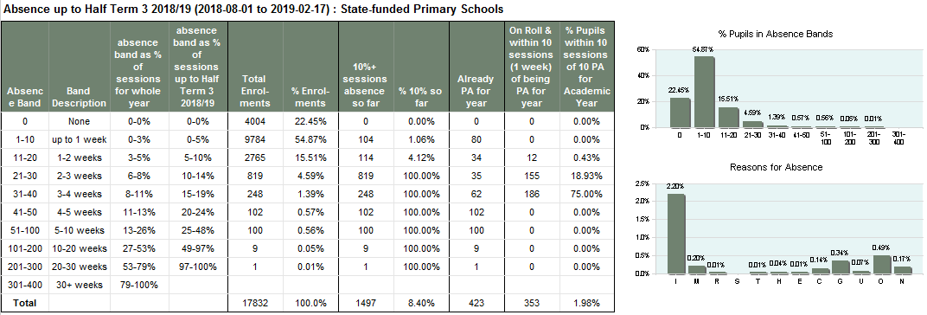
Pa Tracker
Half termly report introduced last academic year
Goes to headteacher via Anycomms+
LA averages for phase under school averages

Slide 49
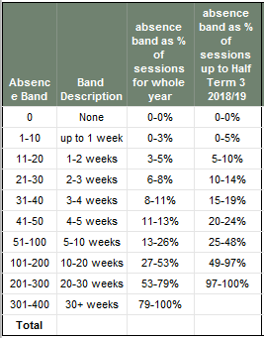
Pa tracker
We noticed that mobile pupils had higher levels of PA than those there for whole year
1st 4 columns just describe different bands of absence
For example, 11-20 sessions is equivalent to 1-2 weeks
this would mean 3-5% of the whole year missed
Of the period in question (3 half terms) this is 5-10% of the time

Slide 50
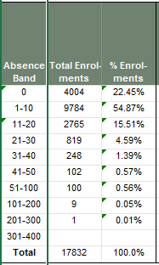
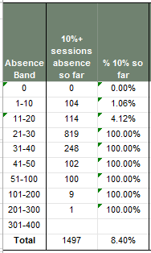
Pa tracker
The next columns show how many pupils (enrolments) there were in each band
We can see that 22% had no absences up to Feb half term
Over half of pupils had 1-10 absences
Over 100 pupils have missed 51+ sessions so far
How many have 10% or more sessions absent so far (i.e. if ac year ended at that point, would be PA)
Over 100 pupils have 10%+ sessions absent that have only been absent for 1-10 sessions
Perhaps these are less worrying than the 100 pupils that have been absent for 51-100 sessions

Slide 51
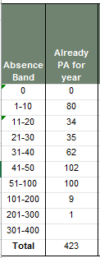
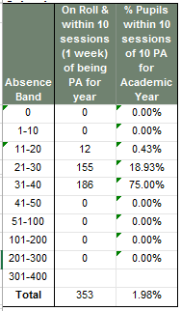
Pa tracker
We look at how many will definitely be PA by end of year
This could be:
  Pupil has so many absences that even if attended the entire rest of year, they would still be PA
  Pupil has left and therefore cannot increase their attendance
The final 2 columns show how many pupils are within 10 sessions of becoming PA
These are pupils that may be supported such that they do not ‘tip over’ into the PA category
Pupil level data is supplied with the report so that you can filter and identify

